Slide 1
MODULE 1
The Need & the Impact of Ethical Food Business
Ethical Food Entrepreneurship (EFE) Programme

Slide 2

In this 90-Day Ethical Food Entrepreneurship (EFE) Programme, we deliver a comprehensive set of Open Education Resources (OERs) to enable educators to excite and engage potential entrepreneurs and students about the market opportunities for innovation and growth in the ethical food economy. This is a new generation training course, equipping educators to go beyond ‘standard’ and general food training topics. It is meant to provoke and inspire more Planet – People – Profit entrepreneurship, with the dynamic of ethical foods as the innovation driver.
OERs
for Educators

Slide 3
PEOPLE
The Ethical Food Entrepreneurship (EFE) course has been specifically developed for educators and SMEs and includes a comprehensive and inspiring curriculum, learning objectives, evaluation techniques & relevant content for classroom-based courses. Our intuitive pedagogy and trainer resources will also increase competencies in digital teaching approaches in line with Dig Comp Edu.
But ultimately this course has been created to assist in the establishment and development of more ethical food enterprises.
PLANET
PROFIT

Slide 4
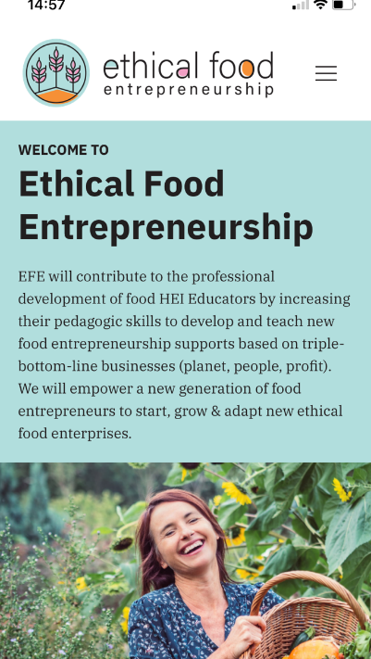
This Course…what lies ahead
Throughout this EFE course, we focus on and expand upon Ethical Issues in our Food Ecosystem and how educators can provide a learning path to students, future entrepreneurs and existing food SMEs to make changes for the betterment of planet – people - profit.
This course is the first open access learning programme on ethical food entrepreneurship, spanning 6 learning modules to be used in classrooms as part of existing studies, or as a separate programme. Educators are encouraged to adapt and build on our work, and use the other EFE learning tools on Resources - Ethical Food Entrepreneurship (ethical-food.eu)
NOTE: The course is supported by an Educator’s Guide, and Good-Practice Compendium where Ethics and Ethical theories are discussed in detail relating to the food system.

Slide 5
The Need & the Impact of Ethical Food Business
01
What is Ethical Food?
Food Ethics is a tricky subject as it is so multifaceted. In this module, we introduce what is deemed ethical food in a general way so learners can come away understanding how by making the correct choices, food enterprises can be more ethical and can have a better impact on climate action, poverty, social justice and the health of both people and planet, thus leading to more sustainable and resilient food businesses.
02
Food Ethics, Consequences of Choices
03
The Climate Emergency - SDGs
04
Food & Poverty
05
Fairtrade & Social Justice
06
The Link between Food and Health
07
Sustainability and Resilience

Slide 6
01
What is Ethical Food?

Slide 7
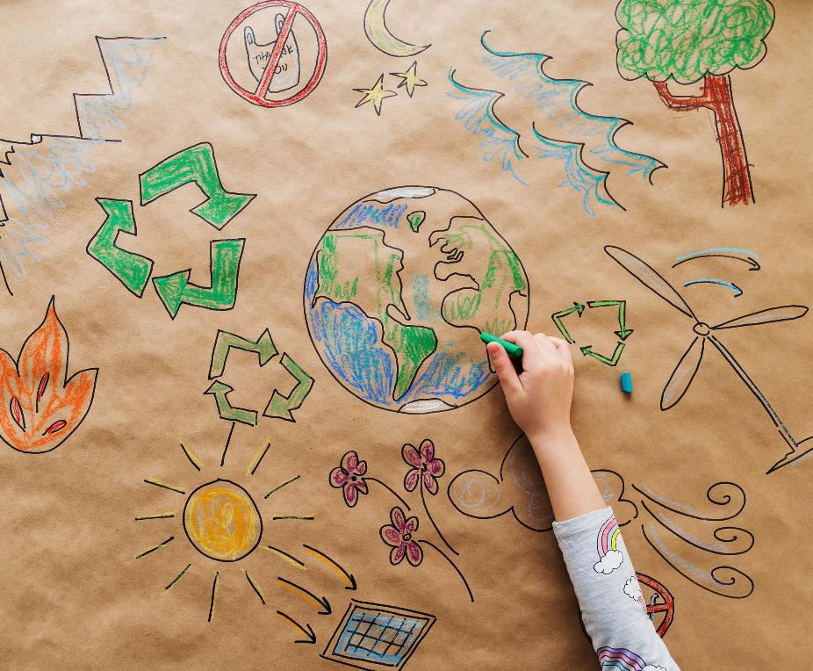
Our Food System
Our Food system is a complex and dynamic structure with several parties involved in the system, both directly (farmers, manufacturers, food services etc.) and indirectly (policymakers, consumers, marketeers, logistics etc).
There are ethical concerns present at every step of our food system including the governance & economics of food production, its sustainability, the degree to which we waste food, how food production affects the natural environment and the impact of food on health.

Slide 8
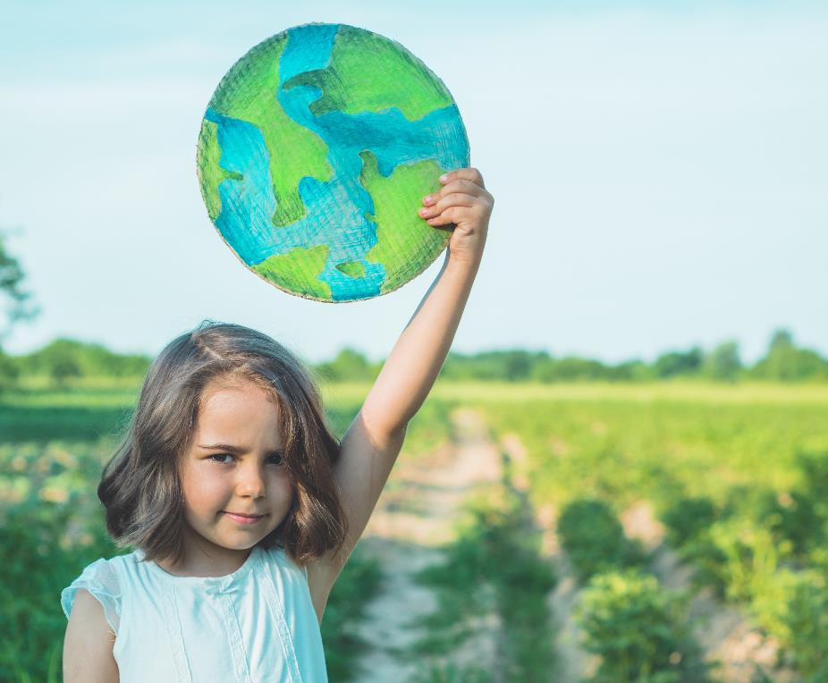
The Context of Food Ethics…
Food ethics or ethical eating is perhaps best defined as being
“about the principles that dictate what counts as acceptable treatment of others in relation to food”
(source: The Food Ethics Council).
In this definition, “others” includes humans, non-human animals, and the planet.

Slide 9
The Context of Food Ethics
The Oxford Dictionary definition of “ethics” is “the moral principles that govern a person’s behaviour or the conducting of an activity”.
As humans, we concern ourselves with ethics in order to define our rights and responsibilities and map out the criteria for what is morally right or wrong in life.
In the context of the food sector, the Food Ethics Council says that “our ethical choices are defined by our values (what we think is good) and our principles (what we think is right) in order to redirect our thinking”.
In other words, food ethics is about making choices that we believe are good and right in relation to the food we produce or eat. But, it is also important to consider for whom they are good and right.
To understand the Ethical matrix read our EDUCATOR’s Guide

Slide 10
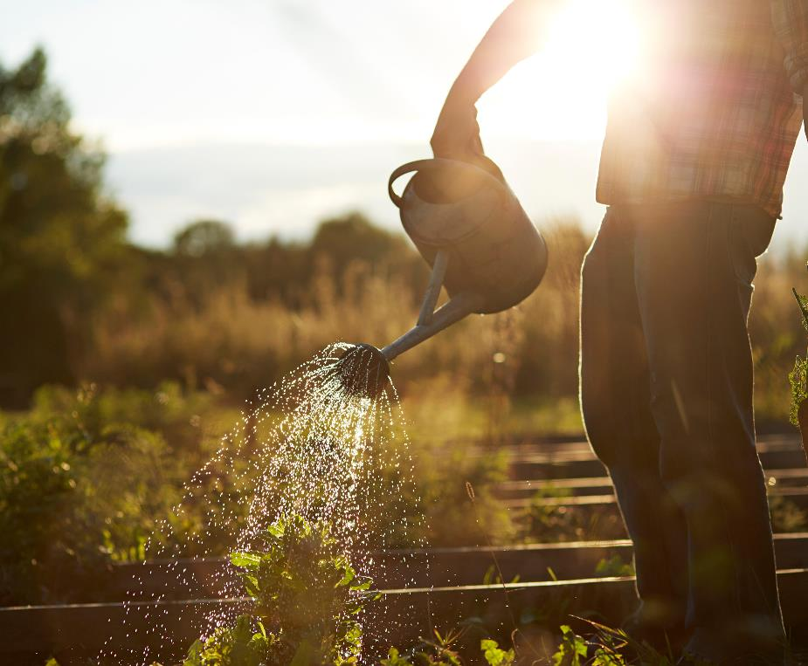
Ethical Food Production
Being ethical has now become a significant part of running a business and is particularly valued in the food sector.
Ethics, beyond a set of values, is a culture that every well-balanced food company should endeavour to adopt, to ensure they give as well as take from their surrounding environment.
There are many ways that a company can practice being ethical, let’s start with 5 general ways…(Slide 14)

Slide 11
Just a sample of ethical food in action
Sustainable farming and fishing practices which enhance and maintain the productivity of natural systems instead of depleting them. They avoid practices that harm the environment, like the overuse of pesticides, the clearing of forests for agriculture, or overfishing.
Fair trade ensures that producers in developing countries are paid a fair price for their work, allowing them to have a decent standard of living and promoting economic growth in these regions.
Animal welfare involves the humane treatment of animals, avoiding cruel practices, and promoting free-range or organic animal farming.

Slide 12
Just a sample of ethical food in action
Reduced food waste: Implementing measures to recycle, reuse and consequently reduce food waste at every stage of the food system, from production and processing to distribution and consumption.
Local and seasonal produce: Supporting local farmers and consuming seasonal produce reduces the carbon footprint associated with the transportation of food
Social impact and community engagement: ethical food enterprises often have a strong social impact, contributing to local economies and community well-being. They often prioritise fairness and equity.
Interestingly, ethical food entrepreneurship relies on value-laden decision-making where personal values and ethics shape the decisions of the business.

Slide 13
What is driving growth of ethical food?
Consumers - as consumers become more educated about environmental and social issues, there is increasing demand for ethical food products.
Differentiation - companies that produce ethical food can differentiate themselves in the market, gaining a competitive edge over businesses that do not follow these practices.
Sustainability trends – we know that sustainability is a growing trend in many sectors, including food.
Health Consciousness – as we become more health conscious, there is a growing demand for organic, free-range, and locally sourced foods.
Corporate Social Responsibility (CSR): Ethical food aligns with CSR initiatives, which can enhance a company's reputation and contribute to its long-term success.

Slide 14
5 general ways Food Businesses can work towards being more ETHICAL
1
2
3
4
5
Listen to the customer about what matters to them
Make Your Products Ethically
Stick to your Values
Give Back to the Community
Create an Ethical Culture
Let’s look in more detail on each of these ways to be more ethical

Slide 15

1. Make your products ethically
It may seem obvious but one of the main ways that you can be ethical as a food business is to make ethical products. This is done by ensuring that the whole supply chain and process of producing your products, is carried out in a way that doesn’t harm people or the environment.
Ethical production starts with ethical sourcing. If, for example, you are producing chocolate, as an ethical food entrepreneur, you are concerned that the cocoa used in much of the chocolate market comes from countries where farmers are paid very low wages and where deforestation and even child labour can be significant problems. To address this, you can commit to buying only fair-trade cocoa, which ensures that farmers receive a fair price for their product. You could work directly with cocoa farmers and cooperatives to improve wages and working conditions. You could also choose to use biodegradable or compostable packaging that is kinder to the environment.

Slide 16

2. Listen to the consumer
According to the Kerry Research Group
Some 45% of European consumers claim ethical production and sustainable sourcing are vital to them READ MORE
70% of consumers in UK, France, Spain, Germany, Sweden and Poland said sustainability was important when choosing where to eat out. READ MORE
The Smart Protein project survey revealed 46% of European consumers are now eating less meat than they once did, while 40% are planning on reducing their meat consumption in the future. The EU-backed study, of more than 7,500 people in 10 European countries, found a third actively sought to minimise their meat consumption – with 73% of that group saying they had “substantially” reduced their meat intake over the past months. READ MORE

Slide 17
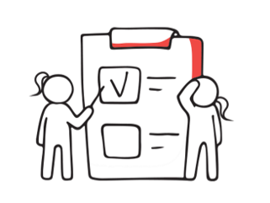
3. Stick to your values
Values are a core part of every business as they can determine how you’re going to conduct business with other people as well as set your organisation’s standard. As an entrepreneur/future entrepreneur, your values, translated into ethical good practices and processes in your business, can result in a positive representation of your company.
It is important that the morals that you define for your food company are evident from the top level of your organisation. By doing this, the rest of your organisation is more likely to mirror your behaviour as you’ll be leading by example.
INTERESTING READ: Food ethics: moral marketing. First published: March 2020
Food ethics: moral marketing - 2020 - Food Science and Technology - Wiley Online Library

Slide 18

4. Give back to the Community
Giving back to the community can be a central tenet of ethical food enterprises. This principle can be integrated into your business model and strategy through:
Ethical food businesses typically have robust Corporate Social Responsibility (CSR) policies that commit them to supporting their local communities. This can involve donating a certain percentage of profits to local causes, providing food to people in need, or sponsoring community events and initiatives.
Sustainable Supply Chains: by sourcing ingredients or materials from local suppliers, businesses not only reduce their carbon footprint, but also invest in the local economy, supporting job creation and fair labour practices.
Businesses can prioritise building relationships with their local communities, even as far as involving the community in decision-making processes.

Slide 19

4. Give Back to the Community - example
IMBIBE, Ireland
Have adopted a model of “conscious capitalism”, which sees them give one percent of their sales to Women’s Aid, 1% of sales to origin/supply chain projects and 1% of sales shared amongst the staff. To be clear, that’s sales, not profits. They also are zero waste advocates
READ MORE
VISIT https://imbibe.ie/

Slide 20

5. Create an Ethical Culture
Making ethics a priority in the workplace and demanding the same from your staff is imperative. This is because when you create an ethical culture, it surpasses set rules and becomes learned behaviour that people begin to abide by and subsequently support. You can also practice being ethical within your business by ensuring your in-house practices are fair and moral. Ensure you address any form of unethical conduct amongst employees to set a standard that the members of your organisation understand they need to follow.
You should also reinforce the behaviour you want and celebrate ethical practices when you see them. Additionally, it’s important that in your bid to create an ethical culture, you are transparent and open when it comes to all of your practices and processes.
INTERESTING ARTICLE How to Design an Ethical Organization (hbr.org)

Slide 21
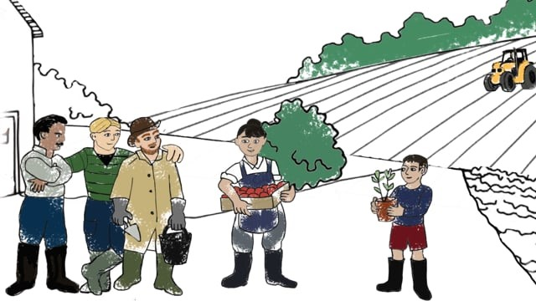
Reflect….
What is food ethics? A short explainer by the Food Ethics Council. on Vimeo
We all make regular ethical decisions about our food but what does the term 'food ethics' mean?
Food ethics is about the principles that dictate what counts as acceptable treatment of others in relation to food - from the humane treatment of farm animals to caring for the environment, from human health to fair treatment of people working in the food system.
This short animation by the Food Ethics Council explores four everyday issues highlighting how food ethics is relevant to all.

Slide 22
02
Food Ethics, Consequences of Choices

Slide 23
Food Choices…
Ethical considerations are becoming dominant in consumer food choices because of the unease expressed by many regarding the increasing gap between production processes and consumption.
Current trends show that consumers have three types of ethical concerns:
fundamental issues like animal welfare
requirements with respect to reliable information
the want for involvement and participation
Source

Slide 24

Which comes first the trend or the production?
It turns out that many consumers are diversifying their food choices depending on their lifestyle, culture and life situations. There is a trend toward increasing diversification into various food styles and corresponding farming and production styles. However, there are several arguments against the idea of the steering role of consumers‘ values and concerns on the market. There is a contention that these arguments are not compelling and that consumers, together with other stakeholders such as producers and regulators, have responsibilities in making the food sector more ethically acceptable.
Source

Slide 25


Food ethics explores the consequences of choices.
There are key over-arching questions such as:
Does the food we produce/eat damage the environment?
Have humans been exploited for the food to be produced?
Have other animals suffered?

Slide 26



Within these, there are many more specific questions
Is it acceptable to destroy areas of rainforest to produce cheap beef, soya & palm oil?
Should the marketing of high fat/sugar/salt foods be better regulated, esp. when aimed at children?
Is single-use plastic packaging ok if it increases the shelf-life of a perishable item and reduces food waste?
As you can see, the need to create a more ethical, just, and equal food system is complex and must represent many different perspectives.

Slide 27

As a potential or existing Ethical Food Entrepreneur
Are you ready to consider and address all these factors and challenges?
As an Ethical Food Entrepreneur, you are seeking to promote a holistic approach to food production & consumption, prioritising the health & well-being of people, animals, and the environment.
By operating in a socially responsible and sustainable manner, you can create value for your customers/communities, while also promoting a more just and sustainable food system.

Slide 28
The Challenges that lie ahead…
Today world agriculture is facing major challenges including:
how to feed a growing world population,
how to reduce rural poverty in the world
how to manage ecosystem goods/services considering global environmental change.
Traditionally, components of modern production and consumption systems have been analysed to improve the efficiency of a particular element or activity, based on the notion that this will also improve the efficiency of the whole system. However, recently it has become clear that a more holistic framework is needed to address these complex issues. As a result, a food system approach has been widely adopted to identify, analyse and assess the impact and feedback of the system’s different actors, activities and outcomes to help identify intervention points for enhancing food security.

Slide 29

What is required…
In order to plan sustainable, equitable, and healthy food systems for the future, we require integrated and innovative analytical methods and approaches from a range of disciplines, as well as effective intersectoral policy analysis and multi-stakeholder engagement to ensure enterprises are future-ready. This is something that won’t happen overnight, but we need to take steps to begin this journey to a greener, fairer better world!

Slide 30
The food system and its drivers. Adapted from Ericksen 2008
SOURCE
Polly Ericksen is Director, Food Systems Research Center, University of Vermont. She has over 20 years' experience working at the interface between research and development on the topics of agriculture, food systems and global environmental change.
Environmental Drivers
Socioeconomic Drivers
e.g. Climate, Soil, Water, Nutrient Availability, Biodiversity etc.
e.g. Economy, demographics, government, technology and culture
‘Natural’ Drivers
e.g. Volcano’s, Solar Cycles, Tides
Water
Production
Environmental Feedbacks
The Food
System
Socioeconomic Feedbacks
e.g. Green House Gases
e.g. Population Change
Consumption
Processing/
Packaging
Distribution Retail
Food System Outcomes
Environmental Welfare
Social Welfare
Food Security
e.g. Access, Availability, Utilisation

Slide 31

The Food System and its Drivers…Explained
As we see, the five elements of the food system (production, processing, distribution, consumption, and waste) and the surrounding framework highlight the complex and interconnected nature of the global food system, and underscore the need for integrated and systemic approaches to addressing the challenges and opportunities presented by the food system…
The production of food is directly related to the demographic, economic, technological, and environmental drivers identified by Polly Ericksen. As populations grow and urbanise, there is increased demand for food, which can influence the types of food that are produced, and the methods used to produce them. Economic factors such as trade policies and market forces can also impact the profitability and sustainability of food production systems. Technological innovations can influence the efficiency and productivity of food production, while environmental factors such as climate change and land use can impact the availability of land and resources for food production.

Slide 32

As an ethical food entrepreneur, you need to consider Food Habits & Choices…
Food preferences, choices, and habits occupy a central role in human cultures and food consumption goes far beyond its functional role to survive.
Food habits are extremely hard to change as they are a central aspect of people’s lifestyles, socio-cultural environment, family education etc.
Food choices are also subject to marketing efforts of food companies that have caused changes in dietary norms, in food and drink category preferences (at population level) and in the cultural values underpinning food behaviours (Cairns, 2019).

Slide 33
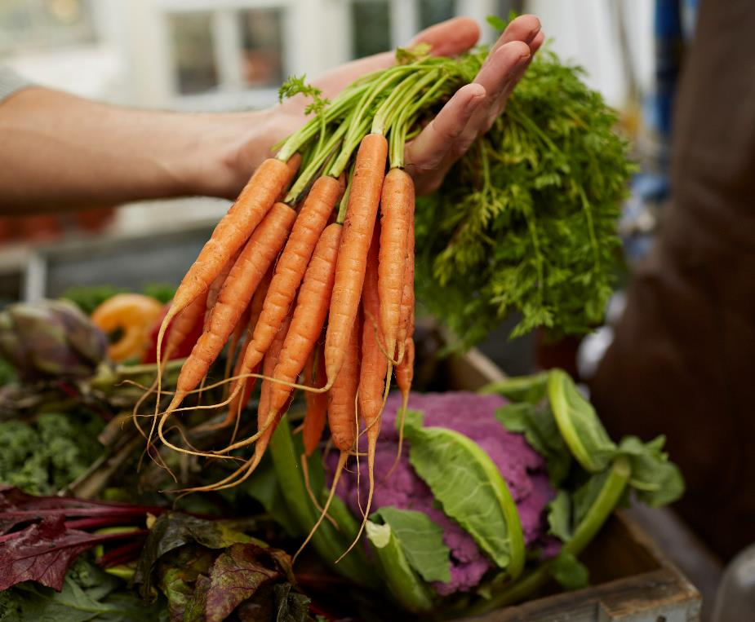
Environmentally Sustainable Food Consumption
Environmentally Sustainable Food Consumption (ESFC) can be defined as the use of food products “that respond to basic needs and bring a better quality of life, while minimising the use of natural resources, toxic materials and emissions of waste and pollutants over the life cycle, so as not to jeopardise the needs of future generations”
(Oslo Roundtable on Sustainable Production and Consumption, 1994)

Slide 34
ESFC & human behaviour to create positive outcomes
The challenge of convincing people to change their eating habits toward more environmentally sustainable food consumption (ESFC) patterns is becoming increasingly pressing. Food preferences, choices, and eating habits are hard to change and although many people already hold positive attitudes toward sustainable food, there is still a notable gap between favourable attitudes and the actual purchase and consumption of more sustainable food products. This gap needs to be bridged.
It is believed that we can promote ESFC by harnessing desirable outcomes…a goal-based perspective. If people do not value the environment (much), or if they have other, more dominant values, they can also be triggered into buying sustainable products as a way of attaining goals that they value more positively (e.g., buying more expensive organic food as a status symbol;) (van der Wal et al., 2016).
NOTE: Goals can be defined as desired end states.

Slide 35
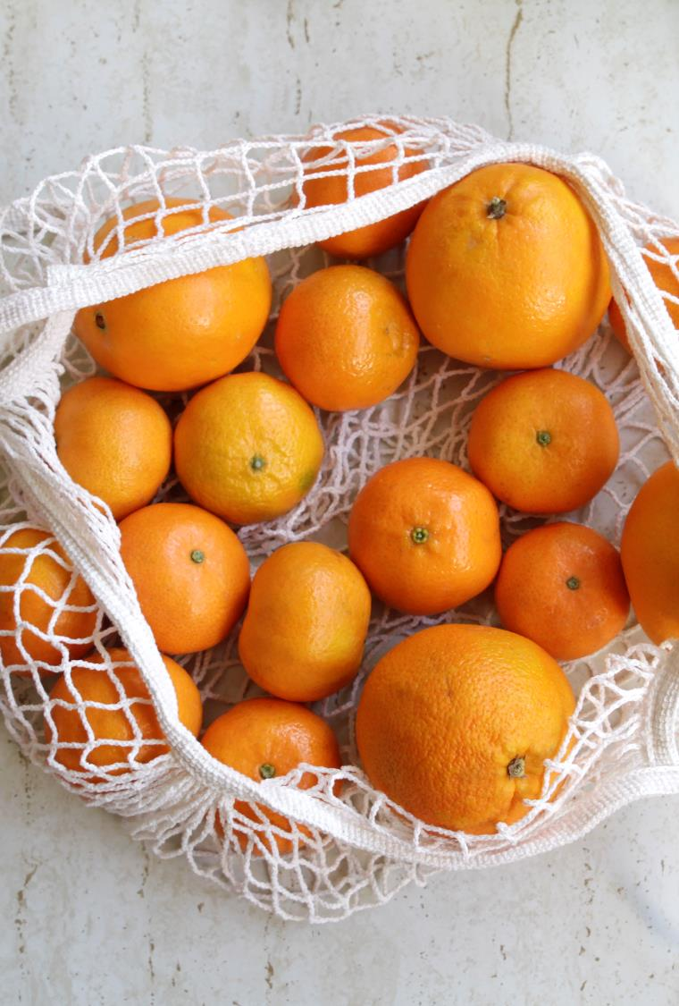
A choice and consequence strategy…
Climate change endangers unique ecosystems, leads to more extreme weather events, reduces biodiversity, and in many ways threatens our current way of living (O’Neill et al., 2017).
Household food consumption gives rise to more than 60% of global Greenhouse Gas emissions and between 50 and 80% of total resource use (Ivanova et al., 2016).
Thus, making people’s eating patterns more environmentally sustainable is becoming ever more important (Springmann et al., 2016; Hartmann and Siegrist, 2017; Magrini et al., 2018; Hedin et al., 2019).

Slide 36
A choice and consequence strategy…
Particularly in high-income countries, transforming food consumption is deemed an essential condition for reaching global sustainability goals (UN, 2016).
This brings about the belief that we need to focus on different behavioural strategies to promote environmentally sustainable food consumption in high-income countries.

Slide 37
03
The Climate Emergency - SDGs

Slide 38

The World Economic Forum share that in 2015, global food systems were responsible for about 25% to 42% - or about a third - of all global greenhouse gas (GHG) emissions. Source
Climate change is affecting every country in the world. It is disrupting national economies and affecting lives and livelihoods, especially for the most vulnerable.
Weather patterns are changing, sea levels are rising, and weather events are becoming more extreme, affecting more than 39 million people in 2018.
2010-2019 was the warmest decade ever recorded, bringing with it massive wildfires, hurricanes, droughts, floods and other climate disasters across continents, and with that comes challenges to food security and prices.

Slide 39
What you need to know about the Climate Emergency
The science of climate change is well established:
Climate change is real and human activities are the main cause. (IPCC)
The concentration of greenhouse gases in the earth’s atmosphere is directly linked to the average global temperature on Earth. (IPCC)
The concentration has been rising steadily, and mean global temperatures along with it, since the time of the Industrial Revolution. (IPCC)
The most abundant greenhouse gas, accounting for about two-thirds of greenhouse gases, carbon dioxide (CO₂) is largely the product of burning fossil fuels. (IPCC)
Methane, the primary component of natural gas, is responsible for more than 25% of the warming we are experiencing today. It is a powerful pollutant with a global warming potential over 80 times greater than CO₂ during the 20 years after it is released into the atmosphere. (Methane Emissions fact sheet, UNEP)
NOTE: IPCC = Intergovernmental Panel on Climate Change
UNEP = United Nations Environment Programme

Slide 40
Thanks to the Intergovernmental Panel on Climate Change (IPCC) we know:
From 1880 to 2012, the average global temperature increased by 0.85°C. To put this into perspective, for each 1 degree of temperature increase, grain yields decline by about 5 per cent. (40 megatons per year between 1981 and 2002)
Oceans have warmed, the amounts of snow and ice have diminished, and sea level has risen. From 1901 to 2010, the global average sea level rose by 19 cm. The Arctic’s sea ice extent has shrunk in every successive decade since 1979, with 1.07 million km² of ice loss every decade
Given current concentrations and on-going emissions of greenhouse gases (GHGs), it is likely that by the end of this century, the increase in global temperature will exceed 1.5°C. Global emissions of carbon dioxide have increased by almost 50% since 1990 (Emissions grew more quickly between 2000 and 2010 than in each of the three previous decades)

Slide 41
Food Production is a major contributor to climate change…
Here are just some of the ways it has an impact:
1. Land Use Change
2. Agricultural Practices
3. Energy Use
4. Food Waste
5. Meat Production

Slide 42
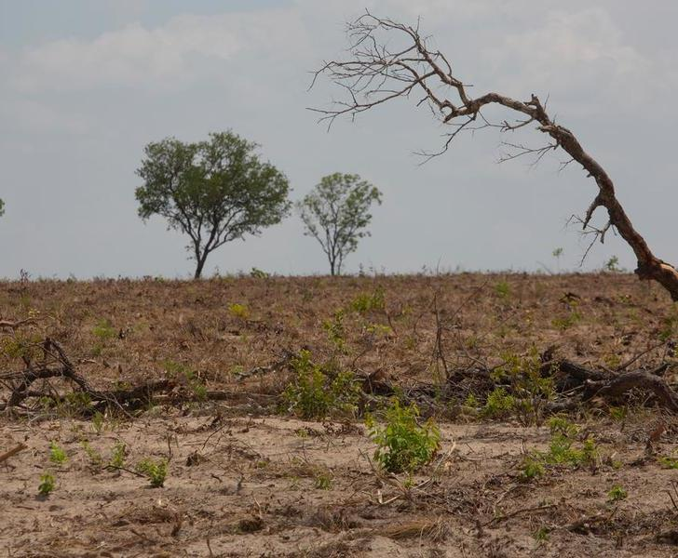
1. Land Use Change
The conversion of forests and other natural ecosystems into agricultural land contributes to ~10% of GHG emissions through the release of carbon stored in vegetation and soil.
Nearly half of the global deforested land (forests burned to clear land), is then used to raise livestock directly or to grow crops – particularly soy – to feed animals such as chickens, pigs and fish (the food we eat). Rainforests are also being destroyed to produce unsustainable palm oil and cocoa.
Source

Slide 43
2. Agricultural Practices
DID YOU KNOW…Worldwide, agriculture accounts for 70 % of human freshwater consumption. A great deal of this water is redirected onto cropland through irrigation schemes of varying kinds. Source
Agricultural practices have intensified continuously since the Industrial Revolution, bringing about huge increases in crop yields by area of arable land. However, many of the techniques and modifications on which farmers rely to boost output also harm the environment. The use of synthetic fertilizers, manure management, and tillage contribute to emissions of nitrous oxide, a potent GHG. Methane emissions are also generated from livestock manure and enteric fermentation.

Slide 44
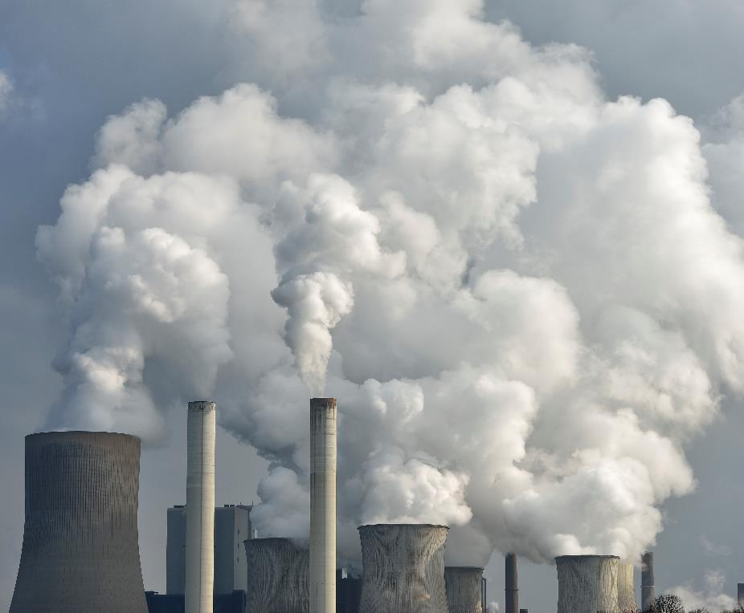
3. Energy Uses
Food production requires significant amounts of energy for irrigation, transportation, and processing. The use of fossil fuels for energy generation is a significant source of GHG emissions.
Reducing the emissions associated with food production will require a combination of strategies, including increased energy efficiency, the use of renewable energy sources, and reducing the overall demand for energy-intensive food production practices.

Slide 45
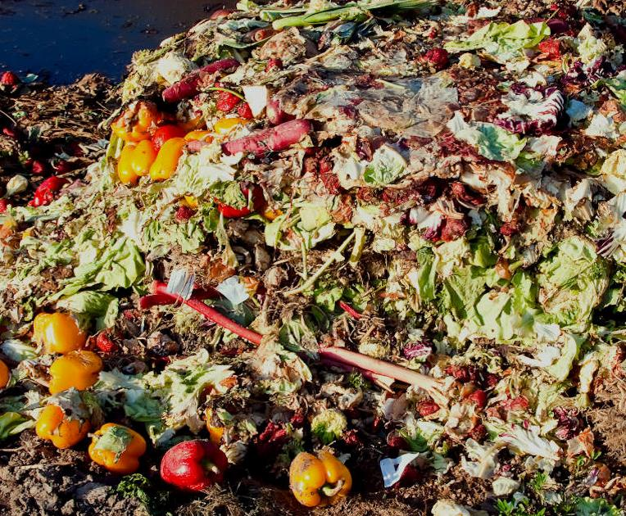
4. Food Waste
When food is wasted, all the resources used in its production, including energy, water, land, and fertilisers, are also wasted. As this food waste decomposes, it emits methane and other GHGs into the atmosphere. In addition, food waste generates additional GHG emissions in the form of transportation emissions and other energy use associated with the production and disposal of the food, thus contributing to climate change.

Slide 46
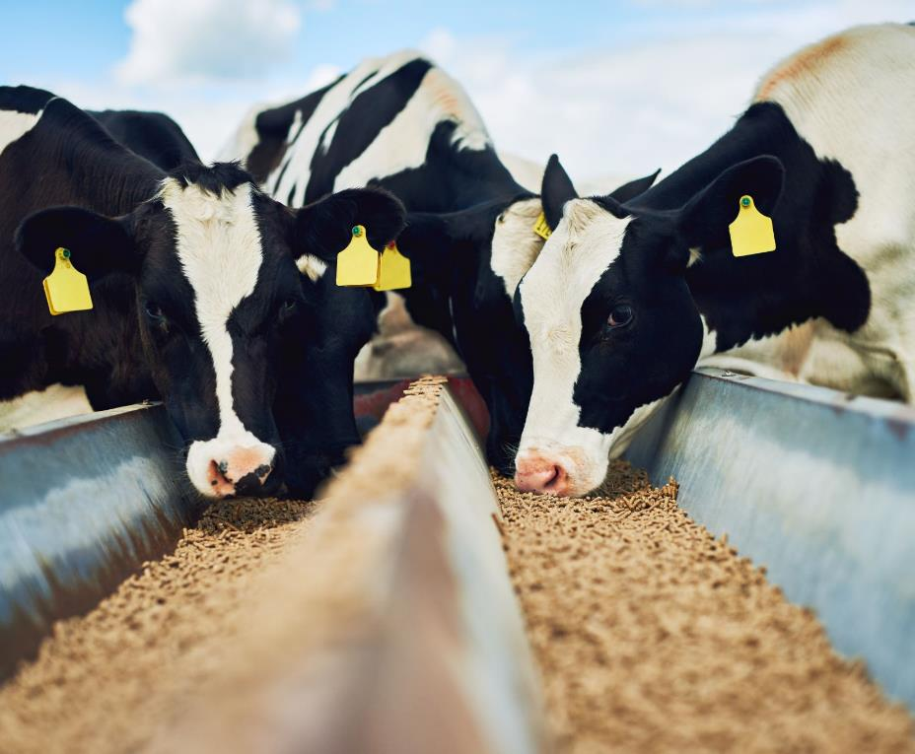
5. Meat Production
Meat production is particularly resource-intensive, requiring large amounts of water, land, and feed, (sometimes land use change is required to allow for grazing or feed crops). Livestock production is responsible for a significant proportion of global GHG emissions, largely through methane emissions from enteric fermentation and poor manure management. Meat production also requires significant amounts of energy for transportation, processing, and refrigeration. Fossil fuels are typically used to generate this energy.

Slide 47

What happens if we don’t take action?
If left unchecked, climate change will cause average global temperatures to increase beyond 3°C and will adversely affect every ecosystem. Already, we are seeing how climate change can exacerbate storms and disasters, and threats such as food and water scarcity, which can lead to conflict.
Doing nothing will end up costing us a lot more than if we act now. We have an opportunity to take actions that will lead to more jobs, great prosperity, and better lives for all while reducing greenhouse gas emissions and building climate resilience. Source

Slide 48

1.5˚C
the difference between 70% or 99% of coral reefs dying.
double the likelihood that insects, vital pollinators, lose half their habitat.
ice-less summers in The Arctic Ocean once per century or once per decade.
1 meter added in sea-level rise.
6 million or 16 million affected by sea-level rise in coastal areas by the end of this century.
Source: Intergovernmental Panel on Climate Change (IPCC)
Why is 1.5˚ Important?
The world will see serious climate impacts at 1.5°C. But after that it gets much worse. The difference between 1.5°C and 2°C is…

Slide 49

The Sustainable Development Goals (SDGs)…
The 2030 Agenda for Sustainable Development, adopted by all United Nations Member States in 2015, provides a shared blueprint for peace and prosperity for people and the planet, now and into the future. At its heart are the 17 Sustainable Development Goals (SDGs) to transform our world. They are a call for action by all countries – poor, rich and middle-income – to promote prosperity while protecting the planet. They recognise that ending poverty must go hand-in-hand with strategies that build economic growth and address a range of social needs including education, health, social protection, and job opportunities, while tackling climate change and environmental protection.

Slide 50
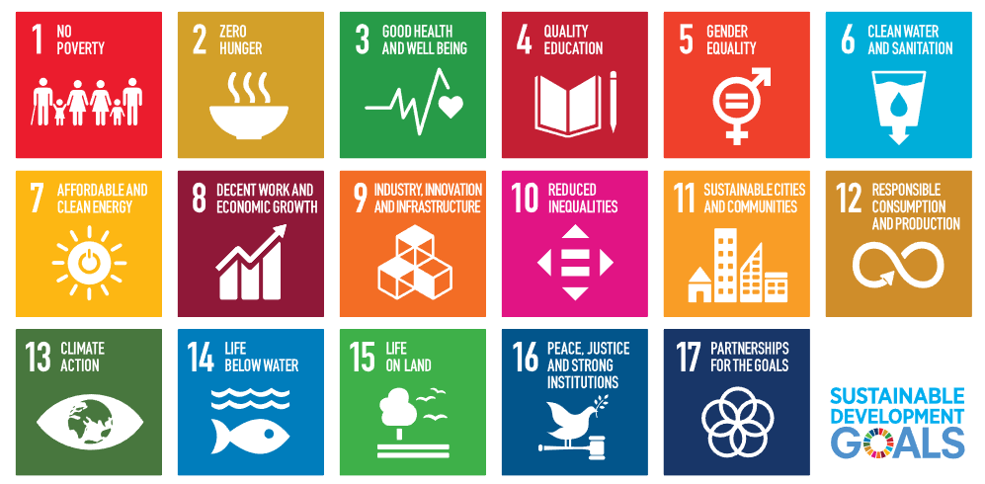

Slide 51

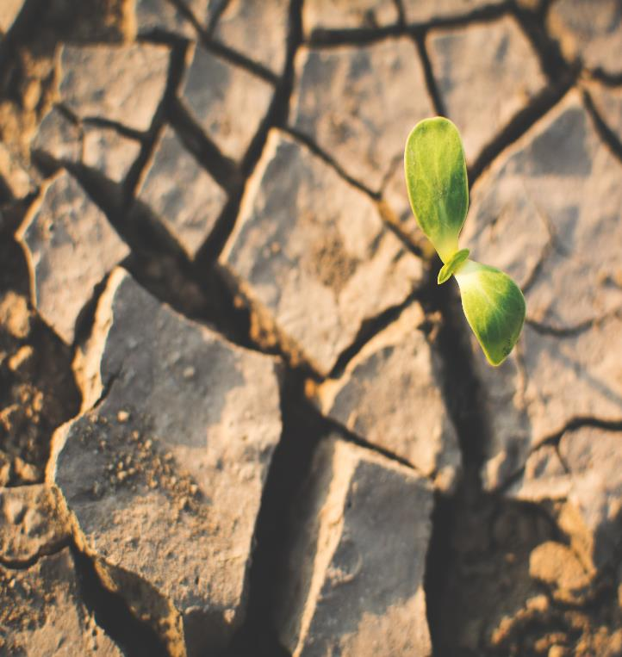
Food and the SDGs
The 2030 Agenda for Sustainable Development focuses on 17 global key goals (United Nations, 2015).
The food system is linked to many of these goals. Food production and consumption patterns are among the main drivers of global environmental problems such as biodiversity loss, soil exhaustion, landscape degradation, and water depletion (Galli et al., 2017, Capone et al., 2019).

Slide 52
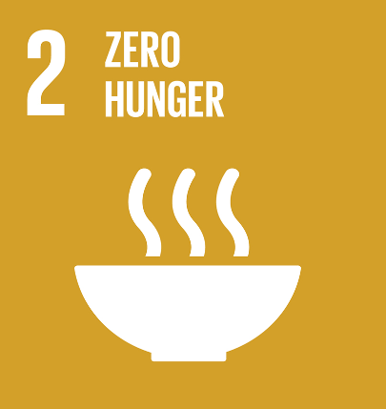
Goal 2 – Zero Hunger
End hunger, achieve food security and improved nutrition and promote sustainable agriculture
There is more than enough food produced today to feed everyone. Yet up to 828 million people remain chronically undernourished.
Malnutrition, meanwhile, is taking a heavy toll across developing and developed nations. While stunting is slowly decreasing, more than two billion people are now obese or overweight. The consequences are severe for public health, for national wealth, and for quality of life. The impact of climate change on agriculture compounds the situation. FAO
Increasing agricultural productivity and sustainable food production are crucial to help alleviate the perils of hunger.

Slide 53
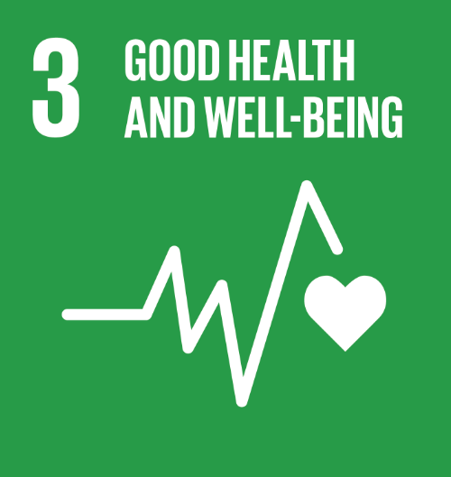
Goal 3 – Good Health & Well-being
Ensuring healthy lives and promoting well-being at all ages is essential to sustainable development.
The world is still dealing with a global health crisis unlike any other — COVID-19 has resulted in the spread of human suffering, destabilising the global economy and upending the lives of billions of people around the globe.
Food Producers like you can play their part by considering the health benefits of their food products and supporting the wider community’s health and well-being.

Slide 54
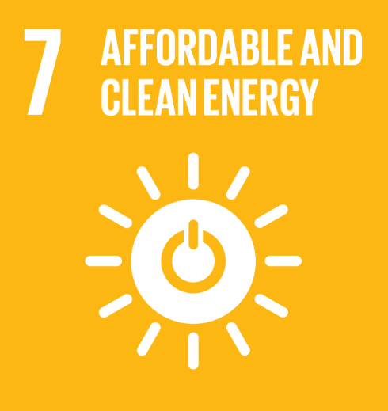
Goal 7 – Affordable & Clean Energy
As a sector, which is energy-intensive, the food sector can accelerate the shift towards increased renewable energy shares in the global energy mix.
By promoting investments in clean energy sources, food production stakeholders can help to reduce greenhouse gases, mitigate climate change, and contribute to access to energy for all.
The world is making progress toward Goal 7, more focused attention is needed to improve access to clean and safe cooking & distribution fuels and technologies for 3 billion people, to expand the use of renewable energy beyond the electricity sector.

Slide 55
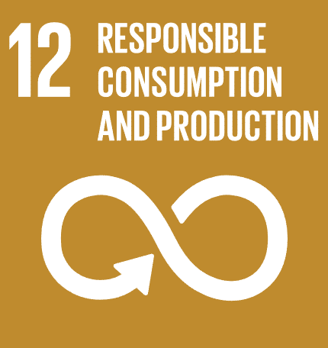
Goal 12 – Responsible Consumption & Production
Science is crystal clear that we are putting extreme pressure on the planet & we urgently need to reduce our ecological footprint by changing the way we produce and consume goods and resources.
For decades scientists have been laying out how humanity is driving the three planetary crises: the climate crisis, the biodiversity and nature crisis, and the pollution and waste crisis.
Our relentless extraction of resources from the Earth is having a devastating impact on the natural world, propelling climate change, destroying nature, and raising pollution levels. SDG 12 Hub

Slide 56
Goal 12 – continued…
The efficient management of our shared natural resources, and the way we dispose of toxic waste and pollutants, are important targets to achieve this goal. Encouraging industries, businesses and consumers to recycle and reduce waste is equally important, as is supporting developing countries to move towards more sustainable patterns of consumption by 2030. UNDP
The Food sector needs to adopt sustainable consumption and production modes, accelerating the shift towards sustainability. Tools to monitor the impacts of food production including energy, water, waste, and job creation will result in enhanced economic, social, and environmental outcomes.

Slide 57
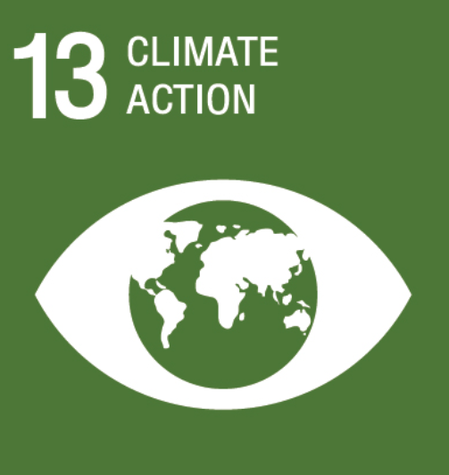
Goal 13 – Climate action
Climate change is affecting every country on every continent. It is disrupting national economies and affecting lives. Weather patterns are changing, sea levels are rising, and weather events are becoming more extreme.
Food Sector stakeholders should play a leading role in the global response to climate change. By reducing its carbon footprint, e.g. via short-supply chains, reduced waste, and leaner practices. Food Businesses like you can benefit from low carbon growth and help tackle one of the most pressing challenges of our time.

Slide 58
04
Food & Poverty

Slide 59

How Food & Poverty are connected…
The link between food and poverty is an important one, and addressing both issues is critical to achieving sustainable development. SDGs 1 & 2 recognise this interdependence and call for integrated, coordinated action to address the root causes of poverty and food insecurity.
Food insecurity is the state of living without reliable access to affordable, nutritious food, often impacting diet quality and leading to undernutrition as well as obesity.

Slide 60
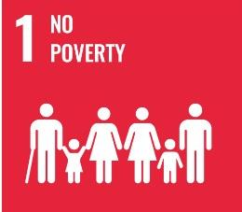
Goal 1: No Poverty
SDG 1 seeks to end poverty in all its forms, which includes addressing the issue of food insecurity. Poverty can be both a cause and a consequence of food insecurity. Lack of access to sufficient and nutritious food can lead to malnutrition, poor health, and reduced productivity, all of which can contribute to poverty. At the same time, poverty can limit people's ability to purchase or produce enough food to meet their needs, perpetuating the cycle of food insecurity.

Slide 61
Hunger & Poverty
Goal 2 of the SDGs seeks to address the global challenge of hunger and malnutrition, which disproportionately affects people living in poverty. While there is currently enough food produced globally to feed everyone, the issue of food insecurity is not only about food availability but also about access and affordability. As mentioned, people living in poverty may lack the resources to purchase or produce sufficient and nutritious food to meet their needs.
In addition, the food system is not always designed to promote sustainable agriculture, which can lead to further challenges for people living in poverty. Unsustainable farming practices, such as the overuse of chemical fertilizers and pesticides, can lead to degraded soils and reduced crop yields, making it harder for farmers to produce enough food. Climate change also poses a significant threat to food security, as changing weather patterns & extreme weather events can impact crop production/food availability.

Slide 62
Malnutrition
Malnutrition is another significant challenge, affecting not only those who are chronically undernourished but also those who consume low-quality diets lacking in essential nutrients.
Malnutrition can lead to stunting, wasting, and other health problems, which can further entrench poverty and hinder economic development.
04
01
Low
Productivity
Poverty
03
02
Poor physical
and cognitive
development
Food insecurity,
hunger and
malnutrition
It is estimated that approximately 100 million people in the Europe and Central Asia region are exposed to moderate or severe food insecurity. Source

Slide 63


This Short Video from the FAO of the United Nations, gives a snippet of the state of Food Security & Nutrition in the World 2020
The State of Food Security and Nutrition in the World 2020 - YouTube

Slide 64
05
Fairtrade & Social Justice

Slide 65

“
Agricultural and food workers do difficult and sometimes dangerous jobs for very little pay. their work is not highly valued in society, and they are more likely than other workers to find themselves unable to afford healthy and nutritious food. Some people working in food and farming are protected by fair trade certification, but surely all workers should be paid fairly and treated well.
“

Slide 66
Why Sustainable Food Systems are essential…
Sustainable food systems protect and enhance the environment and provide people with nutritious and culturally acceptable food. They also ensure that the people who grow and sell our food are treated decently and paid fairly.
Workers in our industrial food system suffer some of the worst documented abuses of rights. Undertaking difficult, dangerous and badly paid work, they are at the sharp end of poverty. In agriculture, the power in the food system has shifted to the corporations that control the technologies and market access that farmers need. This imbalance means farmers can’t demand a fair price for their produce, and it affects food producers in both the developed and developing worlds.
Source

Slide 67

What is Fairtrade?
Fairtrade is a certification system designed to ensure that farmers and workers who produce food and other commodities in developing countries receive fair prices and decent working conditions.
The Fairtrade system works by establishing a minimum price for the product, which is intended to cover the cost of sustainable production and provide a living wage for the producers.
In addition, Fairtrade certification requires that producers adhere to certain environmental and social standards, such as using sustainable farming practices, prohibiting the use of forced or child labour, and promoting gender equity.

Slide 68
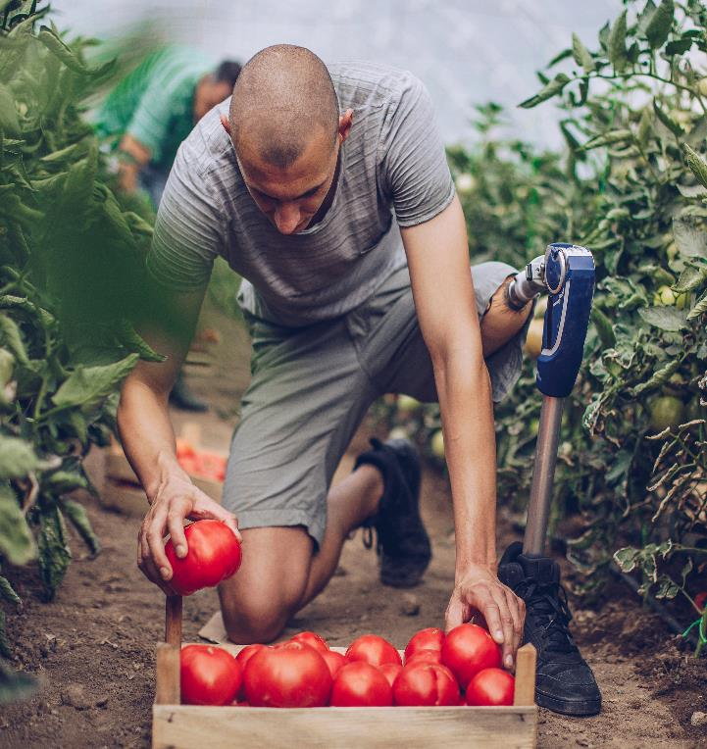
What else can be done?
Fairtrade is not a silver bullet solution to the challenges facing food systems today. While Fairtrade can help to address some of the most pressing issues facing small-scale farmers and workers, it is only one part of a broader set of initiatives needed to build more equitable and sustainable food systems.
Other initiatives may include improving access to markets and finance for small-scale producers, supporting agroecological and regenerative farming practices, and promoting policies that support fair and sustainable trade.

Slide 69
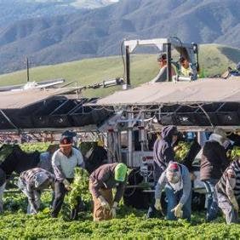
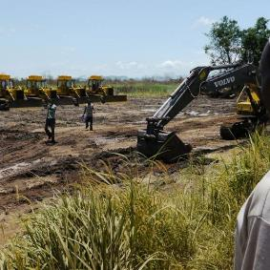
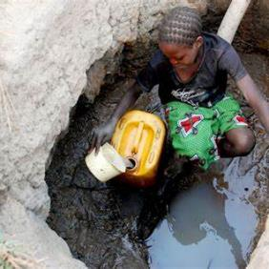
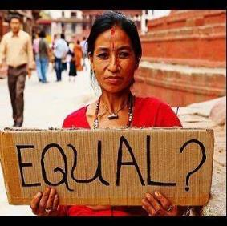
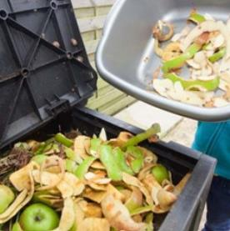
There are many issues in the food production system that can lead to SOCIAL INJUSTICE, including:
Exploitation of workers:
Land grabs and displacement:
Unequal access to resources:
Discrimination and marginalisation:
Food Waste:
Many food production workers, particularly those in developing countries, may be paid low wages, work long hours, and have limited access to basic rights and protections.
In some cases, large-scale food production may result in the displacement of local communities or the forced acquisition of their land, often without adequate compensation or consultation
Small-scale farmers and producers may lack access to the resources and support they need to be competitive, such as supplies, finance, technology, and market access.
Women, indigenous people, and other marginalised groups may face discrimination in the food production system, including limited access to land, credit, and training.
Food waste can exacerbate social injustice by contributing to the loss of valuable resources and exacerbating food insecurity, particularly for vulnerable populations.

Slide 70
Social Justice…
As implied above, social justice issues in regard to food production are not merely about fair trade. In any country (rich and poor), the conditions of farm workers and farmers may or may not be (adequately) protected by various kinds of legislation on for example, safety (including pesticide safety) and working conditions.
Addressing social justice issues in food production requires a range of approaches, including strengthening labour protections, supporting small-scale producers, promoting equitable land tenure, and reducing food waste. It also requires recognising the complex social, economic, and political factors that shape food systems and working to address these underlying issues in order to build a more just and sustainable food system for all.

Slide 71
06
The Link between Food and Health

Slide 72
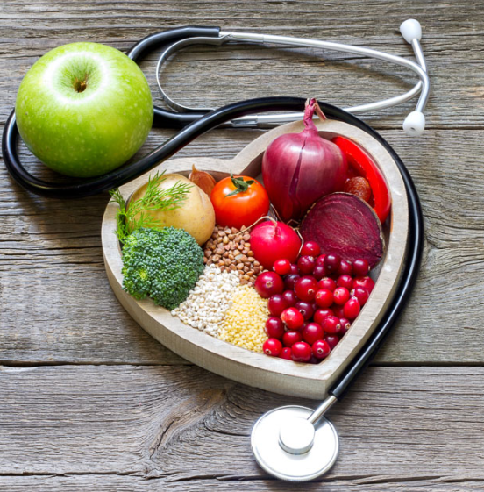
Food & Health
The link between food and health is complex and multifaceted, and there are many factors that can influence our health outcomes, including genetics, environment, and lifestyle factors beyond just diet.
However, as we have learned so far, from an ethical perspective, there is a clear link between food and health. Our food choices have a direct impact not only on our own health and well-being but also on the health and well-being of the planet and other living beings.

Slide 73
As a food entrepreneur, acknowledging the link between food & health is a foundation for building a sustainable and ethical food business.
Here are some ways you can do this:
2
3
4
5
1
Emphasise the nutritional value of your products
Use high-quality, sustainable ingredients
Support local and organic agriculture
Offer a variety of dietary options
Promote healthy eating habits

Slide 74

1. Emphasise the nutritional value of your products:
Make sure your products are nutritious and provide customers with the information they need to make informed choices about their diet.
Highlight the key nutrients and health benefits of your products on your packaging, website, and marketing materials.
EXAMPLE – GOOD4U Our Story | About Good4U – Good4U Online

Slide 75
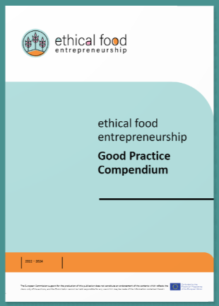
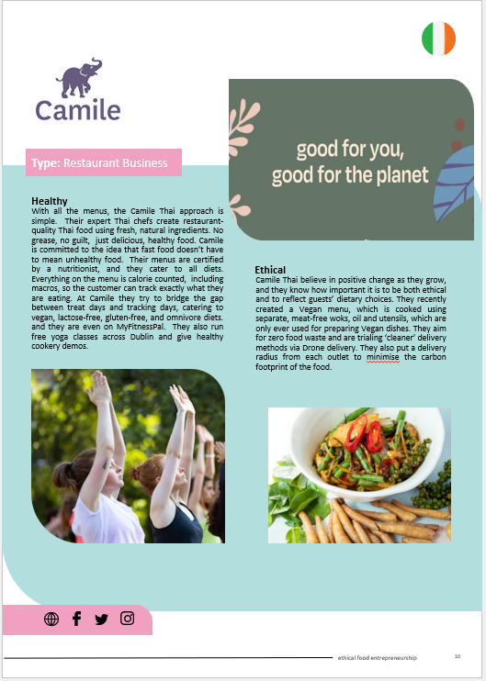
Be Inspired…
Check out our Good Practice Compendium for examples of companies that emphasise the nutritional benefit of their food and operate by informing the consumer.
Camile is one such example. Camile is a restaurant chain in Ireland. Winner of Most Sustainable Restaurant, it offers Ireland's first carbon counted menu #consciouscamile
READ MORE Camile Sustainability Practices

Slide 76
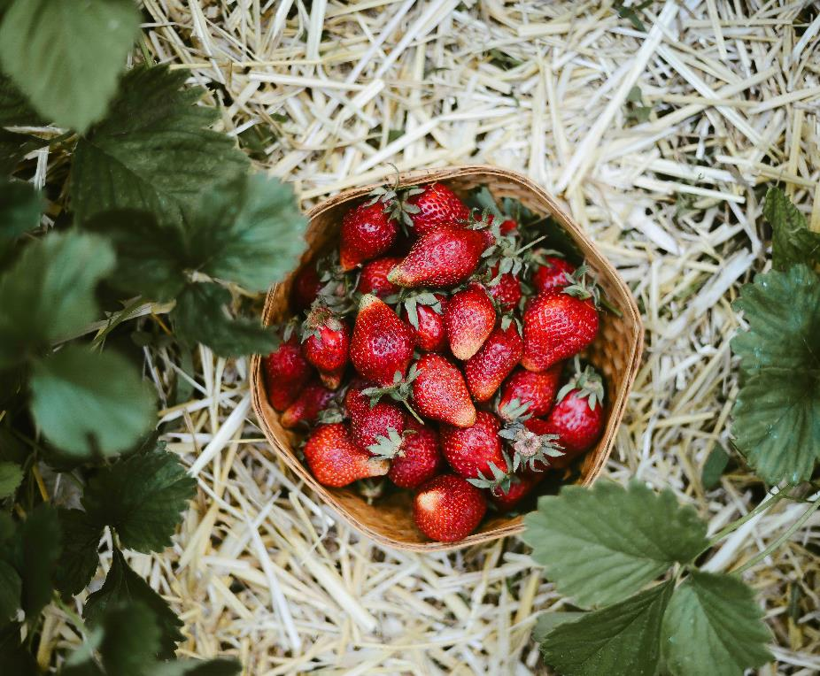
2. Use high-quality, sustainable ingredients:
When you are producing or processing food to make your product, choose ingredients that are sustainably sourced and free from harmful chemicals or additives. This will not only improve the nutritional value of your products but also reduce the environmental impact of your business. QR-codes are now being used by food producers to offer transparency on food origin for the consumer.

Slide 77
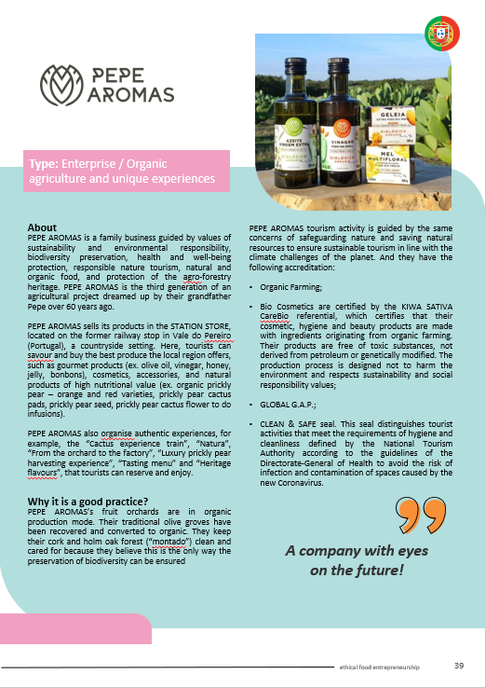
Be Inspired…
Check out our Good Practice Compendium
Pepe Aromas from Portugal is an inspiring business. They grow and harvest organic and sustainably produced fruit & olives to make all their products. Their certified and award winning farming methods and practices demonstrate their respect the environment and biodiversity.

Slide 78
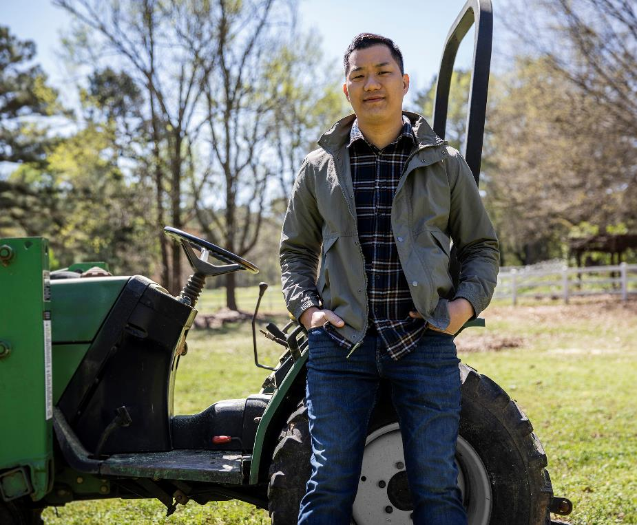
3. Support local and organic agriculture
In an effort to create healthier products, efforts can be put into collaborating with local farmers and producers to source high-quality, organic ingredients for your products. This not only supports local agriculture & biodiversity but also can ensure that your products are free from harmful chemicals and additives. Building a safe and healthy supply chain is key.

Slide 79
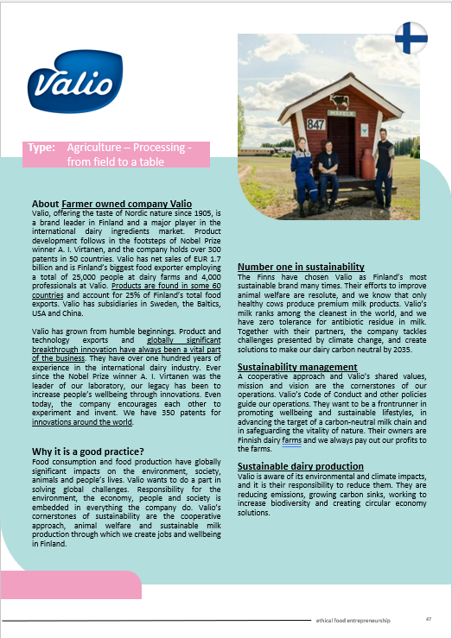
Be Inspired…
Check out our Good Practice Compendium
Valio was chosen as a good practice example as it not only supports local agriculture, but the company also operates via a co-operative approach and so the farmers are the owners.
The company knows the origin of the raw materials they use, and it expects their suppliers to commit to responsible ways of working.

Slide 80
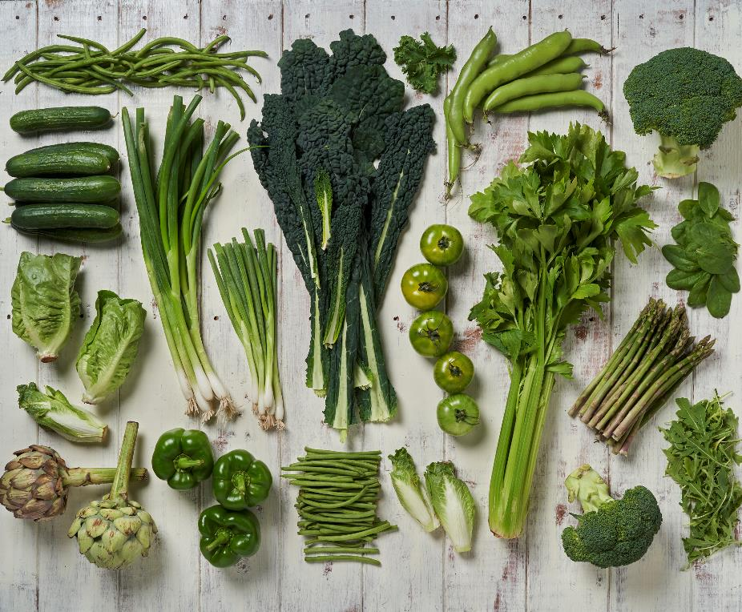
4. Offer a variety of dietary options:
As an ethcial food entrepreneur you need to recognise that people have diverse dietary needs and preferences, and so you should contribute to a range of options to accommodate different diets and lifestyles. This can include vegetarian, vegan, gluten-free, and other options.

Slide 81
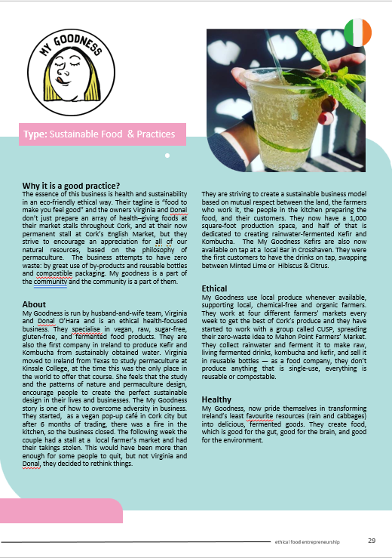
Be Inspired…
Check out our Good Practice Compendium
My Goodness as the name indicates is all about consumer well-being and health. They specialise in vegan, raw, sugar-free, gluten-free, and fermented food products.
Their tagline is “ food to make you feel good”

Slide 82

5. Promote healthy eating habits
Educate your customers about healthy eating habits and encourage them to make informed choices about their diet.
This can include providing recipe ideas, nutrition tips, demo-videos and other resources to help people make healthier food choices via your website, packaging, social-media channels or podcasts. Reaching the consumer was never so easy.

Slide 83
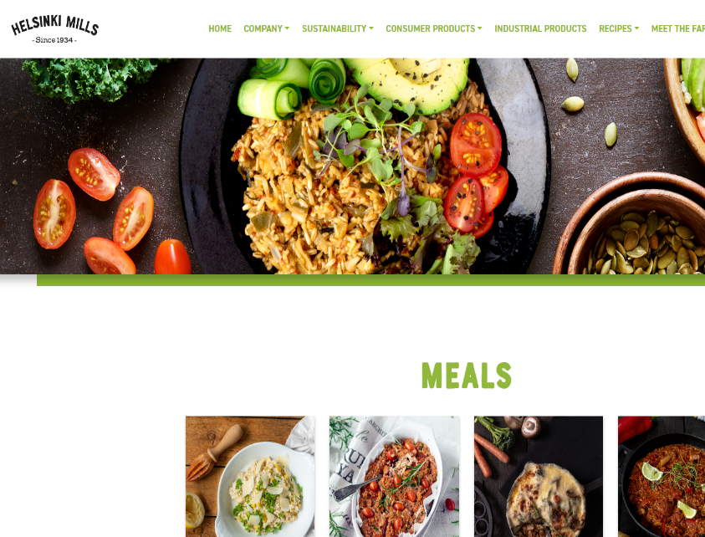
Be Inspired…
Helsinki Mills, another of our Good Practice Case studies, promote healthy eating by simply providing an array of healthy recipes on their website. Their enticing images are high impact and provide motivation for consumers to try healthy dishes.

Slide 84
07
Sustainability and Resilience

Slide 85
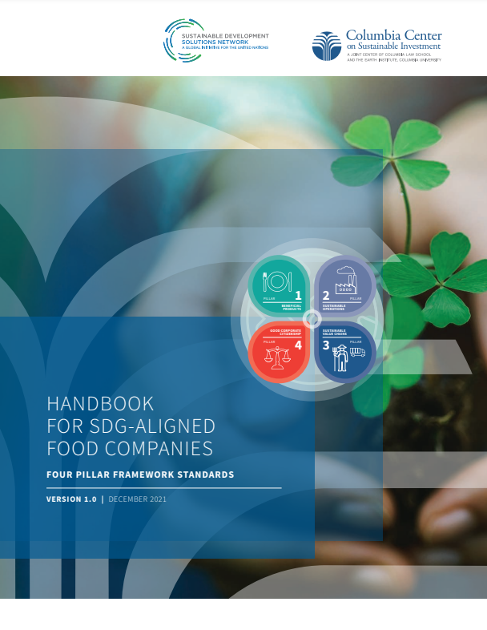

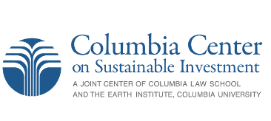
How can you become part of the solution?
As we have explored in this Module, food companies are increasingly recognising the magnitude of the food systems crisis and the need for their active participation to be part of the solution. The Sustainable Development Solutions Network for the UN and Columbia Center on Sustainable Investment, created a Handbook for SDG-aligned Food Companies to help companies understand their roles in this transformation, adjust their internal policies and practices, and report on their actions.
The Framework helps food processing companies, investors, and other stakeholders understand how the food sector can and should align with the SDGs. It is based on 4 pillars which we now explore…

Slide 86

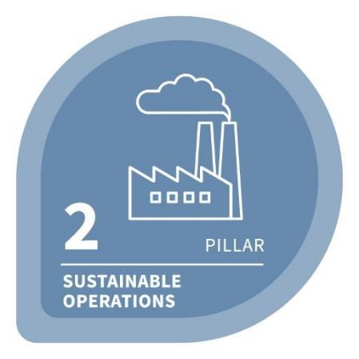
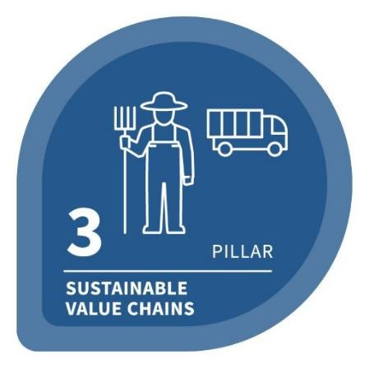
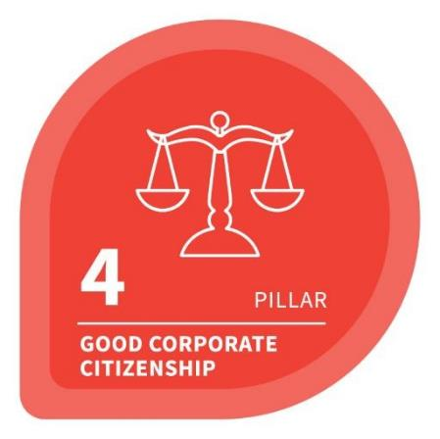
The Framework is based on four Pillars:
BENEFICIAL PRODUCTS
SUSTAINABLE OPERATIONS
SUSTAINABLE VALUE CHAINS
GOOD CORPORATE CITIZENSHIP

Slide 87

Pillar 1 – Beneficial Products
How are food companies’ products and strategies driving healthier and more sustainable dietary patterns among consumers and communities?
Are their food products healthy?
Does their marketing promote health?
Is the use of their products conducive to well-being?
Is their production supportive of food security for producing resilient communities?
BENEFICIAL PRODUCTS

Slide 88
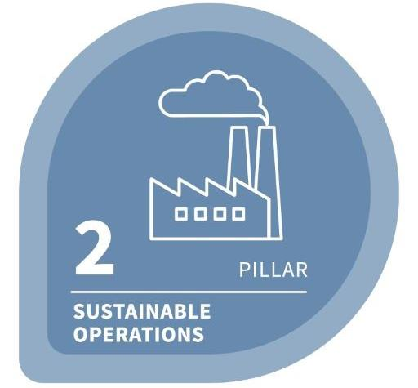
Pillar 2 – Sustainable Operations
What are the environmental and social impacts of food companies’ own operations?
How do they prevent, mitigate and remedy impacts on the lives and local environment of workers, communities and ecosystems?
SUSTAINABLE OPERATIONS

Slide 89
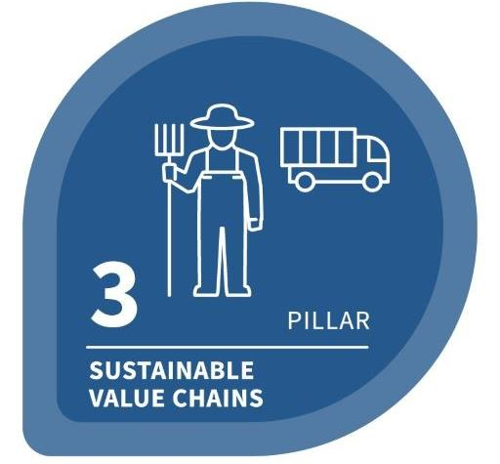
Pillar 3 – Sustainable Value Chains
Are food companies driving sustainable development for workers, producers & communities up and down their value chains and in the ecosystems where they operate?
How do they prevent and mitigate impacts in their value chains by changing their own business practices?
How might they collaborate with peer companies, governments and others to promote and ensure more rights-respecting and environmentally sustainable practices?
SUSTAINABLE VALUE CHAINS

Slide 90
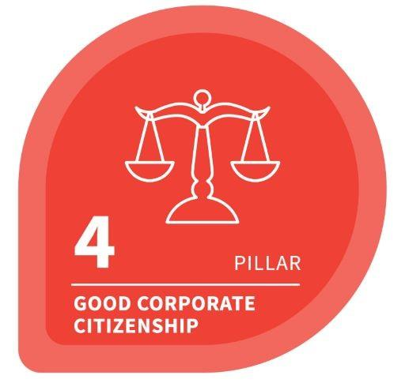
Pillar 4 – Good Corporate Citizenship
How are companies governed? What impact are companies having on societies as a result of how they engage with the legal systems and rules that govern corporations?
Are company strategies contributing to social goods and societal well-being?
Are they supporting the crafting and effective deployment of law and policy that advances sustainable development?
GOOD CORPORATE CITIZENSHIP

Slide 91
Further reading…
Korthals, Michiel. (2006). Ethics of Food Production and Consumption. Understanding Consumers of Food Products. 10.1533/9781845692506.5.624. Link
Revisiting global food production and consumption patterns by developing resilient food systems for local communities – ScienceDirect
2010-Ethics-A-toolkit-for-food-businesses.pdf
EU sets out legally binding food waste targets from processing to household (foodnavigator.com)

Slide 92

You have just completed Module One.
Now, continue your journey to Ethical Food Entrepreneurship in Module 2 where we discuss the critical steps in developing an enterprise.

