Slide 1
MODULE 2
Critical Steps in Building an Enterprise
Ethical Food Entrepreneurship (EFE) Programme

Slide 2
Critical Steps in …
Entrepreneurship-
Building a successful food business is no easy feat. There are many critical steps involved from qualifying your initial idea, to determining how your business model looks and all that is involved in financing your project.
In this module, we discuss these and the legalities of starting a new business, as well as how to keep your business growing and sustainable into the future.
01
Your Creativity and How to Qualify an Idea
02
SMART Goals
03
Determining your goals – Creating a Business Plan
04
Funding & Financing your Journey
05
The Legalities of Starting a New Business
06
The Importance of Sales and Marketing

Slide 3
01
Your Creativity and how to Qualify an Idea

Slide 4


The Importance of Creativity…
Creativity is highly important for ethical food entrepreneurs for several reasons.
Creativity leads to the development of innovative solutions that align with good practices.
Creativity leads to differentiation in the market
Creativity is instrumental in engaging and educating consumers about ethical food choices.
Creativity enables ethical food entrepreneurs to adapt and respond to changing consumer preferences.

Slide 5

The Opportunity that lies within Creativity
Ethical food entrepreneurs have the potential to inspire and influence the broader food industry. By demonstrating the viability and success of ethical practices through creative approaches, they can inspire larger food corporations to adopt more sustainable and ethical practices.
Creativity can be a catalyst for industry-wide change and drive a positive impact at a larger scale where transparency, integrity, and a commitment to ethical values is fostered.

Slide 6

Qualifying your IDEA
1
Identify the problem or opportunity
When it comes to qualifying creativity or ideas in the first steps of business development, food entrepreneurs can consider several factors to evaluate their potential.
Here are some steps you can take:
Remember that entrepreneurship is an iterative process. It's essential to stay adaptable, open to feedback, and willing to iterate/refine and pivot as you learn more about your target market and industry.
2
Validate your idea by conducting market research
3
Assess uniqueness and differentiation
4
Seek feedback and validation
5
Develop a prototype or proof of concept
6
Evaluate the scalability and market potential

Slide 7

1. Identify the problem or opportunity
Start by clearly defining the problem or opportunity your idea aims to address. Assess its significance, scope, and potential impact on potential customers or the market.
This step helps you understand the relevance of your idea and its potential value proposition.

Slide 8

2. Validate your idea by conducting market research
Conducting market research involves gathering information about your target market, potential customers, competitors, and industry trends.
Determine if there is a demand for your food product or service and identify any gaps or areas for improvement in existing solutions. Market research helps you assess the viability and potential market fit of your idea.

Slide 9

3. Assess uniqueness and differentiation
It is advisable to evaluate the uniqueness of your idea and how it differentiates from existing solutions or food products. Consider if your idea offers a novel approach, innovative features, or solves the problem more effectively or efficiently. Assess whether your idea has a competitive advantage and how defensible it is against potential competitors.

Slide 10

4. Seek feedback and validation
Share your idea with trusted individuals, mentors, or potential customers to gather feedback. Consider joining entrepreneurship or food networks, attending startup events, or participating in pitch competitions to gain exposure and receive objective opinions.
Feedback and validation from third parties can help you refine and improve your idea.

Slide 11

5. Develop a prototype or proof of concept
As discussed in the next module as a stage f Design thinking…Creating a prototype or a proof of concept to demonstrate your idea's functionality and potential in very useful. This tangible representation or sample can help potential stakeholders understand and visualise your concept better. It also allows you to test your idea's feasibility and make necessary adjustments before investing further resources.

Slide 12

6. Evaluate the scalability and market potential
It is important to consider the scalability and market potential of your idea. Assess if it has the potential to grow and attract a significant customer base. Evaluate the addressable market size, potential revenue streams, and long-term sustainability of your business model. Being both viable and feasible is critical to business development.

Slide 13
02
SMART GOALS

Slide 14
SMART Goals
Without concrete goals, it is difficult to change or improve. S.M.A.R.T. goals are useful because they contain five aspects that enhance clarity, help you focus and track & re-evaluate goals as needed. This framework can be helpful for any team trying to practice effective project management. The five aspects of S.M.A.R.T. goals are →
We explore what S.M.A.R.T. goals are and how they can help your team & food business.
S
SPECIFIC
M
MEASURABLE
A
ACHIEVEABLE
R
RELEVANT
T
TIME-BOUND

Slide 15

Specific
Specific goals have a desired outcome that is clearly understood. This might be a sales number or a product rollout goal or a production process alteration. No matter what it is, the goal should be clearly articulated so that everyone is on the same page with the objective. Define what will be accomplished and the actions to be taken to accomplish the goal.

Slide 16

Measurable
These are the numbers used with the goal. You need to have a quantifiable objective so that you can track progress.
Before you begin, decide and outline what data will be used to measure the goal and set a method for collection. E.g. by what % do you want to see an increase or decrease?

Slide 17
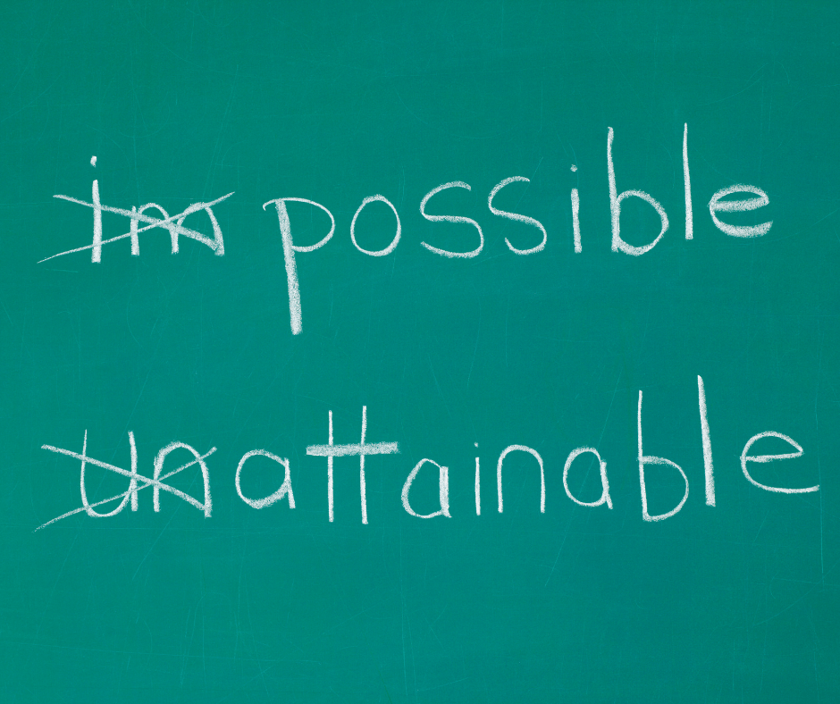
Achievable
Goals need to be realistic or attainable in order to maintain the enthusiasm to try to achieve them. Setting lofty goals is good, but you may want to break them down into smaller, bite-sized chunks. If the goal is not doable, you may need to first ramp up resources to give yourself a shot at success. Ramping up resources would likely be its own S.M.A.R.T. goal.

Slide 18
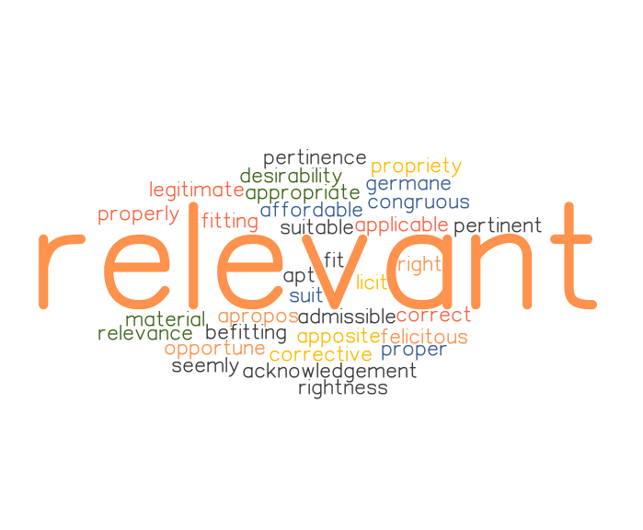
Relevant
The goals you set should be aligned with the mission of the company. For example, your goals should help you to become more ethical in your practices or processes. Don’t set goals just as an exercise for something to do. One way to determine if the goal is relevant is to define the key benefit to the 3Ps (People – Planet – Profit).

Slide 19

Time-Bound
Goals should have a deadline. A goal without a deadline doesn’t do much. How can you identify success or failure? This is why S.M.A.R.T. goals set a final date. This doesn’t mean that all the work is done, but it means that you can evaluate the success of the project or endeavour and set new goals. Time can provide motivation to succeed. When you know where the goal line is, you’ll want to work to meet or beat it.

Slide 20





How To Follow Through on Your Goals
Write Goals Down & place them somewhere everyone can see them
Share Goals With Relevant People – This sets a tone of accountability
Regularly Evaluate Progress - If the goal is a monthly goal, you may want to have daily check-ins
Be Agile - redirect energy & change course if something you are doing isn’t working
Celebrate Wins - the little successes helps maintain the energy to work toward the bigger goal

Slide 21
Example: a SMART goal for an ethical food business:
Specific: Increase the percentage of locally sourced ingredients used in our product offerings.
Measurable: Source at least 50% of our ingredients from local suppliers within a 100-km radius by the end of the fiscal year.
Achievable: Conduct a thorough assessment of local suppliers and establish partnerships with those who meet our quality standards and ethical sourcing criteria.
Relevant: By increasing the use of locally sourced ingredients, we support local farmers, reduce our carbon footprint, and promote the local economy.
Time-bound: Achieve the 50% target within the next 12 months.
This example provides a clear objective for the business to work towards and enables progress tracking and evaluation.

Slide 22

Student Exercise:
Initially list some goals you would like to see happen in your ethical food business
Convert this list into a series of SMART goals following the structure from above
Constantly evaluate and re-align as time goes on

Slide 23
03
Determining your goals – Creating a Business Plan

Slide 24
What is Next when determining your goals?
You are doing this course as you want to ensure your ethical food enterprise is successful in every aspect. Creating a business plan is a step in the right direction on that journey, and it can open doors for funding etc…Prior to writing your business plan, you must have ideas of opportunities to expand upon. There are a few stages in this exploration:
Creativity & Ideation: as discussed in the previous section
Value these ideas: make the most of them and the associated opportunities
Mobilise the resources: gather & manage the resources you may need
Planning & management: Prioritise, organise and determine the best solutions to make it happen.

Slide 25
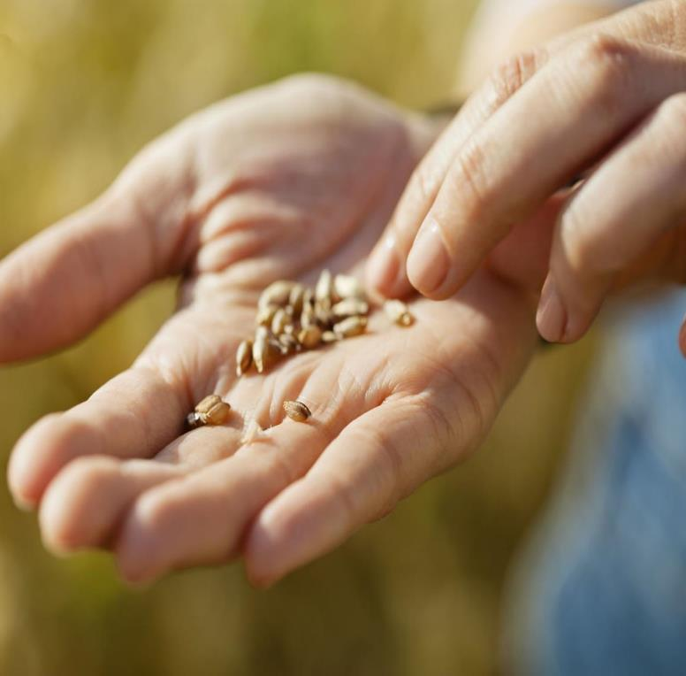
Creating your Business Plan…
with you for your future!
Developing a business plan involves thinking strategically about your enterprise and making a plan to make your plan happen. Planting the seed!
In this course, we help you to develop a simple and practical business plan that enables you to achieve your growth ambitions. Built around tools, templates, and resources that will help you, like the Design Thinking Process, the Business Model Canvas, and real-life case studies, we will help you to articulate your ethical enterprise objectives.

Slide 26
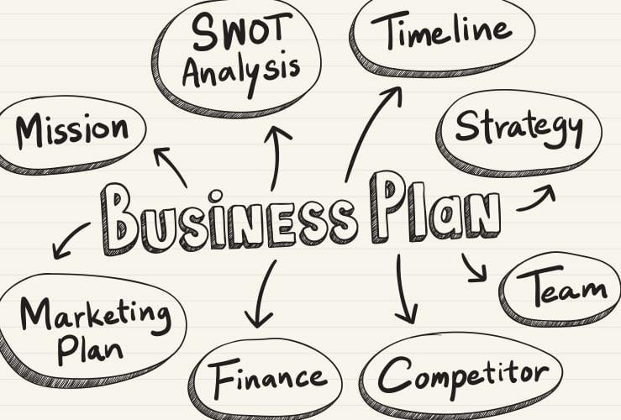
First things first, a Business Plan is…
a study done to understand the viability of a business, analysing the production operations, financial, market, and other points of view.
In short, it is a clear and organised way to project the necessary resources and expected returns for a business. This reduces risks and uncertainties

Slide 27
The Outcome we want to Achieve in this section:
1
2
3
Establish PROCESSES TO COMMUNICATE THE BUSINESS PLAN to key stakeholders important to your enterprise’s success.
Develop your CONFIDENCE & ABILITY TO FURTHER ADAPT the plan to address changing market needs as they arise.
Produce & implement a PRACTICAL BUSINESS PLAN to deliver business growth for your food enterprise.

Slide 28
Creating a Business Plan for your Food Enterprise
The Big Picture first …
Yes, there is some business speak here, but let’s interpret!
Strategy
Your competitive game plan
Vision
What you want to be
Values
What you believe & practice
Mission
Why you exist

Slide 29
The Strategic Planning Process Steps…
Start with a Vision: how does the future of your Food Business look? Reflect on its uniqueness, its distinctive features & what your business can achieve
Define Your Business Model: A business model describes the economic engine that drives your business
Prepare: to gain insight into your ethical food enterprise performance, market, and competitors
Execute an Effective Strategic Planning Process: This should be well-thought-through and well-planned
Focus on “the BIG Rocks” & create a one-page plan or canvas …continuously Review and revise the plan
Food for People – Planet – Profit

Slide 30
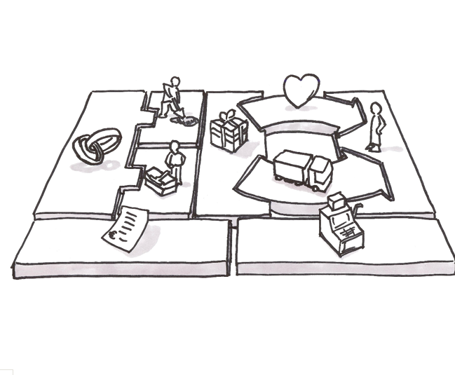
A Business Model…
You have identified your mission and have qualified your idea, now you must define your BUSINESS MODEL.
This is a tool that consists of a Plan used to organise the various resources and key parts of a business.

Slide 31

A Business Model…
A Business Model describes how your food enterprise CREATES, DELIVERS & CAPTURES VALUE in all contexts.
As an entrepreneur, you should expect your Business Model to modify and adapt regularly to meet the needs and demands of customers and to react to events (e.g., Covid).
Your Business Model is in essence the vision of your business

Slide 32
How a Business Model Canvas can help you…
A business model canvas (BMC) is a business and marketing tool that serves as a guide for business owners to create business models. As it is a simple format, it helps business owners see how all the key business elements fit together.
The business model canvas template is structured to help business owners think about how they are going to fill their business with customers, money, and resources all at once. It can help you figure out what your target audience wants, how you plan on selling your products and/or services, and even forecast how much revenue you expect to generate each month.

Slide 33
How To Create a Canvas Model For Your Food Business
As we have explored, the business model canvas is key to business planning. It is an essential business tool that business owners need to use when they are creating business plans or nurturing business ideas. Entrepreneurs can create a business model canvas by answering the questions provided for each of the 9 sections of the canvas:
1. Key partners 6. Distribution Channels
2. Key Activities 7. Potential Customers
3. Key Resources 8. Cost Structure
4. Value Proposition 9. Revenue Streams
5. Customer Relationships

Slide 34

Strategyzer’s Business Model Canvas…
This short video describes how using the 9 ‘building-blocks’ or sections of the Business Model Canvas, you can map existing models or design new business models.
Business Model Canvas Explained - YouTube

Slide 35
1. Key Partners
This section should include a list of all organisations and individuals that need to be involved in making the food business a success. Take note:
Who are your key partners?
Who else has an interest in the business’s success?
How do they contribute to its growth?
How can each partner contribute? Do they need to be compensated for their efforts? How much?

Slide 36
2. Key Activities
This section will include a list of all the tasks that need to be completed for your ethical food business model to work.
What activities are required to support your value proposition?
What activities are required to support the relationships with your consumers?
What activities are required to support your revenue sources?

Slide 37
3. Key Resources
The Key Resources section should focus on what types of equipment, labour, and funds are needed to make this business successful.
• What equipment is needed to start this business?
• What type of labour does this ethical food business require? Your own? With others?
• How much funding will I need in order to start this business?

Slide 38
4. Value Proposition
The Value Proposition section details what your customer base will receive in return for their money and time.
• What makes your product or offering unique?
• What value does it bring compared with other similar food businesses?
• What are the different benefits that your ethical food business offers to its customers?
• How will you be able to differentiate yourself from other brands or products on the market?

Slide 39
5. Customer Relationships
The Customer Relationships section should include all the ways that you plan on communicating with your consumers, including social media to help promote your offerings
• How will you communicate with consumers throughout the buyer’s journey?
• What is the best way to market your ethical food business?
• Which social media platforms do you use?

Slide 40
6. Distribution Channels
The Distribution Channels section is all about how your food product or service will be sold.
What are the best sales channels to reach your target audience/customer?
How are these channels integrated?
Which channels perform the best?
Which channels are the most cost-effective?

Slide 41
7. Potential Customers
This section includes a list of all potential customers within your target group.
How do you identify your customer segments?
What are their demographics?
Which geographical areas will this ethical food product be offered in?
Why would these particular groups purchase from me over others that sell similar products to mine?

Slide 42
8. Cost Structure
This section lists everything you will need to invest in order to run your ethical food business well.
What are the different costs associated with starting and running this business?
How much money do I need upfront?
Which resources am I able to provide myself without having any additional expenses?
For example, if you are creating a business that will sell online, it’s important to include things like hosting costs or website design fees. If your startup requires physical products, then you’ll need to factor in materials and labour costs into this section of the canvas.

Slide 43
9. Revenue Streams
The Revenue Streams section is a list of all the ways that you plan on making money from your ethical food business.
What are my different streams of revenue?
How much money can I make from each one?
Which resources am I able to provide without having any additional costs or expenses attached to them?

Slide 44
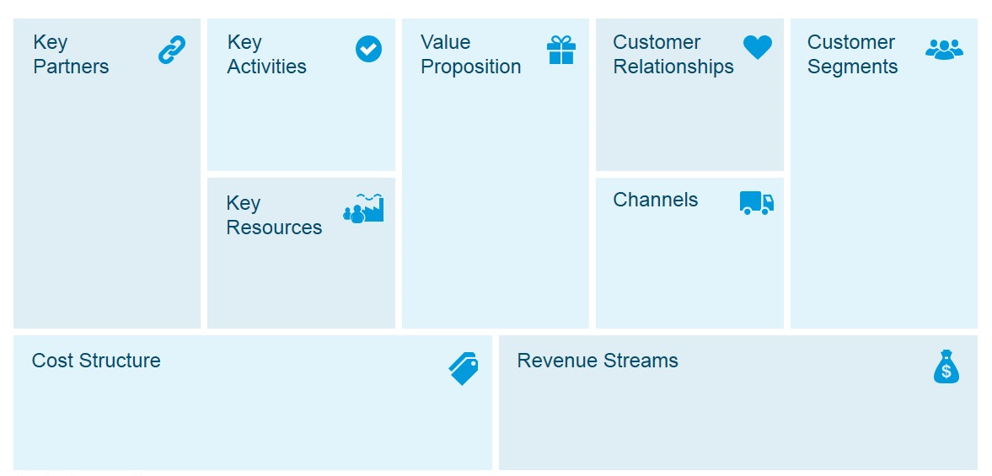
Learner Exercise: Create a Canvas Model for your Business
Use this template to bring all sections together. Remember it needs to be concise and very clear.

Slide 45
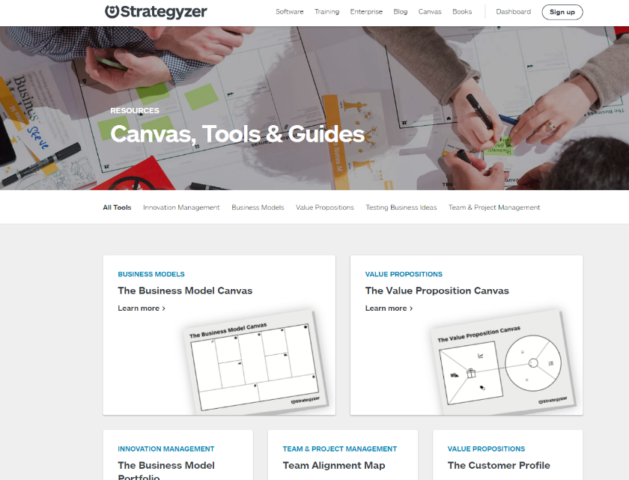
Here are some useful and easy-to-use resources to help you on this journey…
Strategyzer is a complete platform of several methods, tools, and templates to capture your business model approach.
Access free content through this link
https://www.strategyzer.com/resources/canvas-tools-guides

Slide 46
What you have learned so far…
An effective business model helps you to figure out elements such as:
Your business concept
What problem are you solving and for whom?
How will your ethical food product get to customers?
How will your business stay competitive?
All revenue and costs you can anticipate.

Slide 47

Our Business Plan Continued…
W
A key component of a business plan includes identifying your business strengths, weaknesses, threats and opportunities. We can obtain these by carrying out a SWOT analysis and obtain missing pieces of the puzzle
S
O
T

Slide 48
SWOT Analysis
Internal
STRENGTHS
What you do well
Qualities that separate you from competitors
Skilled/ knowledgeable staff
Your USP (unique selling proposition)
WEAKNESSES
Things your business lacks
What your competitor does better
Resource limitations
A SWOT analysis is a simple, but powerful, framework for leveraging any business or project’s Strengths, improving Weaknesses, minimising Threats, and taking the greatest possible advantage of Opportunities.
SWOT analysis is a process where you can identify the internal and external factors that will affect your ethical enterprise’s or project’s future performance.
OPPORTUNITIES
Under-served markets
Few competitors in area
Emerging need you can fill
Project participation
THREATS
Emerging competitors
Changing regulations
Changing customer attitude to your business
External

Slide 49

Strengths:
This refers to internal areas of your food business. Examining these areas helps you understand what’s going to work. You can then use the techniques that you know work—your strengths—in other areas that might need additional support, like improving your supply chain etc.
When looking into the strengths of your business, ask yourself the following questions:
What do we do well? Or, What do we do best?
What’s unique about our product or service?
What does our target customer like about us?
Which features beat out our competitors?

Slide 50

Weaknesses:
This refers to internal areas that are underperforming. It’s a good idea to analyse your strengths before your weaknesses in order to create a baseline of success and failure. Identifying internal weaknesses provides a starting point for improving those areas.
Identify business weaknesses by asking:
Which initiatives are underperforming and why?
What can be improved?
What resources could improve performance?
How do we rank against our competitors?

Slide 51

Opportunities:
Opportunities in SWOT result from your existing strengths and weaknesses, along with any external opportunities that will put you in a better competitive position. These could be anything from the market that you’d like to improve or areas that weren’t identified in the first two phases of your analysis.
Since there are many ways to create opportunities, it’s helpful to ask these questions before starting:
What opportunities arise locally/regionally?
Are there market gaps in our services?
What are our business goals for the year?
What do our competitors offer?

Slide 52

Threats:
Threats in SWOT are areas with the potential to cause problems. Different from weaknesses, threats are external and ‌out of your control. This can include anything from a global pandemic to a change in the competitive landscape.
Here are a few questions to ask yourself to identify external threats:
What changes in the agrifood sector are cause for concern?
What new market trends are on the horizon?
Where are our competitors outperforming us?

Slide 53
Now you can delve further into…
Your business concept – Promoting your business and food products or services in a sustainable & ethical manner, demonstrating the benefit for People – Planet - Profit
What problem are you solving and for whom? – Unethical and damaging food systems by empowering a new generation of food entrepreneurs to start, grow & adapt ethical food enterprises and by equipping their educators with tools and relevant resources.
How will you create customer value? – Through ethical and sustainable food products leading to an improved food system, where the health of the people and planet is critical.
How will your product or service get to customers? Physical products, ideally via short-supply-chains and by developing partnerships within the sector.
How will your business stay competitive? By constantly innovating and diversifying your product offering and the way you service the market by ethical means.
All revenue and costs you can anticipate. How can you increase revenue by re-positioning your produce for a premium market.

Slide 54
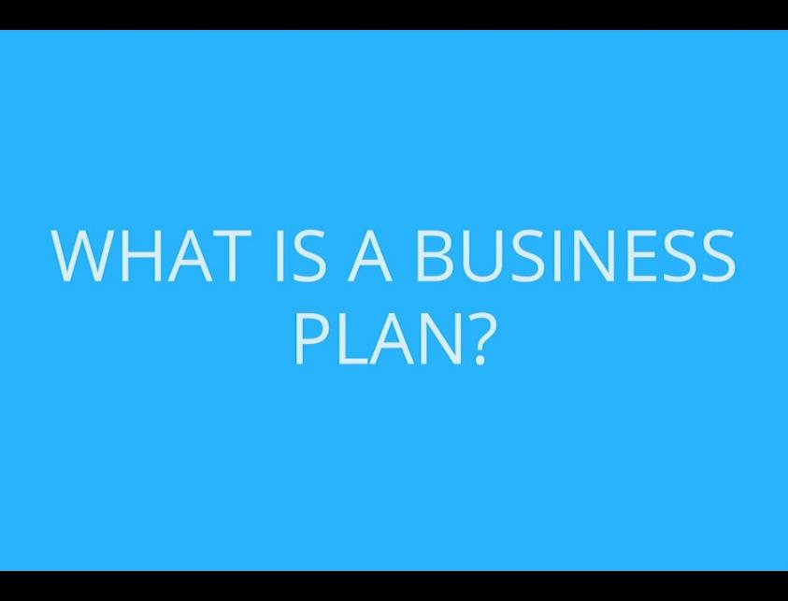
Bringing together your BUSINESS PLAN…
As mentioned earlier a business plan is a written document that describes your business, in terms of objectives, strategies, sales, marketing, and financials.
      A business plan helps you to:
      clarify your business idea
      spot potential problems
      set out your goals
      measure your progress
You’ll need a business plan if you want to secure investment or a bank loan. It can also help to convince suppliers and potential stakeholders to support you.

Slide 55

Writing your Business Plan…
The following documents are blank business plan templates and aids that you can download, edit, print, and fill in to help you start your journey of growth or development…
Business Plan Template from Enterprise Ireland
Business Plan Template with useful hints
Teagasc Step-by-Step Guide to doing the figures
It is now time to make your first attempt at writing your Business Plan and bringing all your work thus far together in one document!
At this stage don’t worry too much about the financials…we will cover this in more detail in the next section

Slide 56
04
Funding & Financing your Journey

Slide 57
The 3 Main Steps to Funding…
1
2
3
Create a solid BUSINESS PLAN
Complete your FUNDING APPLICATION
PITCH your idea to potential funders

Slide 58

Completing your Business Plan...Cash Flow Budgeting
A simple cash flow budget will highlight potential borrowing requirements and will help provide evidence to a bank manager that you have the capability to manage finances effectively and repay any borrowing.
There are 2 key elements of cash flow budgeting
Cash Flow Planning
Review/Control

Slide 59
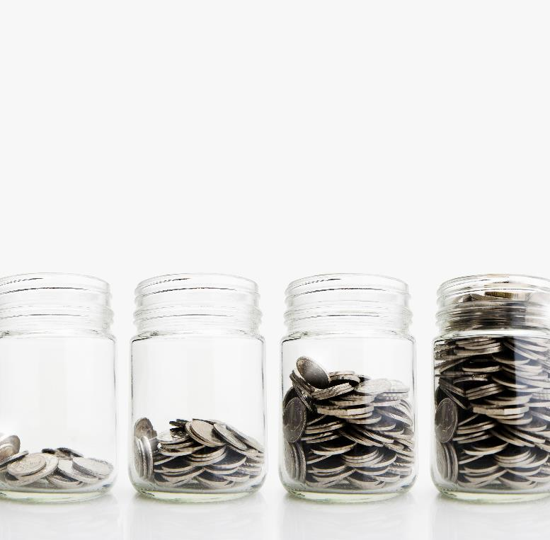
1. Cash Flow Planning
What should you include?
The simple answer is everything!
Anything and everything that will be paid for in the period, and any money coming in from any source must be included.
Cash flow is the movement of money in and out of a business over a period of time. Cash flow forecasting involves predicting the future flow of cash into and out of your bank accounts. Forecasting cash inflows and outflows regularly is important, especially for three types of businesses:
new businesses
fast-growing businesses
businesses with unpredictable sales patterns, for example, seasonal businesses like food producers

Slide 60

2. Review / Control
The 1st step of review and control is to compare actual spending with what was forecast/expected.
What are the differences between the plan and the actual cash flows? Did all the bills you expected, come in? Were all the bills as you expected, (e.g. servicing of a vehicle used for delivery)?
The 2nd step is to understand why these differences occurred. Were sales less than expected? Was there an unexpected bill?
The 3rd step is to decide what the implications are and what you can do about them. It is vital to identify problems and take action as soon as possible.

Slide 61
You will also need a Profit & Loss Statement.
A profit and loss statement (P&L), or income statement, is a financial report that provides a summary of your revenues, expenses, and profits/losses over a given period of time (generally over a quarter or a year)
The P&L statement shows one’s ability to generate sales, manage expenses, and create profits. By using a P&L statement in your food business, you move into using financial data to make sounder decisions.

Slide 62

Money talk and funding…
Now that you have your Business Plan complete with your Projected Financials, it is time to talk money. In this section, we will demystify funding opportunities and attempt to steer you toward viable options and support the guidelines given in the Ethical Entrepreneurship Manual
Finding grant funding is about
making connections.
getting to know what funding is out there and
deciding whether it suits you and your business or not.
You will learn top tips in grant writing and pitching and how to leverage the funding power of many.

Slide 63

Success in securing funding is like making a cake!
For any business, the challenge of pulling together finance for projects or growth can be quite daunting. Sometimes you may just need one finance source but often to make it more viable, multiple finance sources or funders are required.
The way you approach funding depends on the ingredients (you and your project proposal) and you need to follow a recipe.
Following the recipe is easy when you have a set of guidelines and that is what we will try to give you here.

Slide 64

Before you start looking to get financing…
Take a moment to REVIEW & FOCUS on your PRIORITIES:
What are your priorities for the next 1-3/5 years?
Start-up, Survival, regeneration or growth?
New opportunities or the same activities but improved?
Same catchment area or further afield?
Any digitalisation changes?
Your ESG factors – Environmental, Social & Governance factors or outlook.
Answers to these will help you define the ingredients for a successful funding application

Slide 65

Where can you find financial support?
In this section, we introduce you to
Private investment friends and family
Micro-credit and micro-financing
Crowdfunding
Bank loans
Grants

Slide 66

1. Private Investment
Private Investment can be a good option for a start-up especially when you can’t fully prove the basis of the business. It also can have advantages such as a strong contact base/advice and help, which traditional lenders do not provide.
As an ethical entrepreneur you may need to start close to home with Friends and Family but try keep your personal and professional relationships separate, if possible, by getting everything in writing and clearly explaining the risk involved in investing in your project - and make sure they understand they could lose their investment. Don't risk losing friends or family over an investment in your business!

Slide 67

2. Micro-Credit & Micro-finance
Ask your Community/Networks
You might not know where to begin. It’s probably best to start close to home. Meet with other food entrepreneurs, food networks or your local Co-op. Another option is to make contact with a local Business Development Office. Some options that may be available are:
Microcredit usually refers to small loans offered, often without collateral, to an individual or through group lending.
Microfinance refers to a broader range of financial products and services, including loans and other financial supports targeted at low-income clients

Slide 68


An Irish Example, Micro Finance Ireland
Micro Finance Ireland provides small loans through the Government’s Microenterprise Loan Fund. The purpose of the fund is to help start-ups and established businesses to get the finance they need for their business
What do they mean by a micro-enterprise? It is simply a small business with fewer than 10 employees and an annual turnover of less than €2m. They help by providing unsecured business loans of €2,000 to €25,000 for commercially viable proposals.
Sole Traders, Partnerships & Limited Companies are all eligible to apply.
Joe's application to Microfinance Ireland - YouTube

Slide 69

3. CrowdFunding
Crowdfunding is the financing of a project by raising many small amounts of money from a large number of people. Crowdfunding is not only a great way to raise money online for a business idea or project but simultaneously build up a community and improve visibility/credibility for you and your business.
Is Crowd Funding right for you?
Crowdfunding suits certain types of businesses – usually startups or early-stage projects that are looking for relatively small amounts of money. Crowdfunding has a higher success rate within certain sectors including food start-ups.

Slide 70

READ
10 Top Crowdfunding Websites for Entrepreneurs
CrowdFunding can be via:
Pre-selling - when people donate towards the creation of a specific product & receive the product on release.
Peer-to-Peer lending - where each lender gets financial compensation or a return on their investment.
Equity lending - when people lend money to individuals or organisations in exchange for shares.
Charity - when one donates to an individual or project & receives no financial or material return in exchange.
Different platforms facilitate different fundraising models. Finding the right funding model for your project is an important step for a successful campaign.

Slide 71
Dealing with Your Bank –
Do's and Don'ts
4. Bank Loans
A business loan from a bank is a traditional way of financing your business. In most cases, having a robust BUSINESS PLAN is essential to convince the bank that you are worth backing.
Choose between a line of credit and a traditional loan.
Borrow at the right time
Borrow the right amount
Compare loan packages – do you qualify for green loans etc.
Be prepared when meeting your bank
Keep your bank informed in good and bad times
Choose a bank close to you
Shop around before choosing a bank

Slide 72
Ethical Financing:
The term ethical finance, or sustainable finance, is used to describe finance that takes into account environmental, social and governance (ESG) factors affecting a borrower and/or its assets.
Environmental factors are those affecting the natural world and include climate change, energy efficiency, and treatment of waste.
Social factors concern local and global communities and include working conditions, health and safety and diversity and inclusion.
Governance factors concern the internal workings and decision-making processes of the borrower, including board independence and transparency, as well as its relationships with its stakeholders, including shareholder rights, anti-bribery and corruption, and political lobbying.

Slide 73
Three key categories of Ethical Finance:
Green finance – where debt is made available for a specific ‘green’ project with clear environmental benefits, such as renewable energy production or zero-waste.
Social finance – where debt is made available for a specific ‘social’ project which aims to address or mitigate a specific social issue or seeks to achieve positive social outcomes for target beneficiaries, such as programs designed to alleviate unemployment or improve access to essential services.
Sustainability-linked finance – where the ultimate use of funds and/or the borrower entity are assessed and measured against an agreed, documented list of ESG metrics, with positive, metric-compliant behaviours rewarded, usually with a reduction in the cost of the finance.

Slide 74

5. Financial Support Options…Grants
What Is A Grant? - YouTube
A GRANT is an award, usually financial, given by a public body or a foundation, to an individual or a business to facilitate a specific goal e.g. start-up, expansion, etc.
There are many local, regional, and national grant opportunities. Start your research on which one is right for you. This is an interesting video on what a grant does and does not do.

Slide 75

Did you know?
Nationally, funders/lenders estimate that between 50 and 60% of all applications they receive, are immediately turned down because they are ineligible and do not meet clearly laid out guidelines.

Slide 76
Some tips for Funding applications…
Forget about the money (at least initially) & define your project well
Show how your project ALIGNS with your funders aims, criteria and objectives
Sell the benefits of your proposed project in a qualitative and quantitative manner
Build on your credibility, be professional & organised
Share your passion and remember people give to people, the human element

Slide 77
Some tips for Funding applications…
Provide evidence of ‘need’. It is not enough to say: “we know” Back statements up with relevant research
Finances – know your overheads, have your projections, accounts and match-funding if necessary
Pay particular attention to the sustainability section – how will you monitor, evaluate & report
Don’t assume funders knows it all. Describe your background, capabilities & the project truthfully.
Appearances matter. An application that is easy to read it makes the reviewer’s life easier.

Slide 78
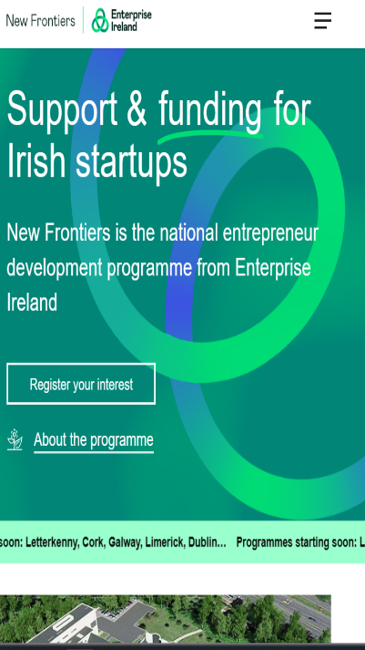
Explore the options available to you in your region…IRELAND
Grants and Schemes - Teagasc | Agriculture and Food Development Authority
gov.ie - Schemes and Payments (www.gov.ie)
Crowdfunding in Ireland - a short guide (thinkbusiness.ie)
Funding, grants and financial supports for entrepreneurs, companies and researchers - Enterprise Ireland (enterprise-ireland.com)
Food Supports - Local Enterprise Office
New Frontiers | The National Programme For Developing Entrepreneurs

Slide 79

Why & when you will need to PITCH…
Sometimes when you are seeking funding, you may have to present or PITCH your project idea to funders (banks or agencies) as you seek their financial support.
Do not let TV shows like Dragons Den/ Shark Tank put you off the idea of what the pitching process involves!
In the slides that follow, we will share some key insights on how you can create a near-perfect pitch.

Slide 80

What is a Pitch?
A pitch is typically a short and concise presentation that provides all relevant and realistic information on WHY the funders should financially back the project.
The best pitches are those that tell a story and are delivered with passion, knowledge of the subject matter and confidence. They create an emotional connection and draw people in to be vested/invested in the project.
Tap into your best storyteller mode and it will be key to your pitch success. People buy people!

Slide 81
PITCH PERFECT INGREDIENTS
Your solution/ project
Compelling story/need
Who supports you?
How it meets funding priorities
Evidence the project will succeed – what impact will it make
Use strong and/or compelling visuals. People only retain 10% of what they hear
Know your project costs…while maintaining a strong ethical focus
Provide a little background on your business development history and who is on board with this project
Choose your strongest presenter, regardless of their position.

Slide 82
Dealing with a NO… see it as a learning experience not failure!!
If the recipe isn’t right, and you don’t get the Grant, Crowd Fund, or Bank Loan - be sure to use these rejections as a learning experience!
Encountering a NO can be disheartening. But don’t let it get the better of you. Consider these steps to increase your chances of being reconsidered, improve your potential for obtaining financing in the future, and in general, relieve the stress of securing funding.
Reflect on your approach: be honest with yourself. Did you rush the application? Did you really meet the priorities, or did you not do yourself justice in writing about your project? Does your Business model have flaws?
Ask for feedback even if your rejection letter specifies a reason for your rejection, asking for verbal feedback will sometimes bring you a fuller and more open response.
Find out what did get funded: funders often publish lists of what they did fund. This can give you insight into types of projects, amounts of funding, stage of business, etc.

Slide 83

Having the right attitude …
I’ve missed more than 9,000 shots in my career. I’ve lost almost 300 games. 26 times I’ve been trusted to take the game winning shot and missed. I’ve failed over and over and over again in my life. And that is why I succeed!
Michael Jordan, US entrepreneur and former professional basketball player

Slide 84
05
The Legalities of Starting a New Business

Slide 85

Legal Requirements & Regulations
As discussed in our Ethical Entrepreneurship manual, starting a food business in Europe involves complying with various legal requirements and regulations. The specific regulations may vary slightly between countries, as some aspects are determined at the national or local level. Therefore, it is advisable to consult with local authorities or seek legal advice to ensure compliance with the specific requirements of the country where you intend to start your food business.

Slide 86

BUSINESS REGISTRATION
1
You will need to register your food business with the relevant authorities in the country where you plan to operate. This involves obtaining a business license/registration certificate.
PLANNING PERMISSION
2
This involves obtaining permission from the local planning authority to use a specific location for your business activities
FOOD SAFETY STANDARDS & REGULATIONS
3
EU countries have strict regulations regarding food safety, hygiene & composition. Food handling, processing, and storage practices must comply with the applicable regulations.

Slide 87
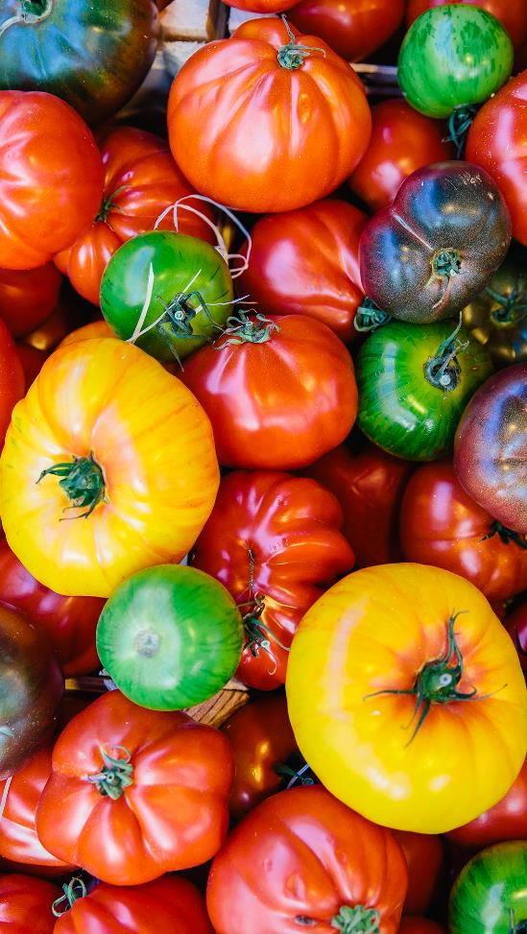
FOOD LABELLING
4
EU regulations require accurate & clear labelling of food products. Information about ingredients, allergens, nutritional values, and any special instructions or warnings must be given
PRODUCT LIABILITY
5
As the business owner you are responsible for the safety & quality of the food products you sell. It is essential to have appropriate product liability insurance coverage.
FOOD IMPORT/EXPORT REGULATIONS
6
If you plan to import/export food products, you will need to comply with customs & trade regulations. This includes obtaining the necessary permits, and certificates .

Slide 88

EMPLOYMENT AND LABOUR LAWS
7
You will need to comply with employment and labour laws, including hiring practices, wage regulations, working hour limits, and health and safety regulations for your employees
THE GENERAL DATA PROTECTION REGULATION (GDPR)
8
Data regulations are a critical aspect of starting a food. GDPR is the primary data protection law in the EU and governs the processing of personal data. You must ensure compliance.
ENVIRONMENTAL REGULATIONS
9
These regulations aim to protect the environment, promote sustainability, and ensure businesses operate in an environmentally responsible manner.

Slide 89

Environmental Considerations
Although the last legality for us to mention, environmental considerations are of particular importance to you if you plan to operate an ETHICAL & SUSTAINABLE Food Business as with this project & course, we aim to create a positive impact on the ‘Planet’ via your actions.
There are several considerations regarding environmental regulations that must be addressed as a Food Business owner, but we will briefly discuss the key ones here…

Slide 90
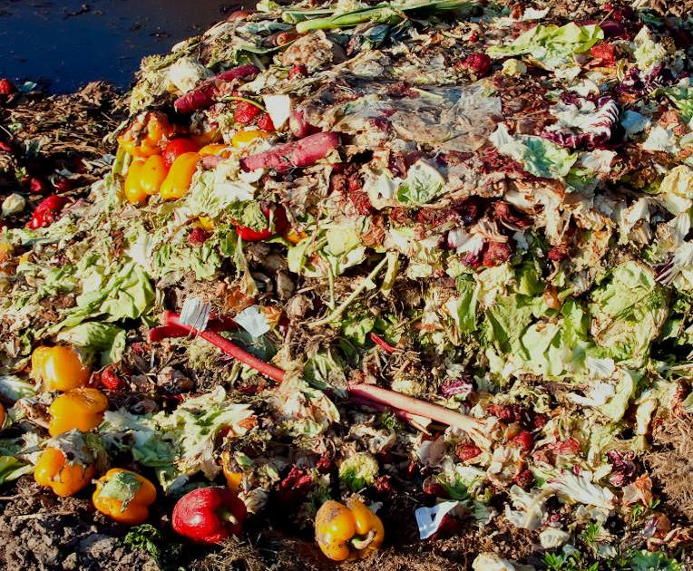
Waste Management:
Food businesses generate various types of waste, including packaging materials, food waste, and cooking oil.
European countries have regulations in place for waste management, which may include requirements for waste separation, recycling, and proper disposal.
You will need to establish waste management practices that comply with local regulations and ensure proper handling and disposal of waste.
Further Reading: Waste Framework Directive (europa.eu) &
EU actions against food waste (europa.eu)

Slide 91

Water Usage and Conservation:
Water is a valuable resource, and efficient water usage is encouraged.
Some European countries have specific regulations regarding water usage in food businesses, such as limits on water consumption, requirements for water-saving equipment, and guidelines for wastewater treatment.
Check what your local authority stipulates.
Further Reading: Water Framework Directive (europa.eu)

Slide 92

Energy Efficiency
European countries have set targets for energy efficiency and encourage businesses to adopt energy-saving or energy-creating practices.
You may be required to comply with energy efficiency standards, use energy-efficient equipment, and implement measures to reduce energy consumption in your food business.
How could your business create energy?

Slide 93

Chemical Usage and Hazardous Substances:
Food businesses often use cleaning agents, sanitisers, and other chemicals. It is essential to handle and store these substances safely and comply with regulations regarding their use. European Union regulations, such as REACH (Registration, Evaluation, Authorisation, and Restriction of Chemicals), control the use of hazardous substances in various industries, including food businesses.

Slide 94
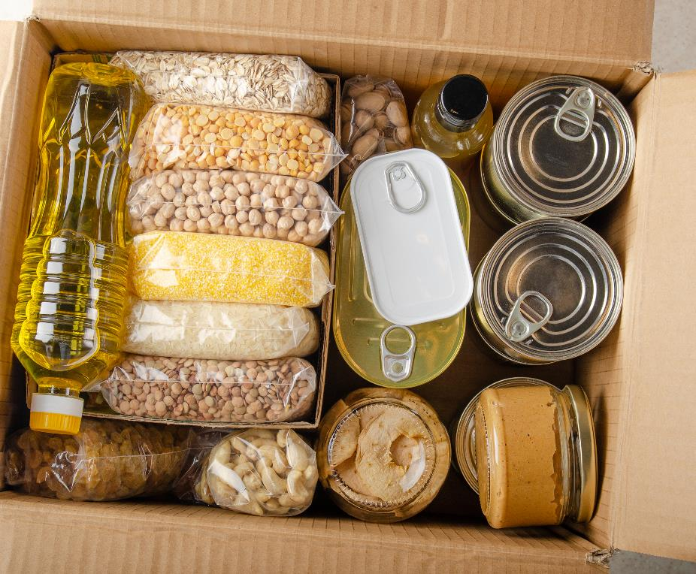
Packaging:
The European Union has been taking steps to reduce packaging waste, promote sustainable packaging, and promote a circular economy for packaging practices.
This includes requirements for packaging materials, recycling symbols, and restrictions on certain types of packaging, such as single-use plastics.
You should be aware of the specific packaging regulations in your country & strive to adopt sustainable packaging options.
Further Reading: EC proposes revisions to packaging and waste legislation | Food Packaging Forum

Slide 95

Pollution Control:
Food businesses must take measures to prevent or minimise pollution, such as air emissions, noise pollution, and odours.
Compliance with emission standards, noise level limits, and odour control measures may be required, depending on the nature and scale of your operations. It's important to consult with local environmental agencies or regulatory bodies to understand the specific pollution regulations that apply to your food business.

Slide 96

Environmental Permits and Reporting:
In conclusion, depending on the nature of your food business, you may need to obtain environmental permits or licenses. These permits may be required for activities such as wastewater discharge, air emissions, or the installation of specific equipment.
Additionally, you may be required to submit regular reports or undergo environmental audits to ensure compliance with environmental regulations, again check your local authorities for details.

Slide 97
06
The Importance of Sales and Marketing

Slide 98

Sales & Marketing…
While sales and marketing have distinct roles, they are closely intertwined and work collaboratively towards achieving the business's goals.
Marketing creates awareness, generates leads, and provides the necessary tools and materials to support the sales process.
Sales, on the other hand, utilises marketing materials, builds relationships with leads, and converts them into paying customers. While also generating feedback that can be useful for further marketing.

Slide 99

Sales & Marketing…
Effective sales and marketing strategies require alignment and coordination.
Both sales and marketing are essential for driving business growth, attracting and retaining customers, and achieving revenue targets.
They work together to create brand awareness, communicate value propositions, build customer relationships, drive sales conversions, and ultimately contribute to the success of the business. Over the next few slides, we will give some key reasons why sales and marketing are important for ethical food businesses

Slide 100

Promoting Ethical Values:
Sales & marketing provide an opportunity for ethical food businesses to communicate their values, mission, and commitment to sustainability, fair trade, animal welfare, organic practices, or other ethical considerations.
Through effective marketing campaigns, businesses can educate consumers & raise awareness about the positive impacts of ethical food choices, fostering a deeper connection and loyalty among conscious consumers.

Slide 101
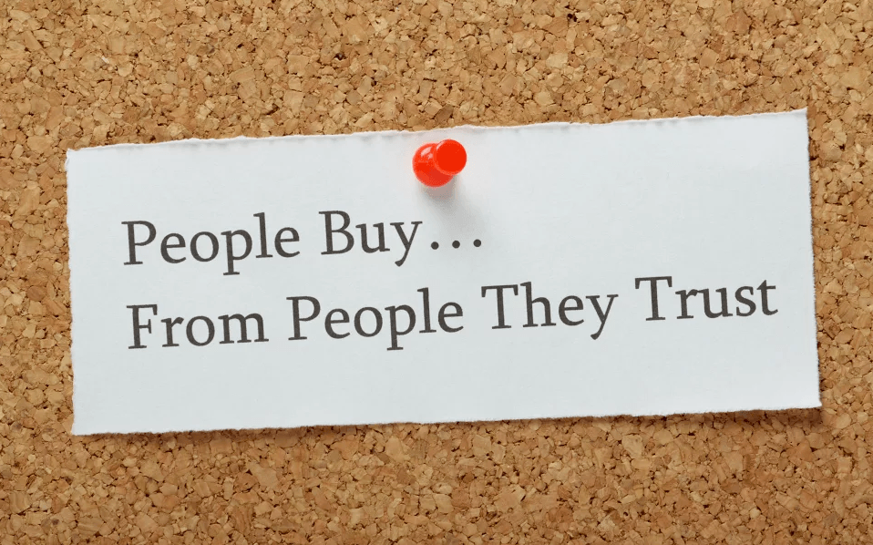
Building Trust & Reputation (& a Competitive edge):
USP – a Unique Selling Point
Ethical food businesses often differentiate themselves from competitors by their commitment to social and environmental responsibility using this as their USP.
Through marketing efforts, businesses can build trust and a positive reputation by transparently showcasing their ethical practices and partnerships. This instills confidence in consumers, leading to long-term customer relationships and positive word-of-mouth recommendations.
People Buy…from People they TRUST

Slide 102

Targeting Conscious Consumers:
Sales and marketing enable ethical food businesses to reach and engage with their target audience – conscious consumers who prioritise sustainability, health, and ethical considerations in their purchasing decisions.
By understanding the values and preferences of these consumers, businesses can tailor their marketing strategies to effectively reach and resonate with them, resulting in increased brand awareness, customer loyalty, and higher sales.
For More on Communication, Engagement & Storytelling go to MODULE 5

Slide 103

Well Done, you have just completed a long module…
please continue your journey of ethical learning.
In Module 3 we Explore the World of Innovation

