Slide 1
MODULE 3
Exploring the World of Innovation
Ethical Food Entrepreneurship (EFE) Programme

Slide 2
Exploring the World of Innovation
Innovation empowers food enterprises to address the changing needs and expectations of consumers, tackle industry and societal challenges, differentiate themselves in the market, and forge collaborative partnerships.
In this module, we want to help you to embrace innovation so that your ethical food enterprise can adapt, thrive, and seize new opportunities in the dynamic and evolving landscape of the food industry.
01
Opportunities in Innovation
02
Innovating for People-Planet-Profit
03
Models of Innovation
04
Starting your Innovation Journey
05
Creating a strategy for the future
06
Innovation & Functionality in Food Business

Slide 3
01
Opportunities in Innovation

Slide 4
Let’s start by recapping what Innovation is…
Innovation can be a confusing topic as there are so many different kinds of innovation. You often hear about innovation in terms of technology and although it’s true that technological innovation has been, and will likely continue to be, the most obvious form of innovation, it comes in other forms too.
Most innovations are smaller, gradual improvements on existing products, processes, and services, while some innovations can be those ground-breaking inventions or business models that transform industries.

Slide 5
The Innovation Matrix
One way to categorise innovation is to classify it based on two dimensions: the technology it uses and the market it operates in.
We can use the innovation matrix to visualise the four most common types of innovation:
Incremental
Disruptive
Sustaining
Radical
Sustaining
A significant improvement on a product that aims to sustain the position in an existing market.
Disruptive
Technology or new business model that disrupts the existing market
IMPACT ON THE MARKET
Incremental
Gradual, continuous improvements on existing products and services
Radical
Technological breakthrough that transforms industries, often creates a new market
LOW
HIGH
TECHNOLOGY NEWNESS

Slide 6
An Introduction to Innovation Categories & Types
In this video, the most common ways to categorise innovation are explained. While not food specific, it encourages us to look at innovation from different angles to better understand how innovation really works.
Viima is on a mission is to help organizations around the world make more innovation happen. Visit their YouTube channel on Viima - YouTube
Different Types of Innovation Explained - YouTube

Slide 7
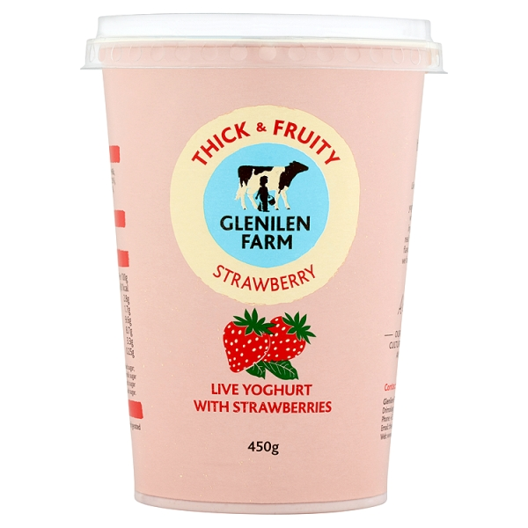
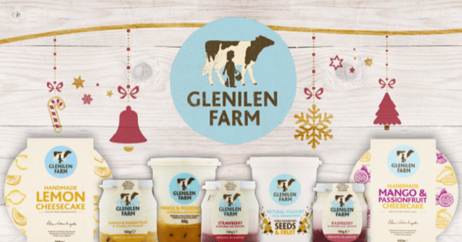
Glenilen Farm
1. Incremental Innovation
When people, especially the press, talk about innovation, they usually refer to disruptive, and often technology-based, kinds of innovations.
However, those are only a small part of the innovation puzzle. In fact, most of the innovation happening in companies across industries is much more mundane and incremental in nature.
Incremental innovation tends to be a big factor behind the most successful companies, even when their success might have originated from disruptive innovation.
Traditional values have prevailed from before the industrialisation of farming to inform the sustainability and environmental credentials of the business, illustrating that it is possible to achieve scale in business without sacrificing planet in pursuit of profit.
VISIT Glenilen Farm – Everyday Goodness

Slide 8
1. Incremental Innovation
In essence, incremental innovation is the process of making minor improvements to existing products, services, processes, methods, or even the food company itself. If a change creates value and has some element of novelty to it, it can be classified as incremental innovation.
Incremental innovations don’t require big leaps in technology and tend to harness their existing technology and business model, so they don’t usually have much impact on market dynamics.
They are typically much than other types of innovations, and there is less uncertainty involved, which makes them much more predictable, and thus safer for your business.

Slide 9
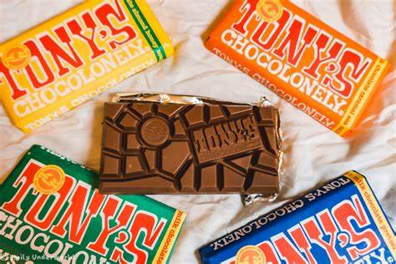
Tony’s Chocolonely
1. Incremental Innovation
Products can be made smaller, easier to use, have line extensions, or are more attractive without changing the core functionality of it. Services are often made more efficient via constant improvement.
Although incremental innovation does not create new markets and often does not use radically new technology, it can attract higher-paying customers as it fulfills the customer needs identified.
The product/service may also appeal to a larger, mainstream market if the same functionalities & value at a lower cost are provided.
In November 2005
the first Tony’s
Chocolonely
chocolate bars came on the market in the Netherlands: 5,000 milk chocolate bars in an alarming red package carrying the label “100% slave free.” By introducing unexpected flavour combinations, they altered the chocolate market in the Netherlands—to the extent that many other brands are copying their strategy and introducing their own exotic flavours. And not only in chocolate bars, but also in chocolate paste, peanut butter and cookies.
READ How To Bring Sustainability To The Masses: Tony’s Chocolonely’s Impact Strategy (forbes.com)

Slide 10
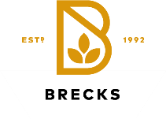
2. Disruptive Innovation
Disruptive innovation is a concept introduced by academic & business consultant Prof. Clayton Christensen first in an HBR article and later in his book called Innovator’s Dilemma.
Disruptive innovation is a theory that refers to a concept, product, or service that creates a new value network either by entering an existing market or creating a completely new market. In the beginning, disruptive innovations have lower performance when measured by traditional value metrics but have different aspects that are valued by a small market segment. These types of innovations are often capable of turning non-customers into customers but do not necessarily appeal to the needs and preferences of mainstream customers, at least not yet.
A PRIME EXAMPLE OF DISRUPTIVE INNOVATION in the food industry is the replacement of meat with plant-based proteins, creating animal-realistic meat-free products.
Startup companies such as Brecks Food (UK) and Impossible Foods (US) are often using food science and genetic sequencing technology to simulate plant protein-based equivalents to animal-derived products. The Impossible Burger, described by some as “the game-changer in the food industry, is made with soy leghemoglobin, a protein that carries heme, mimicking the taste of actual meat. The way research is making progress, it is expected that the plant meat foods will reach par (in blind testing) and may obviate the need for traditional intensive farm-raised animals, thus disrupting an entire industry.

Slide 11
Disruptive innovation is where traditional business methods fail and require new capabilities. Although the risks are big, there’s a huge growth potential if everything goes right
2. Disruptive Innovation
What makes disruptive innovation difficult, is that established companies are completely rational when making decisions related to their existing business. They then fail to adjust to the new competition because they’re too focused on optimising the existing offering or business model that has proven to be successful in the market so far.
Therefore, the market is generally disrupted by a new entrant rather than an incumbent.
Once the incumbents realise that new disruptive innovations are gone mainstream, it is often too late for them to catch up despite the extent of resources at their disposal.
Initially
Small Market
Lower Margins
Higher Risk
Huge Growth Potential
Initially
Large Market
High Margins
Lower Risk
Small Growth Potential
Disruptive
Innovation
Sustaining
Innovation

Slide 12
Playing Catch up:
The reason for this problem isn’t that the incumbents fail to develop disruptive technologies. Instead, the problem occurs when incumbents attempt to apply new technologies to their existing value networks or reject moving into new markets because they are seen as too small to drive growth goals or are simply perceived to have too low margins. Source
If you want to make innovation happen in an established SME, the best way to do so is to treat your innovation project as a separate unit.

Slide 13
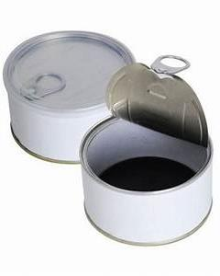
3. Sustaining Innovation
An example of Sustaining innovation would be the introduction of the ring pull on food cans. This eliminated the need for a can-opener, but the product remained the same…it just became easier to open/ use and then meets consumer needs more effectively…this is where the value lies.
Sustaining innovation is the opposite of disruptive innovation as it exists in the current market and instead of creating new value networks, it improves and grows the existing ones by satisfying the needs of a customer.
Just like incremental innovation, the product performance of sustaining innovation is made slightly better with every iteration, reducing defects. The new improved version of the product can be more expensive and have higher margins than the previous one if it targets more demanding, high-end customers with better performance than what was previously available.
However, it might as well be cheaper if it leads to higher volumes and thus higher absolute profits.

Slide 14
3. Sustaining Innovation
Traditional business methods and sustainable innovations are often sufficient because they are the most profitable, and the risks are lower.
Disruptions, on the other hand, typically enable top-line growth: large market share growth or the creation of an entirely new market but aren’t typically profitable for a long time because they require heavy initial investment for growth.
Sustaining innovations, in turn, continue to grow the market slowly, but no longer in the same proportion. At this point, the focus shifts to increasing profits.

Slide 15
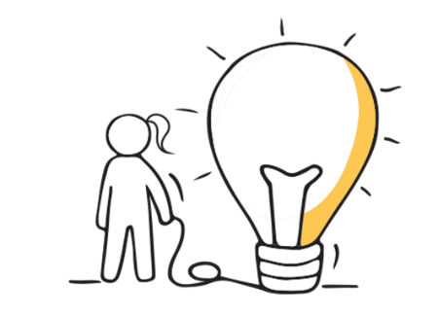
Some sustaining innovations are the incremental year-by-year improvements that all good companies grind out. Other sustaining innovations are breakthrough, leapfrog-beyond-the-competition products. It doesn’t matter how technologically difficult the innovation is, however: The established competitors almost always win the battles of sustaining technology.
Because this strategy entails making a better product that they can sell for higher profit margins to their best customers, the established competitors have powerful motivations to fight sustaining battles. And they have the resources to win.
– Clayton Christensen

Slide 16
4. Radical Innovation
3D PRINTING OF FOOD
Israeli startup Redefine Meat Redefine Meat - New Meat, No Compromise is experimenting with 3D-printed steak. The printing process is designed to mimic the texture and taste of real meat.
Read more Redefine Meat strikes partnership to boost 3D-printed meat sales in Europe | Reuters
Radical innovation is rare as it has similar characteristics to disruptive innovation but is different in the way that it simultaneously uses revolutionary technology and a new business model.
Radical innovation solves global problems and addresses needs in completely new ways than what we’re used to and even provides solutions to needs and problems we didn’t know existed, completely transforming the market or even the entire economy.
Although radical innovations are rare, there have been more and more of them in the recent past.

Slide 17
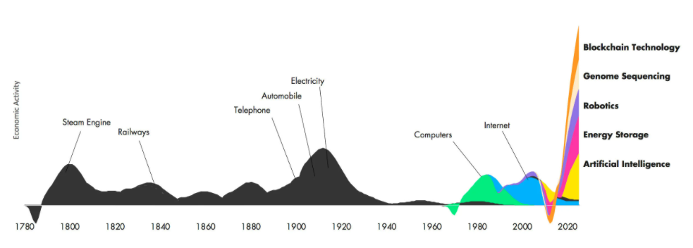
4. Radical Innovation
Wave of Radical Innovations
Currently, there’s a new, even bigger wave of radical innovations that are considered to be on the verge of becoming mainstream. These are robotics, artificial intelligence (AI), blockchain technology, energy storage and genome sequencing.
As radical innovation is so different from what people are used to, it does usually face significant resistance at first. These types of innovation typically require a lot of time and technological development before they’re ready for mainstream markets.
However, when executed successfully, it often means the beginning of a new era that affects many sectors and geographies.
Blockchain
Technology
Economic Activity
Electricity
Genome Sequencing
Automobile
Telephone
Robotics
Steam Engine
Railway
Internet
Computers
Energy Storage
Artificial Intelligence
Year (in 20-year increments)
Source: ARK Invest

Slide 18
Innovation can offer numerous opportunities for food businesses, including:
New Product Development
Differentiation from Competitors
Improved Efficiency & Productivity
Increased Revenue & Market-share
Innovation can enable food businesses to create new products that meet changing consumer demands, e.g., healthier or more sustainable options.
By innovating & offering unique products, food businesses can stand put and create a competitive advantage.
Innovation can help food businesses streamline their operations & reduce costs, leading to increased efficiency & productivity.
By developing innovative products and solutions, food businesses can increase revenue & capture a larger share of the market.

Slide 19
Innovation can offer numerous opportunities for food businesses, including:
Improved Sustainability
Improved Safety and Quality
Enhanced Customer Experience
Innovation can also help food businesses to become more sustainable by reducing waste, conserving resources & minimising their environmental footprint.
Innovation can help food businesses to improve the safety & quality of their products through the development of new technologies and processes.
By leveraging innovation, businesses can improve the customer experience, via new products, services, or technologies that enhance convenience, speed, or personalisation.

Slide 20
02
Innovating for People-Planet-Profit

Slide 21
From an Ethical Food Innovation perspective… opportunities can be created by:
2
3
4
5
1
Developing new ETHICAL food Products
Creating new DISTRIBUTION channels
Improving supply chain TRANSPARENCY
Promoting SUSTAINABLE AGRICULTURE
Creating new BUSINESS MODELS

Slide 22
1. Developing new ETHICAL food Products
Ethical food enterprises can innovate by creating new products that are more sustainable, healthier, and safer for consumers.
For example, they can develop plant-based or organic products that promote animal welfare, reduce environmental impact, and promote fair trade.
Innocent Drinks is a UK-based company that produces smoothies, juices, and plant-based milks using sustainably sourced ingredients and ethical production methods.

Slide 23
2. Creating new DISTRIBUTION channels
Ethical food enterprises can innovate by creating new distribution channels that enable them to reach consumers more effectively.
For example, they can use online platforms, social media, or mobile applications to market their products directly to consumers, cutting out middlemen and reducing costs.
Clean Cut Meals is an Irish healthly food, producer that mainly operates via direct online sales to their consumers.

Slide 24
3. Improving supply chain TRANSPARENCY
Ethical food enterprises can innovate by using new technologies to improve transparency and traceability in their supply chains.
For example, they can use QR Codes or blockchain technology to track the origin of their ingredients, monitor their production processes, and ensure compliance with ethical standards.
The company Provenance via blockchain empowers brands, retailers & consumers to choose products that match their values
Their aim is that one day every great product will come with Provenance: accessible, trustworthy information about its impact.

Slide 25
4. Promoting SUSTAINABLE AGRICULTURE
Ethical food enterprises can innovate by promoting sustainable agricultural practices that reduce environmental impact, conserve natural resources, and support local communities.
For example, they can develop regenerative farming practices that enhance soil health, biodiversity, and ecosystem services.
Glenilen Farm is an Irish company that produces organic dairy products. They work with local farmers and promote sustainable agriculture practices, such as organic farming, protecting animal welfare, promoting biodiversity and reducing chemical inputs.

Slide 26
5. Creating new BUSINESS MODELS
Ethical food enterprises can innovate by creating new business models that align with their ethical values and social mission or those of their customers.
For example, they can use cooperative ownership models, community-supported agriculture, or impact investment to create a more equitable and sustainable food system.
Montado Freixo do Meio is a Portuguese farm and social enterprise that promotes regenerative agriculture, sustainable farming practices, and rural development. They operate a diversified farm that produces organic food, offers educational programs, and promotes community-supported agriculture (CSA) models to connect consumers directly with farmers

Slide 27
By LEVERAGING INNOVATION in these and other ways, ethical food enterprises can create new opportunities for growth, social impact, and environmental sustainability, while also responding to the evolving needs and expectations of consumers and stakeholders.

Slide 28
The Potential Social Impact of Food Enterprises…
PEOPLE
You as an entrepreneur could also innovate by integrating social impact initiatives into your food business. This could involve creating employment opportunities for marginalised communities, supporting fair labour practices, promoting gender equity, promoting diversity and inclusivity in the workplace, and supporting community development.
This would contribute to the "People" aspect of People-Planet-Profit by addressing social issues and promoting social well-being.

Slide 29
The Potential Social Impact of Food Enterprises…
PEOPLE
You could also innovate by engaging consumers in your sustainability efforts. This could involve educating consumers about the social and environmental impacts of their food choices, encouraging sustainable consumption patterns, promoting responsible packaging and waste management, and involving consumers in co-creation or feedback processes for developing more sustainable food products or services.
This would also contribute to the "People" aspect of People-Planet-Profit by empowering consumers to make informed choices and be active participants in sustainability initiatives.

Slide 30
The Potential Environmental Impact of Food Enterprises…
PLANET
Sustainable Sourcing: As an ethical entrepreneur, you could innovate by incorporating sustainable sourcing practices in your food business.
This could involve sourcing organic, locally-produced, and fair-trade ingredients, supporting regenerative agriculture practices, promoting biodiversity, and protecting natural resources.
This would contribute to the "Planet" aspect of People-Planet-Profit by reducing environmental impact and supporting sustainable food systems.

Slide 31
The Potential Economic Impact of Food Enterprises…
PROFIT
Again, as an entrepreneur, you could innovate by adopting circular economy principles in your food business. This could involve reducing food waste through innovative packaging, leaner practices or processing, and distribution methods, implementing recycling and composting programmes, promoting upcycling or repurposing of food by-products, and optimising resource use throughout the supply chain.
This would contribute to the "Profit" aspect of People-Planet-Profit by reducing costs, improving operational efficiency, and creating value from waste or by-products…while simultaneously having a good effect on the PLANET.

Slide 32
03
Models of Innovation

Slide 33
Business Innovation
Business innovation is a top priority for entrepreneurs.
But why does a business need an Innovation model?
What’s the role of the innovation model?
Innovation is generally part of a successful business strategy. Often innovators fail when they follow the wrong model for the implementation of innovation.
An Innovation model provides a detailed framework to identify, advance, and implement ideas. Thus, focusing on adopting methods to create the needed value.

Slide 34
Models of Innovation
Models of innovation refer to frameworks or theories that describe how innovation happens and how it can be managed or stimulated while types of innovation provide a classification system for different types of innovative activity.
Some examples of models of innovation include:
the linear model of innovation,
the user-centered innovation model,
the open innovation model,
the network model.

Slide 35
Linear model:
This model, also known as the "technology-push" model, suggests that innovation is a linear process that begins with scientific research and development, followed by engineering, manufacturing, marketing, and finally, sales.
This model with a complete emphasis on R&D has the disadvantage of not considering customer feedback and expectations. Thus, these innovations would often get ignored in the market.
Linear Model – Technology Push
Develop -ment
Manu-
facturing
Research
Sales

Slide 36
User-centered innovation model
This model, also known as the "demand-pull" model, suggests that innovation is driven by user needs and demands. In this model, companies seek to understand their customers' needs and preferences and develop products and services that meet those needs. For a long time, those ‘needs’ have led to an unsustainable world & consequently many global challenges but now the consumer is changing mindset and they are now concerned with sustainability
Human
Business
Technology
Innovation

Slide 37
Open Innovation Model
This model also known as the network model, suggests that innovation is not limited to a company's internal research and development activities but can also be achieved through collaborations with external partners, including customers, suppliers, and even competitors.
Open innovation has the potential to widen the space for value creation, be it through new partners with complementary skills or by unlocking hidden potential in long-lasting relationships.
Internal Technology Base
External Technology Base
Firm Current Market
Other Firm Markets
External Technology Insourcing
Firm Current Market
Firm Current Market
Internal/External Venture Handling

Slide 38
Flexibility and Variation
It's worth noting that many food companies may adopt elements of multiple models of innovation and that innovation processes can vary widely even within the same company depending on the specific product or project being developed.

Slide 39
04
Starting your Innovation Journey

Slide 40
Doblin’s Ten Types of Innovation
As mentioned already, when we hear people talk about innovation, we often hear it being used as a synonym for new products, or perhaps new features in existing products. This is quite a narrow view of innovation & is one of the root causes of mistakes by inexperienced innovators.
Getting past the implications caused by this can often be challenging, especially in larger SMEs where everyone is not familiar with innovation.
These challenges, however, are not exactly a new thing. Innovation consultancy Doblin realised this back in the ‘90s and developed the ‘Ten Types of Innovation Framework’ to help solve the problem. It’s a simple, elegant, and practical tool from which every innovator can benefit! After extensive research, Doblin discovered that all innovations are actually comprised of the same 10 basic elements.

Slide 41
Doblin’s Ten Types of Innovation Framework
Profit Model
The way in which you make money
Process
Signature or superior methods for doing your work
Product System
Complementary products and services
Channel
How your offerings are delivered to customers and users
Customer Engagement
Distinctive interactions you foster
Profit
Model
Network
Structure
Process
Product Perfor-
mance
Product
System
Service
Channel
Brand
Customer
Engage-
ment
Configuration
Offering
Experience
Profit Model
The way in which you make money
Structure
Alignment of your talent and assets
Product Performance
Distinguishing features and functionality
Service
Support enhancements that surround your offerings
Brand
Representation of your offerings and business

Slide 42
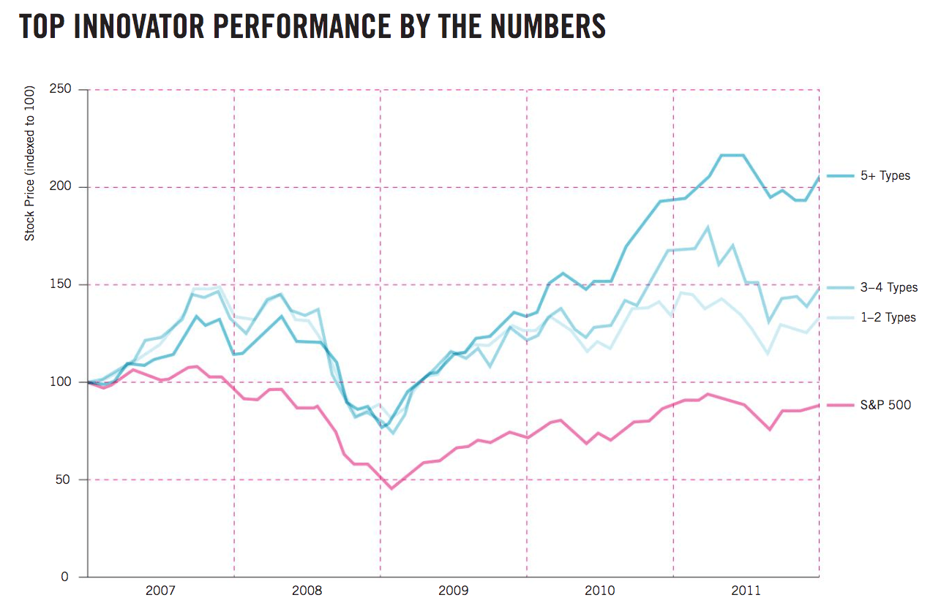
Doblin’s Framework explained
The ten elements are further grouped into three main areas:
Configuration essentially covers the internal workings of the organisation and its business model etc.
Offering covers the key aspects of the products and/or services the organization offers.
Finally, the outward-facing elements of the business, or in other words, the whole customer experience.
Doblin highlighted that based on their research, the more types of innovation an organisation used the better their performance was.
5+ Types
3-4 Types
Stock price (indexed to 100)
1 -2 Types
S&P 500
Source: Ten Types of Innovation: The Discipline of Building Breakthroughs, 2013, Wiley

Slide 43
Using the Framework
The framework is a very versatile and practical tool that in addition to designing new innovations, it can be used to:
Determine how innovative your business and its services and products actually are.
Try to understand a market and identify opportunities for innovation within it.
Assess your offerings, or market on each of the ten elements, and identify things done well, and where there is room for improvement and innovation.

Slide 44
Getting started in Innovation…
Whether you’re just getting started with innovation, have already gained some successful experience from it, or are a battle-scarred veteran innovator, you can still try to find new growth opportunities in your ethical food SME, no matter your current level. Your approach to innovation depends mainly on your unique capabilities and strategic goals. Ultimately, managing innovation is no different from managing any other major change, and more or less the same principles apply.
Although it's important to move fast, don't bite off more than you can chew. To avoid unnecessary havoc, you want to use the framework to analyse your business and then:
Break down your strategic goals into smaller, easily implemented pieces
Commit to the process

Slide 45
The Ethical Question to ask…
What is the problem??
A Problem = An Opportunity
A BIG Problem = A BIG Opportunity
Design thinking helps us to find the SOLUTIONS!

Slide 46
Design thinking is a human-centered approach to innovation that draws from the designer’s toolkit to integrate the needs of people, the possibilities of technology, and the requirements for business success
- Tim Brown executive chair IDEO

Slide 47
Human Centric Problem Solving
Design Thinking is a 5-step process to create meaningful ideas that solve real problems for a particular group of people.
The process has brought many businesses lots of happy customers and helped entrepreneurs from all around the world, to solve problems with innovative new solutions.
The Design Thinking Process - YouTube

Slide 48
The 5 Stages in the Design Thinking Process
Empathise
Ideate
Define
Prototype
Test

Slide 49
Food Design Thinking is the process that triggers creativity and leads to innovative, meaningful, and sustainable propositions for new dishes, food products, food events, food services, food systems, and anything in between.
FRANCESCA
ZAMPOLLO

Slide 50
Stage 1: Empathising
The purpose of stage one is to step into the user’s shoes so that you gain a better understanding or an improved idea about what people really care about. We need to develop their story and learn about the problem and those that are experiencing it.
For example, if you want to help consumers to use more sustainable food systems, you might find that they want shorter supply chains or information on food origin. In your conversations, they might share the different ways they would like to do that. Later in the interview, you'll want to dig a little deeper, and look for personal stories or situations where things became challenging. Ideally, you redo the process with many people with the same problem or needs
Building Understanding or Empathy

Slide 51
Empathise - Observing customer behaviour in their natural environment
We shouldn’t draw conclusions at this stage
Goals:
Expand knowledge about the user and their problems
Obtain knowledge about the background of the problem, the place of use of the product, and the operating environment
Develop a common understanding of the challenge
Develop specialist knowledge about the project
Examples of Tools for the empathy stage:
Surveys
Target group observation
Interviews
Listening to the end user
Shadowing
Body-storming
Role Playing

Slide 52
Empathy as a tool
This short video defines what empathy is and highlights the importance of empathy and total immersion in the issue or to your end user, in order to solve their problems and therefore you are staying connected to your mission.
Empathy - YouTube

Slide 53
Stage 2: Define the Problem
The Define stage can often be the longest stage but it is worth not rushing, so as to develop a better understanding of the actual needs of people via certain activities like empathy mapping or underlining the verbs or activities that the people mentioned when talking about their problems: like finding local seasonal produce or healthy options, or having information on the food origin and it’s carbon footprint.
You might realise it's not always about the food, but more about the tasks surrounding it. After your analysis, formulate a problem statement to suit this cohort.
Identify specific
issues & needs
that the user has

Slide 54
Define the Problem – Assessing the actual needs and formulating the problem statement
We need to identify the real problems & needs
Goals:
The goal here is to understand more about the problem and those who experience/are impacted by it. (your Target Group)
Then gather what you have learned, the insights you have gained and start to articulate the potential user’s real needs/wants.
Develop the Problem Statement
Examples of Tools for the Define stage:
Empathy mapping
Creating Personas
Storytelling
Customer path mapping
Lean Canvas
Apps e.g, Trello, Asana, Evernote, OneNote

Slide 55
Problem Exploration
Breaking Down the Problem
2
3
4
5
1
REVIEW
IDENTIFY
ASK ‘WHY?’
LIST
CREATE
YOUR SELECTED PROBLEM
ALL THE CAUSES OF YOUR PROBLEM
FOR EACH OF THE CAUSES TO FIND ANY THEMES OR SUB-THEMES
THE IMPACTS OF THE PROBLEM
POSSIBLE PROBLEM STATEMENTS

Slide 56
Other Questions:
Who is impacted by this problem?
Who cares about this problem?
Which of these will be YOUR target group?
Is there already an idea?
Is there already a solution?
Who has these?
How can you do better?

Slide 57
Empathy Maps
This is a short video with an overview of the Customer Empathy Map. This is a useful tool that can be used to help businesses better understand their customers and help them discover and define the real problem that the customer is experiencing
Understanding Customers - An Introduction to Customer Empathy Mapping - YouTube

Slide 58
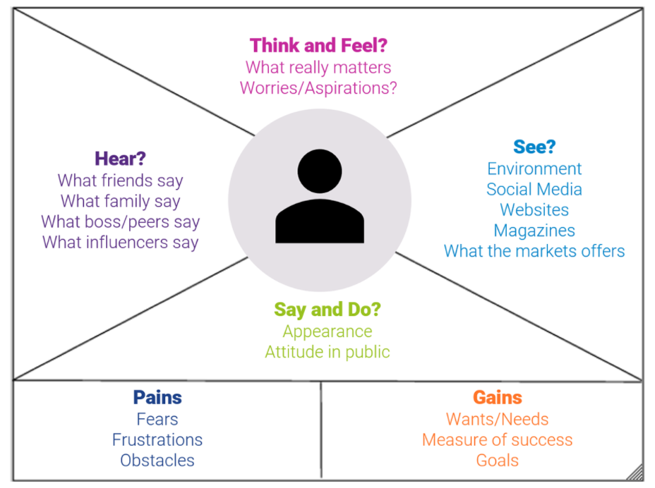
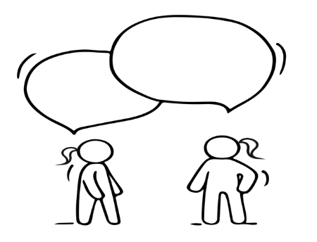
Understanding Customers – through Empathy Maps
Think And Feel?
What really matters
Worries / Aspirations!
Name:
Age:
Status:
See?
Environment
Social Media/ friends
Websites
Magazines
Marketing
Hear?
What friends say
What family say
What boss/ peers say
What influencers say
Say and Do?
Appearance
Attitude in public
Pains
Fears
Frustrations
Obstacles
Gains
Wants / Needs
Measure of Success
Goals

Slide 59
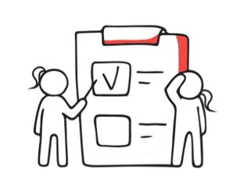
Student Exercise:
Start thinking about your Target or potential customer…
Grab a sheet of paper or work on Mural and start your own EMPATHY MAP
Note :
How do they think and feel?
What do they see / observe regularly?
What do they hear and from whom…who influences them?
How do they behave…what do they say and do?
Once you have created a picture of your customer you should now be able to identify some of their pains and gains

Slide 60
Stage 3: Ideate
Now focus only on the problem statement and come up with ideas that solve the problem. The point is not to get a perfect idea, but rather to come up with as many ideas as possible: like unique virtual reality experiences, zero-cook healthy options, zero-waste foods, ways to offer information. Whatever it is, sketch up your best ideas and show them to the people you are trying to help, so you get their feedback.
Brainstorm and
come up with creative
solutions

Slide 61
Ideate solutions – Brainstorm and come up with creative solutions
This phase should limit criticism
Quantity is what counts, not quality
There are no silly or wrong ideas!
Goals:
Generate and collect as many ideas as possible in a collaborative manner
Analyse ideas and choose most appropriate
Form real concepts
Obtain the optimal solution
Examples of Tools for the Ideate stage:
Brainstorming
Braindumping
Brain writing
Brainwalking
6 Thinking hats method
SWOT / PEST analysis
Sketching

Slide 62
How to Ideate
This video is a brief outline of what is involved in the Ideate stage of the Design Thinking process. Quantity is more important than quality initially. Then you can converge again and select the most suitable solution to the problem to bring to the prototype stage.
Design Thinking Step 3: Ideate - YouTube

Slide 63
Stage 4: Prototype
Next take a moment to reflect on what you have learned from your conversations with your ‘users’, about the different ideas. Ask yourself, how does your idea fit in the context of people's actual lives? Your solution could be a combination of a new idea and what is already being used. Then connect the dots, sketch up your final solution and go build a real prototype that's just good enough to be tested.
Build a representation for
one or more of these ideas, to show others

Slide 64
Prototype – Checking solutions in practice
Goals:
Creating a food prototype, defined as a three-dimensional manifestation of your food product or concept, is an essential early step in new food, beverage, and nutraceutical product development…we need to:
Build simple representations as visual object(s) to demonstrate the effect of innovation
Not to overcomplicate the prototype
Fail fast / iterate quickly
To create as quickly as possible
Time to choose the best ideas!
Narrow the created solutions to a maximum of several variants
Examples of Tools for the Prototype stage:
Mock-ups
Tasters/ Batch testing
Storyboards
Figma
Adobe XD
In Vision
Froghop food prototyping

Slide 65
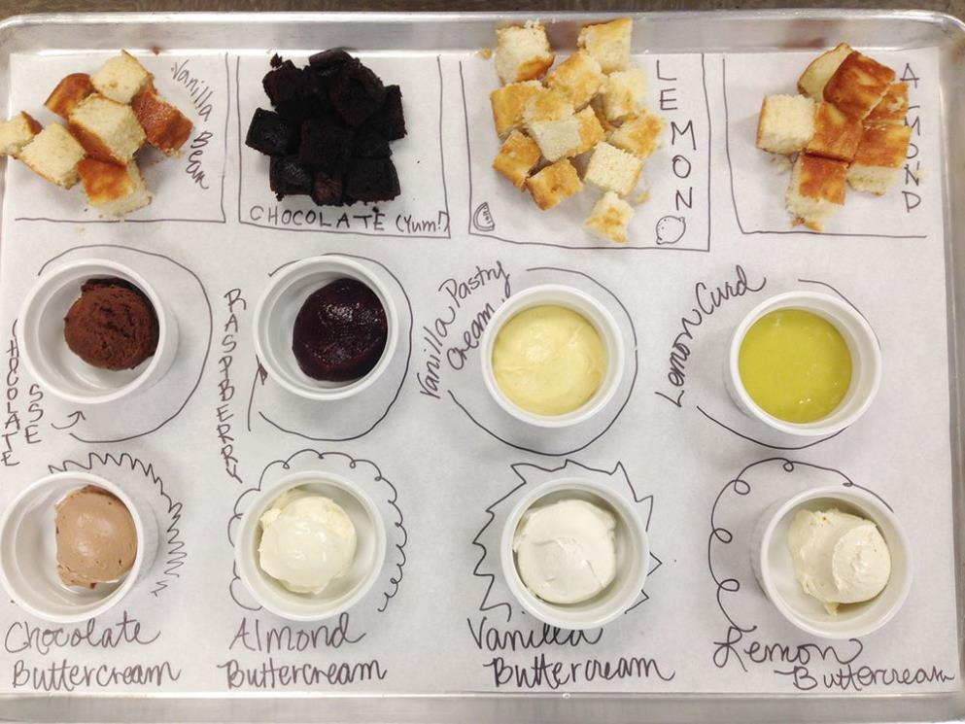
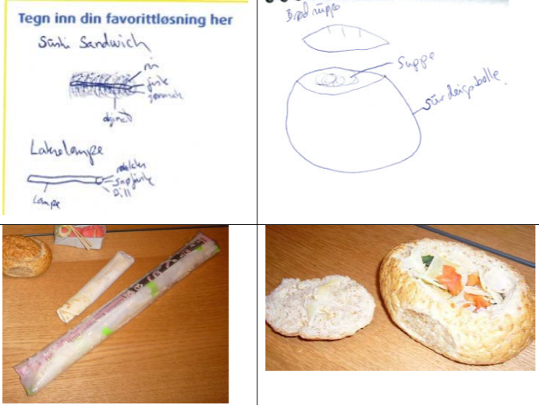
Examples of simple visualisation and prototyping…

Slide 66
Why use the prototype stage?
This video is a brief outline of why prototyping is used during the design thinking process and how it saves time and money in the long run and helps us refine our product or service and understand the problem or challenge even better.
Design Thinking Step 4: Prototype - YouTube

Slide 67
Stage 5: Test
Then test your prototype with the actual end users. Don't defend your idea in case people don't like it, the point is to learn what works and what doesn't, so any feedback is great. Then go back to ideation or prototyping and apply your learning. Repeat the process until you have a prototype that works and solves the real problem.
Now you are ready to change the world or fill the massive gap in the Sustainable & ethical Market Market.
Return to the people
experiencing the problem and test your ideas to receive feedback

Slide 68
Test – The opportunity to test prototypes in real conditions
Goals:
Understand what works and what are impediments
Test in a neutral environment or that most similar to typical user location
Observe spontaneous and authentic reactions from users
Getting feedback from users about the prototype to make decisions about the next steps
The Design team needs to take a back seat for this stage and just observe interaction with the prototype.
Things to consider for the Test stage:
Just observe don’t comment or defend your product
It is ok to fail you are still on a journey of discovery
The design thinking process is an iterative process. To adapt the prototype properly to the needs of its future users and really refine it, the last three phases should be repeated

Slide 69
The Testing Stage
This video is a brief outline of what is involved in the Test stage of the Design Thinking process. It explains why testing is important and how it helps us refine our product or service and understand the problem or challenge even better.
Design Thinking Step 5: Test - YouTube

Slide 70
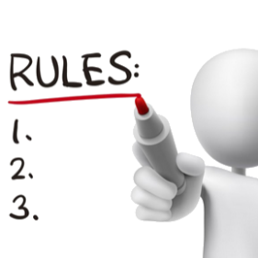
Summary of the Rules of DESIGN THINKING…
1. The Human Rule: All Design Activity Is Ultimately Social in Nature
Implementing solutions should strive to meet human needs.
2. The Ambiguity Rule: Design Thinkers Must Preserve Ambiguity
Moving away from restrictions and creating conditions for experimenting on the border of knowledge and imagination. Look for solutions that seem to be inappropriate
3. The Re-design Rule: All Design Is Re-design
Designing future technical and social conditions, based on historical solutions, in order to best analyze and solve the problem
4. The Tangibility Rule: Making Ideas Tangible Always Facilitates Communication
Making ideas reality by visualizing and prototyping improves communication among project team members
Source: H. Plattner,C. Meinel, L. Leifer, Design Thinking: Understand - Improve - Apply

Slide 71
Advantages of the
Design Thinking Process
Frequent contact with potential clients/users
Extremely high customer focus
Eliminating incorrect assumptions by monitoring the process
Implementation of the basic functions
Savings thanks to frequent user reviews
Cost savings due to the omission of some components

Slide 72
05
Creating an Innovation Strategy for the Future

Slide 73
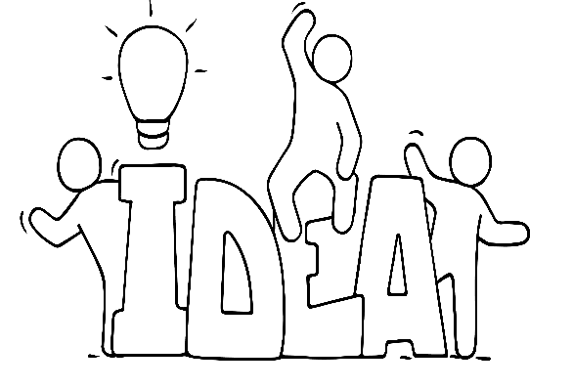
An Innovation Strategy
The Strategy Choice Cascade demonstrates the ever-evolving nature of innovation & business…see the next slide to learn more
Creating an innovation strategy for the future requires a balance between long-term vision and flexibility to respond to changing market dynamics. By following some steps and fostering a culture of innovation, you can position your food business to thrive in an ever-evolving business landscape.

Slide 74
The Strategy Choice Cascade
What is our
winning
inspiration?
Where will
we play?
How will
we win?
What
capabilities
must be in place?
What
management
systems are
required?
The
Purpose
The right
playing field
The unique
way to win
The set of
capabilities
The support
systems
What is our
guiding aspiration?
Geographies,
product categories,
segments, channels
Value proposition,
competitive
advantage
Reinforcing
activities
specific
configuration
Systems,
infrastructure,
measures to
support
our choices

Slide 75
Some steps to consider when Developing your Innovation Strategy…
1. Define your long-term vision & goals
2. Assess the Current Business Landscape
3. Foster a Culture of Innovation
4. Engage with your key stakeholders (see module 5)
5. Prioritise areas for Innovation that align with your vision
6. Establish Innovation Processes and Structures
7. Allocate appropriate resources (financial, human, and technological)
8. Monitor and Evaluate Progress
9. Embrace Agility and Iteration

Slide 76
Be Inspired…How Challenges can become OPPORTUNITIES
As mentioned already a challenge or a problem can also be seen as an opportunity!!
In our Good Practice Compendium, we examine 20 examples of SMEs innovating food and services in ethical and responsible ways across Europe. From this, you can be inspired by efforts already being made to fill the gap or challenges within the market!!

Slide 77
Learner Exercise- Turning the challenges into opportunities!
Now that you are aware of the challenge, can you and your team envisage which challenge may be the opportunity waiting for you to find a solution to?
Will it be a new ethical food product?
An adapted ethical food product?
Will it be a more sustainable service?
Will it be a combination of the two?
ATTEMPT TO ANSWER THESE 4 QUESTIONS…

Slide 78
Preparing for Failure
Failure is a really powerful tool for learning. Experimenting with foods or ideas to create prototypes and then interacting with them and testing them is the core of innovation. You have to understand that not all of your attempts will or can work. Especially as we attempt to solve big problems (like food waste or improved food systems) we are bound to fail. However, if we are prepared for this failure and adopt the correct mindset we will inevitably learn something from that failure.
Fail Early to Succeed Sooner!!!
IDEO team mantra

Slide 79
Don’t think of it as failure, think of it as designing experiments through which you’re going to learn.
- Tim Brown executive chair, IDEO

Slide 80
The benefit of Failure…
Ultimately, failure can serve as a catalyst for growth and improvement. Entrepreneurs who embrace failure as a learning opportunity, reflect on their experiences, and apply the lessons learned are better equipped to navigate future challenges, make informed decisions, and increase their chances of success. For example, failure can:
Build your resilience and ability to bounce back and persevere through challenges
You can learn to adapt and be flexible in the face of adversity
Provide an opportunity to reflect and identify weaknesses or shortcomings in business models, processes, or skills
Reveal valuable insights about customer preferences, needs, or pain points
Help you to assess and mitigate risk more effectively and to have continency plans
highlight the significance of networking and collaboration. You can learn to seek support, advice, and mentorship from others in the industry

Slide 81
I have not failed. I have just found 10,000 ways that won’t work
Thomas Edison

Slide 82
06
Innovation & Functionality in Food Business

Slide 83
Bringing Innovation and Functionality together…
Bringing innovation and functionality together can lead to significant benefits.
It will allow you as an ethical food business to create sustainable solutions that align with your values while meeting consumer demands.
By continuously seeking new ways to improve and optimise processes, products, and customer experiences, your business can position itself as a leader in the sector, attract conscious consumers & contribute to a more sustainable future.

Slide 84
Sustainable Solutions or Product Development :
In the sections above, we discussed the power of innovation and we briefly mentioned how it can drive the development of sustainable and ethical food products. By combining functionality with sustainability, you could offer products that not only meet consumer demands but also have a lower environmental impact …This can include creating plant-based alternatives, reducing food waste through innovative packaging or preservation methods, or utilising alternative supply sources.

Slide 85
Alternative Sourcing and Production Methods
Innovation can enable you & your food business to explore alternative sourcing and/or production methods that prioritise sustainability. This can involve sourcing from those that are aligned with your values, (e.g. produce using vertical farming techniques, hydroponics, or aquaponics systems to reduce water usage, or regenerative agriculture practices).
By integrating innovative methods into production processes, one can enhance efficiency, reduce resource consumption & minimise their ecological footprint.

Slide 86
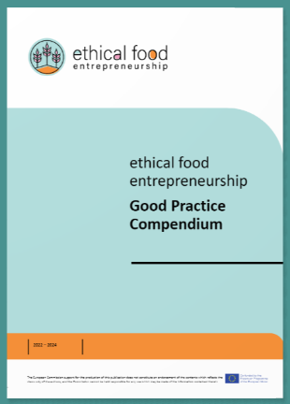
Be Inspired…
Check out our Good Practice Compendium
Loam was chosen as a good practice example that demonstrates ethical food supply or food sourcing. Here they only use Irish ingredients and limit their number of suppliers to 8 creating mutually beneficial collaborations. Owner, Enda also innovatively also uses the restaurant space to house grow boxes where they grow their own herbs and flowers avoiding the need to import them.

Slide 87
Packaging Innovations:
Functionality & innovation can converge in the area of packaging. You & your Ethical food business can explore innovative packaging solutions that prioritise sustainability, such as biodegradable or compostable materials, recyclable packaging, or packaging designs that minimise waste.
Functional packaging that enhances convenience, portion control, or extends product shelf life can also enhance the customer experience while aligning with ethical values.
We will discuss Packaging in more detail in Module 4

Slide 88
Technology and Digital Solutions:
AN INTERESTING READ: 17 ways technology could change the world by 2027 | World Economic Forum (weforum.org)
Leveraging technology can lead to innovative solutions. This can include the use of blockchain technology for supply chain transparency and traceability, implementing IoT (Internet of Things) devices to monitor and optimise energy consumption or reduce food waste, or utilising data analytics to make informed decisions regarding sourcing, production, and distribution. These technological advancements can enhance efficiency, reduce environmental impact, and improve overall operations.

Slide 89
Customer Engagement and Experience:
Innovation can be applied to enhance the customer experience in your food business. This can include developing user-friendly mobile apps or online platforms that provide information about product origins, certifications, and ethical practices. Integrating augmented reality or virtual reality experiences can educate and engage customers about sustainability efforts or provide interactive workshops. Such actions can foster stronger connections, brand loyalty, and a deeper appreciation for ethical values.

Slide 90
Collaborations and Partnerships:
Working with other innovative businesses or organisations can drive progress in ethical food practices. This can involve teaming up with technology companies, research institutions, sustainability-focused organisations, or non-profit initiatives to collectively address challenges and develop innovative solutions.
By pooling resources, knowledge, and expertise, you & your ethical food business can accelerate your innovation efforts and create a greater impact.

Slide 91
You are now halfway through the EFE course…keep going as in Module 4 you will learn about useful Tactics in Ethical Food Operations.

