Slide 1
MODULE 4
Tactics in Ethical Food Operations
Ethical Food Entrepreneurship (EFE) Programme

Slide 2
Tactics in Ethical Food Operation
01
Ethical Sourcing & Production
Ethical enterprise growth and success require a holistic approach that integrates ethical values into all aspects of business operations. We will focus on the topics listed here & at the end of this module; you will recognise the practical & tactical side of an Ethical Business Model. You have a challenging role, to balance financial success with environmental stewardship, social responsibility, and stakeholder engagement, but by doing so your enterprise will contribute to a more sustainable and responsible business landscape.
02
GMO & Plant-based Foods
03
Be aware of Health & Eco Claims
04
Ethical Food Packaging
05
Ethical Distribution Models
06
Enterprise Growth & Success (marketing)

Slide 3
01
Ethical Sourcing & Production

Slide 4
What is ethical Sourcing & Production
Ethically sourced means that products and services from each point of a business's supply chain are obtained in an ethical way. This includes upholding rights, decent working conditions, health and safety, good business ethics and more.
Ethical Production is achieved when the manufacturing process prioritises good health for all parties involved, including the environment, workers, and consumers. Products that are designed and created with sustainable materials and have a positive impact on communities are products of ethical manufacturing.

Slide 5
Food Supply Chain
The food supply chain connects three main sectors: agriculture, the food-processing industry (including food service) and the distribution sector, and involves a wide diversity of stakeholders:
Farmers
Food processors and food service
Traders and wholesalers
Retailers, with both independents and very large companies.
There are often significant imbalances in bargaining power within the food supply chain, which can lead to unfair trading practices. Small farmers or cooperatives, as well as food businesses, often deal with large buyers which represent their only access to the market and can exert strong pressure on prices and margins.

Slide 6
Where do or will you source your food supplies?
Many food businesses are very mindful of sourcing local food from local farmers, fishers, growers, herders and other local suppliers. It is part of their unique selling point.
Others are budget-confined and purchase from large wholesalers who source mass goods from all over the world.
This section takes an aerial view of both short and long supply chains and enables you to make more informed decisions about your purchasing.

Slide 7
What is a Short Food Supply Chain ?
Short food supply chains involve very few intermediaries. The definition of the European Commission:
“Short supply chain means a supply chain involving a limited number of economic operators, committed to cooperation, local economic development, and close geographical and social relations between producers, processors & consumers In many cases produce only travels a short distance.”
Such supply chains typically involve local producers working together to promote local food. These partnerships help boost the local economy, creating new ways of selling local produce and attracting new types of customers. They also foster cooperation between local farms, the hospitality industry and the food sector.

Slide 8
Why do they matter?
In the UK for example, the Government puts the social and environmental costs of food transport at £9 billion a year. Food is responsible for a quarter of the distance lorries travel in the UK, and shoppers drive around 12 billion miles a year to buy it.
Buying locally produced food supports sustainable development by reducing:
transport costs and CO₂ emissions
wear and tear on roads
traffic congestion and road accidents

Slide 9
Long Supply Chains... the negative impact
Contribute excessively to climate change, especially when food travels by air
Widen the gap between consumers and producers.
Can compromise animal welfare by transporting livestock long distances.
Unjustly harm local & economies & the communities they support.
Damage environments of poorer countries
Depend on dwindling oil reserves and are geopolitically vulnerable e.g. Ukraine war

Slide 10
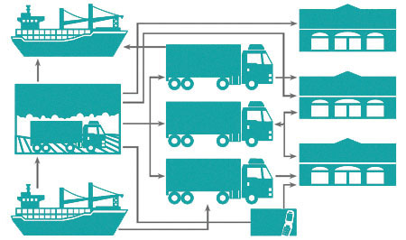
Long Supply Chains can be very complex & typically can have high Carbon Footprints…
Direct Markets
Exports
General line grocery wholesalers
Food Retail Outlets
Growers and
grower-shippers
Specialty produce wholesalers
Food Service establishments
General line grocery wholesalers
Imports
Agents / Brokers

Slide 11
The Carbon Cost of Food
Food's carbon footprint, is the greenhouse gas emissions produced by growing, rearing, farming, processing, transporting, storing, cooking and disposing of food for consumption.
There are excellent apps now available to help consumers calculate their carbon footprint.
– Android Apps on Google Play
One such app, Evocco has published a free guide for Food businesses on how to make more informed decisions
https://evocco.hubspotpagebuilder.com/food-businesses

Slide 12
Benefits of Short Food Supply Chains (SFSC):
Farmer/Producer
The Consumer
The Community
Receive Fairer Prices
Less Energy costs
Less Transportation costs
Receive fresher Produce
Increased transparency
Communication with the producer
Creates Sustainability
Employment/ economy
Reduces CO₂ emissions

Slide 13
Short Supply Chains & Local Food Systems
Your food business can shorten your food supply chain by:
Direct purchases from local growers/producers
Collective direct sales via a local food system, a collaborative network that integrates sustainable food production, processing, distribution, consumption, and waste management in order to enhance the environmental, economic, and social health of a particular area.
Partnerships

Slide 14
Direct Purchasing:
Direct purchasing is the simplest form of SFSC and involves a direct transaction between farmers and your food business.
They can take place on the farm, via online ordering, or indeed at a farmers’ market.
Food products can also be delivered to your food businesses through a basket or box scheme.
The benefits are manyfold - produce is locally grown, very fresh, without packaging, and sold directly by the producer themselves.

Slide 15
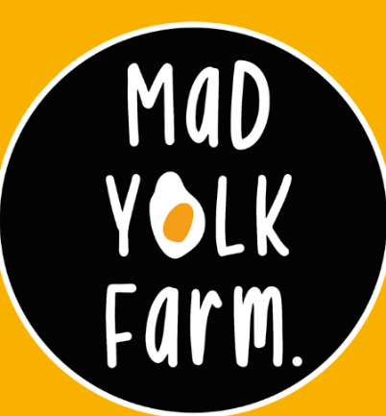
Be Inspired – A Case Study
Mad Yolk Farm, Ireland
An urban farm Mad Yolk Farm is a new project in Galway on a mission with two simple aims:
1. Grow & showcase the best local, seasonal produce.
2. Have a great time doing it.
Brian met Joe on a remote Swedish farm while studying Regenerative Agriculture in Summer 2019. Brian had a farm of land back home in Ireland and was looking for a fresh start. Joe was handy with a trowel. In a yurt in Sweden, they 'hatched' the plan for Mad Yolk Farm.
Now Mad Yolk Farm offers a weekly Click and Collect Service from their purposefully small Local Farm & local markets.

Slide 16
Collective Direct Supply:
An efficient way to source produce can be when producers cooperate to sell their products collectively.
Direct Sales on your own as a farmer or producer can be isolating, slow & difficult.
Forming groups, networks, or co-operatives allows for greater potential to gain access to buyers whether domestic or food businesses.
Collective sales make it easier for you as the buyer too as it saves time, motion and effort to source the quality products they desire.
01
The initiative creates a cooperative & network of artisan food producers
02
Food producers get increased exposure, increased Sales
03
You the buyer get access to quality artisan products, a single non- disruptive method, one invoice/ payment

Slide 17
Powering a New Food System
The Open Food Network Ireland webinar from July, 2020.
WATCH
OPEN FOOD NETWORK is an open-source platform to enable new, ethical supply chains. Food producers can sell online & wholesalers can manage buying groups and supply produce through networks of food hubs and shops/food outlets. Communities can bring together producers to create a virtual farmers’ market, building a resilient local food economy.
OFN is operating in 9 countries, with 1000’s of local producers using it to reach markets to sell their products and support their local food economies in these difficult times.
VIEW Example of an OFN
North Tipperary Online Farmers Market - Open Food Network

Slide 18
Partnerships
- Community Supported Agriculture (CSA)
The EU Farm 2 Fork Strategy is a roadmap for making European food systems more sustainable by turning climate & environmental challenges into opportunities for farmers & food producers:
https://europa.eu/!gf93pw
WATCH
EU Farm 2 Fork - Community supported agriculture – YouTube

Slide 19
Supply Chain Partnerships
A supply partnership is a deeper commitment – by definition, it is a commitment over an extended time to work together to the mutual benefit of both parties, sharing relevant information and the risks and rewards of the relationship.
Partnering with suppliers to develop deep, mutually beneficial relationships over the long-term is frequently cited as a means by which to lessen that risk and develop true supply chain excellence. Building strong partnerships between your food business and producers can bring advantages for you both.
Opportunity for long-term contracts - The carrot for many small suppliers is to get a long-term contract that guarantees volume. This is a good thing for many suppliers and allows them to schedule their production.
Achieve the product/specification you want - By collaborating, you get the chance to work with the supplier to improve innovation and create joint value.

Slide 20
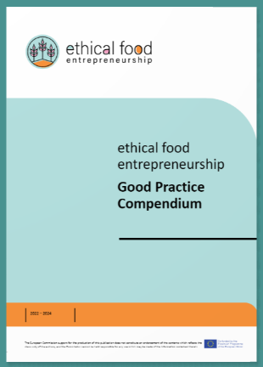
Be Inspired…
Check out our Good Practice Compendium
Nam was chosen as a good practice example as it not only supports urban agriculture & circular economy, but the company also operates via a PARTNERSHIP approach where they receive top quality resources (coffee waste) from their partner Delta Coffee.
Together the two companies have developed a symbiotic working relationship/partnership.

Slide 21
Drivers of Change…
To summarise
Supply chains of the future need to produce healthy and nutritious food that has been grown in an environmentally friendly and ethical way, while also dealing with the significant challenges of a growing population, climate change and declining natural resources.
Consumers have become more health- and environment-conscious and demand more locally produced, less processed food of known origin.
Longer supply chains are resulting in a declining understanding of agricultural processes, challenges faced by farmers and an environmental impact.
Short food supply chains have the potential for the food industry to act as a driver of change.

Slide 22
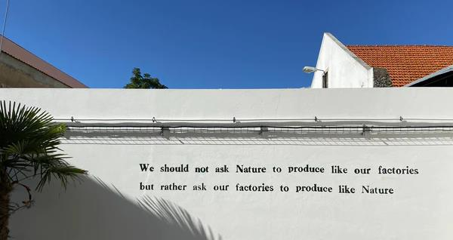
What our outlook for the future should be…
Source: Nam, Urban Farm wall, Portugal

Slide 23
Student Exercise:
Pen & Paper Exercise:
Can you list where you (will) source the top five ingredients for your food business?
Are you using short or long supply chains?
Is it possible for you to reduce your Supply chain length?
Which new sourcing process is available to you, or would you be willing to use?
Long Supply Chain
Short Supply Chain

Slide 24
The IMPACT of Change
Changes in supply chain systems are bringing more transparency to the food production process, improving incomes and profitability and minimising environmental impacts
This is leading to a ‘circular economy’ where the feedback between supplier and consumer is continuous, resource consumption and waste are minimised, and the supply chain is no longer one-directional.
This is aligned with Pillar 3 – Sustainable Value Chains, mentioned in Module 1 of The Sustainable Development Solutions Network.

Slide 25
A Circular Economy:
The Future of the food industry
“Through the circular economy, our food systems can better deliver nutrition and combat climate change”. Carlos Moedas, EU Commissioner for Research, Science & Innovation.
As discussed in Module 2, Changing our food system is one of the most impactful things we can do to address climate change, create healthy communities, and rebuild biodiversity.
The current food system has fuelled urbanisation, economic development, and supported a fast-growing population. This has come at an enormous cost to society and the environment.

Slide 26
A Linear Economy Model
TAKE
MAKE
DISPOSE
Recognise this ?
A linear economy traditionally follows the “take-make-dispose” step-by-step plan. This means that raw materials are collected, then transformed into products that are consumed with byproducts/surplus discarded as waste. Value is created in this economic system by producing and selling as many products as possible. This model is characterised by two unsustainable processes, resource scarcity & excessive pollution load.

Slide 27
Food Production & The Circular Economy
Recycling
Sustainable Production
Sustainable Use
By examining the true cost of the current approach (the linear model) to food production you can explore the catalytic role of the food sector and how you can seize the opportunity to change the inefficient food system through three ambitions:
ETHICAL FOOD PRODUCTION STARTS HERE →
Sourcing food grown regeneratively, and locally where appropriate
Designing and marketing healthier food products
Making the most of food and minimising waste.

Slide 28
Spotlight on Food Systems Innovations
REGENERATING NATURAL SYSTEMS
Designers need to create products with ingredients that are, regardless of their source (animal or vegetable), produced regeneratively. Where possible they need to be obtained locally and seasonally, to be safely used as inputs for new uses. It is these processes which will contribute to a thriving bioeconomy
THERE BE GOLD IN THAT WASTE
Pasta manufacturer Barilla have teamed up with paper company Favini to produce a line of quality packaging & paper products call ‘Cartacrusca’ using the by-products of pasta production.
HEALTHY FOR PEOPLE AND PLANET
Yuba- also known as bean curd robes – is the skin collected from the tofu making process. Layered and bound together, yuba can be made into an imitation chicken breast – it evens gets a crispy chicken-like skin when you pan fry the outside. Delicious!
DESIGN BETTER FOOD OPTIONS
Blending mushrooms into burger patties adds delicious ‘umami’ & Vitamin D and means fewer calories. Mushrooms can be grown on spent coffee grounds, therefore combined with a lower meat content can enhance health and that of the planet.

Slide 29
Be Inspired:
Sysco is a large Food Wholesale & Distribution company that sits in the middle of the food supply chain and is committed to responsible sourcing in order to protect Ireland’s natural resources and preserve the future of our food industry for generations to come. They work with their food service customers, who demand responsibly sourced products. Consumers today have an awareness of where their food comes from and have a need for confidence in the conditions in which it was produced, this inspires Sysco to source nothing but the very best, and they collaborate with all their suppliers to meet customers’ high standards.

Slide 30
Be Inspired…
Check out our Good Practice Compendium
Meira Nova was chosen as a good practice example as their ethical & sustainable practices begin with the choice of suppliers. Through procurement framework agreements, Meira Nova's quality and responsibility requirements are carried forward in the supply chain. Each supplier goes through a supplier approval process, which reviews the supplier's operating models regarding food safety, social responsibility, environmental issues, and the company's management practices.

Slide 31
02
GMO & Plant-Based Foods

Slide 32
What are GMO foods?
GMO foods, or Genetically Modified Organisms foods, are foods derived from organisms (plants, animals or microorganisms) whose genetic material has been altered using genetic engineering techniques. In GMOs, specific genes or DNA are isolated from one organism and are inserted, deleted, or modified to introduce desired traits or characteristics that are not naturally present in the organism.
There are many arguments both for and against GMOs, including ethical questions about ownership of genetic resources.
This technology has primarily been used in crops to increase insect resistance and herbicide tolerance, and in micro-organisms to produce enzymes.

Slide 33
Past to Present…
Although genetic modifications have occurred throughout history with selective breeding and growing methods, scientific advances have allowed this practice to advance to the genetic level. In the modern GMO, plants can be resistant to specific pesticides and herbicides while becoming adaptive to changing environmental conditions. With a growing population, the PRIMARY ADVANTAGE of genetically modified foods is that crop yields become more consistent and productive, allowing more people to be fed.

Slide 34
Engineers design plants using genetically modified organisms (GMOs) to improve taste, nutritional content, and resilience. However, people have concerns over their safety, and there is much debate about the pros and cons of using GMOs.
Medical News Today

Slide 35
GMO regulation…
Most of the currently available GMO foods are plants, such as fruit and vegetables. In the United States, the Food and Drug Administration (FDA) regulates all foods from genetically engineered plants. They must meet the same safety requirements as non-GMO foods.
However, via the European Food Safety Authority (EFSA) the EU has possibly the most stringent GMO regulations in the World. EFSA assesses any possible risks from GMOs to human and animal health, and the environment in Europe.

Slide 36
Potential ADVANTAGES of GMO crops include:
increased attractiveness to consumers, for example, apples and potatoes that are less likely to bruise or turn brown
enhanced flavour
longer shelf life, easier to store & transport, and therefore less waste
greater resistance to insects, viruses, and other diseases, which could lead to less waste and increased food security
greater tolerance to herbicides, making it easier for farmers to control weeds
increased nutritional value, as in golden rice, which can boost the health of people with limited access to food
ability to thrive in a harsh climate, such as drought or heat
ability to grow in poor quality or salty soil
Source
All these factors contribute to lower costs for the consumer and can ensure that more people have access to food.

Slide 37
Potential DISADVANTAGES of GMO Crops include:
Genetically engineering foods is a relatively new practice, which means the long-term effects on safety are not yet clear. Many concerns about the disadvantages relate to human health. Scientists have not yet shown that GMO foods are harmful to health, but research is ongoing.
Allergic Reactions – can the genetic change trigger the production of an allergen
Cancer – can GMOs raise levels of potentially carcinogenic substances in the body?
Antibacterial resistance – if a plant has resistance and if consumed will humans or animals develop the same resistance?
Changes in human DNA – if food DNA can survive as far as the gut, this is leading to concerns that this could affect the immune system.
the risk of outcrossing, where genes from GMO foods pass into wild plants and other crops
a negative impact on insects and other species
reduction in other plant types, leading to a loss of biodiversity

Slide 38
Labelling & Traceability…
The OECD has introduced a "unique identifier" which is given to any GMO when it is approved, which must be forwarded at every stage of processing
The regulations concerning the import and sale of GMOs for human and animal consumption grown outside the EU involve providing freedom of choice to farmers and consumers. All food (including processed food) or feed which contains greater than 0.9% of approved GMOs must be labelled & EU law also requires that all GM food be traceable to its origin
EU regulations require measures to avoid mixing of foods and feed produced from GM crops and conventional or organic crops, which can be done via isolation distances (these distances are regulated by individual countries).

Slide 39
Additional Reading to delve deeper:
Nothing to Sneeze at: the Allergenicity of GMOs - Science in the News (harvard.edu)
GMO legislation (europa.eu)
What GMO CROPS are grown and sold in the U.S.? (fda.gov)
Genetically Modified Organisms (nationalgeographic.org)
"Summaries of EU legislation: Traceability and labelling of GMOs”
2019 Eurobarometer Reveals Most Europeans Hardly Care About GMOs- Crop Biotech Update (June 26, 2019) | Crop Biotech Update - ISAAA.org
EUROPA - Food Safety - Biotechnology - GMOs in a nutshell (archive.org)

Slide 40
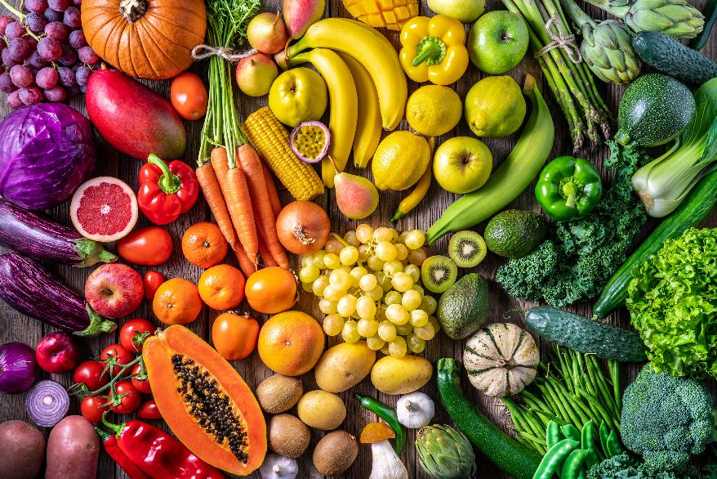
Plant-based Diets as a tactical business move…
Plant-based diets as an ethical business route have gained significant momentum in recent years due to increasing awareness of environmental sustainability, animal welfare, and public health concerns. Embracing a plant-based approach in the food industry aligns with ethical principles and values, offering several advantages for businesses that prioritise sustainability and social responsibility.

Slide 41
Environmental Sustainability:
1
Plant-based diets have a significantly lower environmental footprint compared to diets that rely heavily on animal products. Plant-based food production generally requires less land, water, and energy, and generates fewer greenhouse gas emissions.
Some benefits and considerations of adopting a plant-based focus for your business
Animal Welfare:
2
Plant-based diets avoid the use of animal products, thus reducing the demand for factory farming and the associated ethical concerns related to animal cruelty and confinement.
Health and Wellness:
3
Plant-based diets have been associated with numerous health benefits, such as reduced risk of chronic diseases like heart disease, obesity, and certain cancers. You could position your ethical business as an advocate for consumer health.

Slide 42
Market Demand:
4
The demand for plant-based foods has surged in recent years, due to a growing number of flexitarians, vegetarians & vegans. Embracing plant-based options can help you tap into this expanding market segment, leading to increased sales.
Some benefits and considerations of adopting a plant-based focus for your business
Innovation & Creativity:
5
Adopting a plant-based focus can spur creativity and innovation in NPD. You could explore new and exciting plant-based recipes, alternative protein sources, and innovative food technologies, offering unique and appealing options to customers.
Diversification and Resilience:
6
Diversifying product offerings to include plant-based options could enhance your business's resilience to market fluctuations and changing consumer choices. By expanding your range, you can appeal to a broader customer base and the shifting food trends.

Slide 43
Processed plant-based foods
Notwithstanding the health benefits of a diet rich in plant-based foods, not all plant-based diets are healthy, therefore consideration needs to be given to this also. It is common to associate plant-based diets with healthful, whole, and minimally processed plant foods such as whole grains, fruits and vegetables, legumes, nuts, and seeds. However, refined grains, and sugar-sweetened, beverages, snacks, and confectionery are foods that can still be considered “plant-based” as they or their ingredients originate from plants and may be free from animal products.

Slide 44
Ultra-processed Plant-based foods
Modern plant-based diets may also include ultra-processed foods. These include imitation processed “meats” (e.g. marketed as sausages, nuggets or burgers), beverages (for example, almond and oat “milk”), and plant-based “cheese” and “yogurt”.
To understand the NOVA Food Classification System, watch this Video
This leads to the question…
Are these foods ethical??
WATCH

Slide 45
03
Being Aware of Health & Eco- CLaims

Slide 46
Responsible Communication
As a food business owner, by being diligent, transparent, and responsible in the communication of your health and eco-claims, you can maintain the trust of your customers and contribute to a more informed and sustainable food industry.
Along with good communication (Module 5), as mentioned in Module 2 it is important to comply with regulatory requirements. Over the next few slides, we will recap some key tips of how to remain responsible.

Slide 47
Importance of the correct use of CLAIMS
Protein
HIGH
Health
Food products, bearing claims that could mislead consumers are prohibited in the EU market. This not only protects consumers but also promotes innovation and ensures fair competition.
The rules ensure the free circulation of foods bearing claims, as any food company may use the same claims on its products anywhere in the European Union.
For more information click here…
natural
Claim
Low-fat
Low
HIGH
Calcium
High-fibre
Minerals
Nutrition
Food
Low
SALT
vitamins
Fat-free
Sugar
FREE-FROM
Source
vitamins
Sustainably Made
Eco-friendly
ORGANIC
ROADMAP (europa.eu)

Slide 48
The role of the European Food Safety Authority EFSA
EFSA is responsible for verifying the scientific substantiation of the submitted claims, some of which are currently in use, some of which are proposed by applicants – (companies who want to submit claims for authorisation in the EU).
This information serves as a basis for the European Commission and the Member States, which will then decide whether to authorise the claims.
Nutrition applications: regulations and guidance | EFSA (europa.eu)
What are health claims and how are they assessed? - YouTube

Slide 49
Selecting Claims…
For food companies, getting a new health or nutrition-related claim approved by EFSA is difficult as it needs strong scientific evidence and consensus.
Therefore, SMEs may use the EU database on “EU Register of nutrition and health claims made on foods”, which lists permitted health & nutrition-related claims.
ESSENTIAL READING:
EU Register of nutrition and health claims made on foods (v.3.6) (europa.eu)
Nutrition claims (europa.eu)

Slide 50
Understand Regulations
Familiarise yourself with relevant regulations and guidelines governing health and eco-claims in the food industry. Different regions may have specific rules regarding the use of terms like "healthy," "natural,” “free-range”, "organic," or "sustainable." Ensure that your claims align with legal requirements and seek guidance from regulatory authorities or legal experts if needed. (Module 2)

Slide 51
Ensure Substantiation:
Certifications from reputable organisations can provide credibility and assurance to consumers. Examples include organic certifications, fair trade certifications, or eco-labels that demonstrate adherence to specific standards or practices.
It's crucial to substantiate health and eco-claims with reliable scientific evidence or certifications from recognised organisations. Substantiating the claims correctly will validate the specific benefits or attributes you are promoting and help you gain trust and a secure following. Never exaggerate or use misleading claims that cannot be adequately supported.

Slide 52
Be Transparent and Accurate
Clearly communicate the health or eco-claims in a transparent and accurate manner. Provide detailed information about the specific attributes (e.g. the nutritional value – mentioned in Module 1), practices, or certifications that support your claims. Avoid vague or ambiguous statements or Greenwashing (Module 5) that may mislead consumers. Clearly disclose any limitations or conditions associated with the claims

Slide 53
Educate Your Team
Ensure that your team, including marketing and sales personnel, understands the importance of responsible health and eco-claims. Provide training and resources to ensure they are well informed about the claims your food business makes and the requirements for substantiation.
This will help ensure consistent and accurate messaging across your organisation.

Slide 54
Regularly Review and Update
Keep track of emerging scientific research, industry trends, and regulatory changes related to health and eco-claims. Regularly review your claims to ensure they align with the latest information and requirements. Update your messaging or practices as needed to maintain accuracy and compliance. If necessary, seek professional advice, regulatory experts, food consultants, or legal advisors can provide guidance and ensure your claims are compliant and ethical.

Slide 55
Mandatory information for prepacked foods in the EU…
What type of information are you required to mention?
name of the food
ingredient list (including any additives)
allergen information
quantity of certain ingredients
date marking (best before / use by)
country of origin, if required for consumer clarity e.g. Country Flag
name and address of the food business operator established in the EU or importer
net quantity
any special storage conditions and/or conditions of use
instructions for use if needed
alcohol level for beverages (if higher than 1.2%)
nutrition declaration
Click here
Food labelling - general EU rules - Your Europe (europa.eu)
Under EU law and/or national law, some food products might also need to show specific warnings referring, for example, ingredients not recommended for consumption by children (such as caffeine).

Slide 56
04
Ethical Food Packaging

Slide 57
Food Packaging
Food packaging prevents foods from spoiling and enables traceability, marketing, and sharing of information with customers.
Most materials used for packaging foods belong to the following classes: metals, glass, paper & polymers. Some packaging media consist of a combination of two or more materials of the classes listed above. While disposable packaging has been an essential part of most modern food supply chains, environmental problems related to packaging waste have grown exponentially during the last decades.
Food Packaging | Regulations & Types of Materials (highspeedtraining.co.uk)
READ

Slide 58
What is ethical food packaging?
Ethical food packaging refers to the practice of using packaging materials and designs that prioritise environmental sustainability, social responsibility, and consumer safety. It encompasses various principles and considerations that aim to minimise the negative impact of packaging on the environment and promote ethical practices throughout the packaging lifecycle. It optimises the use of recycled or renewable source materials.
To be aware of legislation and the implications of using certain materials…CLICK here

Slide 59
Packaging plays an essential role towards transitioning to a green economy. It helps reduce product and food waste and protects resources across the value chain. As a driver of resource efficiency, packaging is critical for achieving the EU’s environmental ambitions.
- Europen- The European Organisation for Packaging & the Environment

Slide 60
A Startling Fact…
Food packaging accounts for nearly half by weight of total packaging sold and almost two-thirds by volume of total packaging waste in solid municipal waste
Source

Slide 61
Sustainability
Collaborative efforts among retailers, packaging designers, and manufacturers are pushing for a comprehensive and sustainable approach to packaging across industries. The transition towards sustainable and recyclable packaging is becoming increasingly essential for all brands and the environment alike.
Ethical food packaging involves using sustainable materials that have minimal environmental impact. This includes opting for materials that are renewable, recyclable, compostable, or biodegradable. Examples of sustainable packaging materials include glass, recycled paper, cardboard, bioplastics derived from plant sources, and plant-based or bio-based films.
It is anticipated that in 2024, the trend of replacing plastics with bioplastics and paper will continue to gain momentum.

Slide 62
Less is more
Ethical packaging aims to minimise waste generation throughout the packaging lifecycle. ‘Less is more’ is probably best for ethical food brands by keeping the design classic and uncluttered. Using less ink and ensuring the packaging is sized for purpose is best for the environment and carbon footprint. Designing packaging that is easy to recycle or compost and incorporating strategies such as lightweighting to minimise material usage. The goal is to reduce the amount of packaging waste that ends up in landfills or as litter.

Slide 63
Resource Efficiency
Ethical food packaging strives for resource efficiency by optimising the use of energy, water, and other resources in the manufacturing and production of packaging and adopting efficient recycling or composting systems.
Similarly, as discussed in the next section the distribution and transport of the packaged goods need to be considered, as weight and size can reduce transport efficiency.
READ Delivering-Resource-Efficiency-EUROPEN-Brochure.pdf

Slide 64
Be Inspired…
Check out our Good Practice Compendium
Snellman Group was chosen as a good practice example as Naturalness and sustainability are two fundamental elements of their business. They are present throughout the production chain – from their family farms, to environmentally friendly transport and packaging. The Snellman Group’s constant goal is to reduce the environmental impact of its operations. In concrete terms, they have been switching from oil to biogas and significantly reducing the amount of packaging plastic.

Slide 65
Hazardous Substance Reduction:
Ethical packaging avoids the use of hazardous substances that can damage human health or the environment. This includes minimising the use of chemicals, such as certain types of inks, dyes, gases, or coatings, that can be harmful during production, use, or disposal.
Ethical packaging ensures that materials and substances used are safe and compliant with relevant regulations.

Slide 66
Transparency & Information:
Ethical food packaging promotes transparency and provides clear and accurate information to consumers. This includes labelling that indicates the materials used, recycling instructions, relevant certifications or eco-labels, and information about the environmental impact of the packaging. Transparent labelling allows consumers to make informed choices and understand the sustainability aspects of the packaging.

Slide 67
Reuse and Refill
There is a slow and steady growth in reusing and refilling packaging that is set to continue. It is best to encourage ‘keepability over disposability’ to consumers and to food producers when they are considering their packaging. Food businesses need to present or promote innovative ideas to foster the use of ‘bags for life’ and other packaging items that can be repurposed rather than be single-use packaging.

Slide 68
Smart Packaging
Smart packaging does not actually refer to one type of packaging; it’s actually an umbrella term for different types of intelligent packaging. This type of packaging has enhanced functionalities and uses technology as part of the experience.
The addition of technology is used for health & safety and quality and labelling is now becoming part of the customer experience too!
1
Active Packaging
2
Intelligent Packaging
3
Connected Packaging

Slide 69
1. Active Packaging
This packaging is designed so it interacts with its contents and improves its shelf-life/quality while being stored.
Active packaging uses light-filtering materials, oxygen & ethylene absorbers, antimicrobial surface coatings, or moisture-regulating materials, either by adding them into the packaging or as an insert to interact with the contents.
Active packaging can be a major benefit in food and beverage products as it adds value without affecting the look or feel of the food.

Slide 70
2. Intelligent Packaging
Intelligent packaging works by integrating additions into or onto the packaging that essentially communicates with the environment around it and the outside world.
This could be in the form of indicators, sensors, and diagnostic functions that continuously monitor the product and provide information to ensure consumers receive items of the best quality.
This is beneficial for both retailers and consumers because they receive real-time information about the product and catch key issues such as leaky packaging, bacteria, and temperature disruptions based on the sensors and indicators used.

Slide 71
3. Connected Packaging
Connected packaging leverages QR codes, barcodes or image recognition, through a browser-based app, to connect consumers to relevant content and experiences. It could be a questionnaire or product information. This technology enables food brands to extend their conversations with customers through the packaging and creates experiences that educate customers about the brand or products, which results in a brand awareness boost, while also gathering valuable insights to better understand their customers.

Slide 72
Is Smart Packaging Ethical?
PROs
CONs
With more and more consumers demanding more sustainability, better ethics, and transparency from brands, packaging has to innovate to serve this demand. Smart packaging provides better accountability and tracing of product contents and packaging materials, carbon footprint, and manufacturing.
Brands can build a better connection with customers and create a more ethical brand that shines a spotlight on transparency.
One of the main barriers to widespread smart packaging usage is how to dispose of it.
Should smart packaging be considered electronic due to the components needed? If so, throwing it away as part of household waste may not work.
You would need to be more explicit on the packaging itself to ensure that it is thrown away safely, which could prove to be challenging and costly.

Slide 73
Changes in lifestyle & shopping patterns
Changing consumer lifestyles and shopping behaviours have had a significant impact on the packaging market. Consumers' desire for convenience has fueled the demand for lightweight, on-the-go, ready-to-eat, and portable food packaging. The shift towards online sales, which experienced a significant surge during the pandemic, is expected to persist. However, engaging with customers solely through digital platforms presents challenges in creating a memorable experience. Therefore, focusing on the unboxing experience and brand differentiation has become crucial for maintaining a strong brand narrative that resonates with customers and drives sales, particularly in the realm of branded e-commerce packaging. This trend is projected to continue.

Slide 74
05
Ethical Distribution Models

Slide 75
Food Miles
According to the Cambridge dictionary, food miles is ‘‘the distance between the place where food is grown or made and the place where it is eaten’’.
The food we eat may have run hundreds of kilometres until it reaches our plate. For example, a plate of New Zealand lamb with Kenyan beans and South African carrots has covered a total of 27,700km!
This indicates we need to consider food miles when distributing food in an ethical manner as an ethical entrepreneur.

Slide 76
Field to Fork – Food Distribution
Food trade is key to achieving global food security, with internationally traded food making up 19% of consumed calories worldwide. But what is the environmental impact of this trade? Worryingly a recent study “Science for Environment Policy” estimates that global food miles generate nearly 20% of all CO₂ emissions from food.

Slide 77
Field to Fork – Food Distribution
The researchers also estimated the global food-system emissions equate to 30% of the world’s GHG emissions. With global food expenditure around €4.85 trillion in 2017 and the global population rising annually, it is useful to consider the impacts of food miles on climate change. The researchers say that this should be coupled with more locally produced food items (that add improved food security) and better food-system management that requires the integration of environmental protection targets.

Slide 78
Food Distribution
1
Local and Community-Based Distribution
Similar to when choosing suppliers, when it comes to the distribution of your food products, you need to decide what is the best model for you, and whether can you follow example by your suppliers, using models that prioritise sustainability, fairness, and social responsibility.
Here are a few examples and they will sound familiar as some have been discussed in section 3 above.
2
Direct Sales & Distribution
3
Wholesale Distribution
4
Online Platforms and Marketplaces
5
Zero-Waste Distribution

Slide 79
Local and Community-Based Distribution
This model focuses on distributing products locally. Food producers often sell their products directly to consumers through channels such as farmer’s markets, farm stands, or cooperative distribution (through consumer subscriptions). This model reduces carbon emissions associated with long-distance transportation, promotes local economic development, fosters a sense of community, and promotes transparency and traceability, while ensuring that consumers have access to fresh, locally-produced food. This is a model that can use a shared delivery service to reduce fuel usage.
This is where being in a food network can be beneficial…meet similar food businesses and share or co-ordinate your deliveries together

Slide 80
Direct Trade
Direct trade involves establishing direct relationships between producers and buyers, (consumers or retailers) bypassing intermediaries such as wholesalers/distributors. This model emphasises transparency, fair pricing, and long-term partnerships. Food producers set up direct channels to reach their target customers. This can include physical locations such as farm stands, on-site retail stores, or pop-up shops. It can also involve online platforms, e-commerce websites, or social media channels where customers can place orders directly.
You will notice Direct trade can also be local & community-based!

Slide 81
Wholesale Distribution
Food producers can work with wholesalers or distributors who purchase products in bulk and distribute them to retailers, restaurants, or other businesses. This channel allows for wider distribution without the need for individual sales efforts, as the wholesaler handles the logistics of getting products to various outlets. This can reduce the carbon footprint of a product as the distributor will organise deliveries in a logistical manner, servicing many companies simultaneously. This model is most used for supplying the food service sector, but some distributors are transitioning to electric vehicles now.

Slide 82
Online Distribution
Online platforms and marketplaces can facilitate ethical distribution by connecting ethical food producers with consumers directly. These platforms may vet and curate you as the producers based on your ethical practices, certifications, and sustainability commitments. They also provide a convenient way for producers to eliminate intermediaries shortening the food supply chain and ensure consumers can gain access to ethically sourced and produced food products, supporting responsible businesses. Often this model is supported by green courier services or central click-and-collect depots.

Slide 83
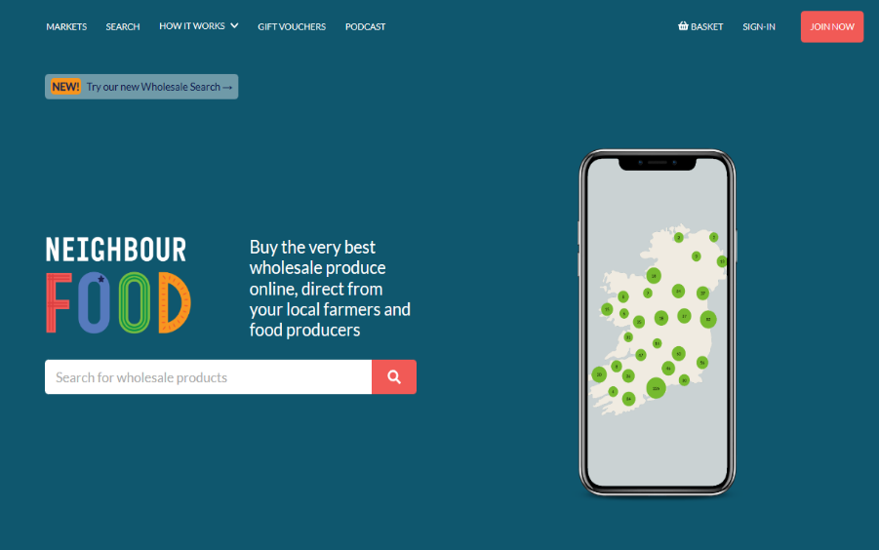
An example of Online, Community & Direct Distribution
This Online Community platform works by directing consumers to their local market. Then they choose from a wide range of local products including fruit and veg, bread, pastries, cheese, meats, preserves, beers, and many more. When they are happy with the items in their basket, they complete their purchase online and collect the entire haul on the designated day.

Slide 84
Zero-Waste Distribution
Zero-waste distribution models aim to eliminate or minimise packaging waste throughout the supply chain. This can involve using reusable containers (return-to-sender), bulk packaging options, or innovative packaging materials that are biodegradable or compostable.
By reducing waste generation, these models contribute to environmental sustainability and promote a circular economy approach.

Slide 85
You as a Food producer or Entrepreneur can choose one or multiple distribution channels depending on your target market, product type, and business goals.
Combining different channels allows for diversification, increased market reach, and flexibility in meeting customer needs. Ethical and sustainable elements can be considered in each model type.

Slide 86
06
Enterprise Growth & Success (marketing)

Slide 87
Growth Tactics…
1
Continual Market Research:
When it comes to starting your own business, there is a lot of planning involved to ensure that your venture will be successful. Without proper planning, you will lack direction and jeopardise the likelihood of your success.
Marketing plays a crucial role in the growth and success of an enterprise. It encompasses various strategies and activities. Here are some key aspects highlighting the role of marketing in enterprise growth and success
2
Consistent Brand Building
3
Product Promotion
4
Customer Insights and Feedback
5
Competitive Advantage
6
Being Agile

Slide 88
1. Market Understanding:
Effective marketing begins with a deep understanding (empathy – Module 3) of the target market. As mentioned in the Empathy mapping exercise, via market research and analysis, businesses can identify customer needs, preferences, and trends. This knowledge allows enterprises to develop products or services that align with market demands, positioning themselves competitively and meeting customer expectations.

Slide 89
2. Brand Building:
Marketing helps build and enhance a brand's identity and reputation. By crafting a strong brand image, values, and personality, enterprises can differentiate themselves from competitors and build customer loyalty. Branding encompasses elements such as logo design, brand messaging, visual identity, and consistent communication across various channels.
After your concept has passed the test process and your enterprise has determined that there is a market for this food product, you must select what kind of message you want to communicate to your potential customers.

Slide 90
An Interesting fact…
Colours such as red and yellow are thought to have a positive psychological effect on people’s appetites for eating.
A food product concentrating on Organic, on the other hand, might use more “earthy” hues rather than bright colours, that can indicate the use of artificial colours.

Slide 91
The key principles of building a strong food brand:
Insightful consumer understanding…EMPATHY
Clearly defined Target audience…Know who your target customer is
Clarity of communication…Keeping your customer informed with Relevant news
Clearly defined Unique Selling Points / Benefits…How are you going to help them
Clearly Defined market focus…What customer sector you want
Creation of a clear and relevant ‘brand personality’…How you want to be perceived
Consistency of brand positioning…No mixed messages
Progressive brand evolution and New Product Development…Keeping up with trends

Slide 92
3. Product Promotion
Marketing is instrumental in promoting products or services to the target market. Through various channels such as advertising, public relations, social media, content marketing, and influencer partnerships, you can create awareness, generate interest, and drive demand for your offerings. Effective promotion helps attract new customers and increase sales. By nurturing customer relationships and delivering value, you can foster customer loyalty, repeat purchases, and positive word-of-mouth referrals.

Slide 93
4. Insights & Feedback
Marketing activities provide opportunities for you and your enterprise to gather customer insights and feedback. Through market research, surveys, social media listening, and customer feedback mechanisms, you can gain valuable information about customer preferences, satisfaction levels, and areas for improvement. This feedback helps drive product innovation, enhance customer experiences, and refine marketing strategies. The key is to LISTEN to the feedback!

Slide 94
5. Competitive Advantage
Marketing plays a pivotal role in creating and sustaining a competitive advantage. By effectively communicating unique selling propositions, value propositions, and competitive differentiators, you can position your food business favourably in the market. By having a Competitive Strategy (a long-term plan) you can use your marketing efforts to showcase the benefits and advantages of choosing your products or services over competitors, helping to attract customers and win market share.
Click here
Four Types of Competitive Strategies

Slide 95
6. Being Agile
Marketing enables enterprises to adapt to changing market dynamics and consumer behaviours. Through monitoring market trends, consumer insights, and competitor activities, you can adjust your marketing strategies, messaging, and product offerings to stay relevant and responsive to evolving customer needs. This brings us back to continuous innovation, agility & reiteration for both your products and marketing.

Slide 96
Marketing Strategy
An effective marketing strategy underlines business growth, and often its very existence. From meeting the target audience's needs and helping you build brand loyalty to determining the right prices for your products and services, the right strategy maximises your chances of making it in the business world

Slide 97
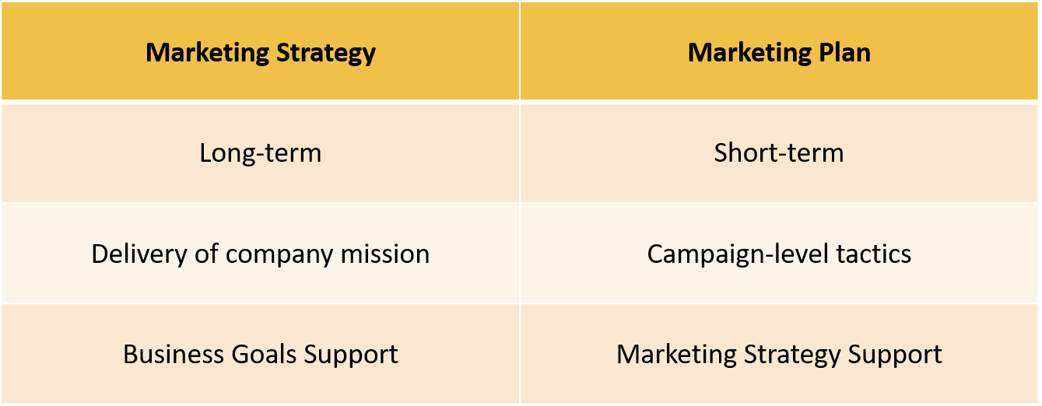
Marketing Strategy vs. Marketing Plan
Source

Slide 98
Growth Strategies
A successful marketing plan will enable you to expand your business in various ways. To directly support this growth, you need to determine how you want your company to grow in the long run. This is where growth strategies come in.
Growth strategies, also known as product-market strategies, aim to increase your market share and persuade more customers to invest in your products or service
Some useful Tools: Ansoff Matrix
STP Marketing Model
BCG Matrix

Slide 99
Attitude Strategies
It isn't enough to simply plan for your company's growth. The most successful businesses also identify the method of growth, which is determined by attitude strategies:
Growth Method Acquisition: the acquisition of one business by another one
Organic Growth: this refers to an increase in sales through the company's own resources (expanding your market share via marketing, entering new markets, adding new products)

Slide 100
7 Steps of a Marketing Strategy Process
1. Build your Marketing Plan
2. Create Buyer Personas
3. Identify Your Goals
4. Select the appropriate tools
5. Review your Media
6. Audit & plan media campaigns
7. Bring it to Fruition

Slide 101
It’s Your turn now…
There are numerous ways to help your business grow, but one of the most powerful tools that you can use is an effective marketing strategy.
The above steps can help you get started on forming a strategy that brings out the best in your company. By taking the process one step at a time, you can expand your customer base, boost your revenue and steer your business towards lasting success…see it as the missing piece of the puzzle!!!

Slide 102
A quick EXERCISE -
In terms of your Marketing Strategy…
List what you are doing already?
What could you do to improve?
________________________________________________________________________________________________________________________________________________________________________________________________
________________________________________________________________________________________________________________________________________________________________________________________________

Slide 103
You now have completed Module 4…You are gathering tips and tools on this journey of Ethical Entrepreneurship as we aim to support and equip you for your business venture. The next module discusses the importance of communication in business and how to ethically work with PEOPLE…please keep going!

