Slide 1
MODULE 6
Sustainability for the future –
Ethical Food Entrepreneurship (EFE) Programme

Slide 2
Sustainability for the future
Throughout this course, we have studied a range of topics, relevant to starting & managing a food business, but ultimately the goal of the course is to contribute to the empowerment of people like you…a new generation of food entrepreneurs to start, grow and adapt to new ethical food enterprises. In this module, we look to the FUTURE & recap the main elements that are critical to the sustainability of your enterprise & to the future of the planet.
01
The Power of the ETHICAL Food System
02
Developing SUSTAINABLE food systems
03
A Recap on Innovation as a tool for the future
04
Creating a healthier future for P-P-P & the SDGs

Slide 3
01
The Power of the ETHICAL Food System

Slide 4

Planning for the future…
Long-term sustainability planning is critical in any business and requires a holistic approach that integrates environmental, social, and economic aspects, reporting & accountability into your business practices.
By embedding ethical values, setting goals, engaging stakeholders, and continually improving your sustainability efforts, you can position your ethical food business for long-term success while making a positive impact on the environment and society.

Slide 5
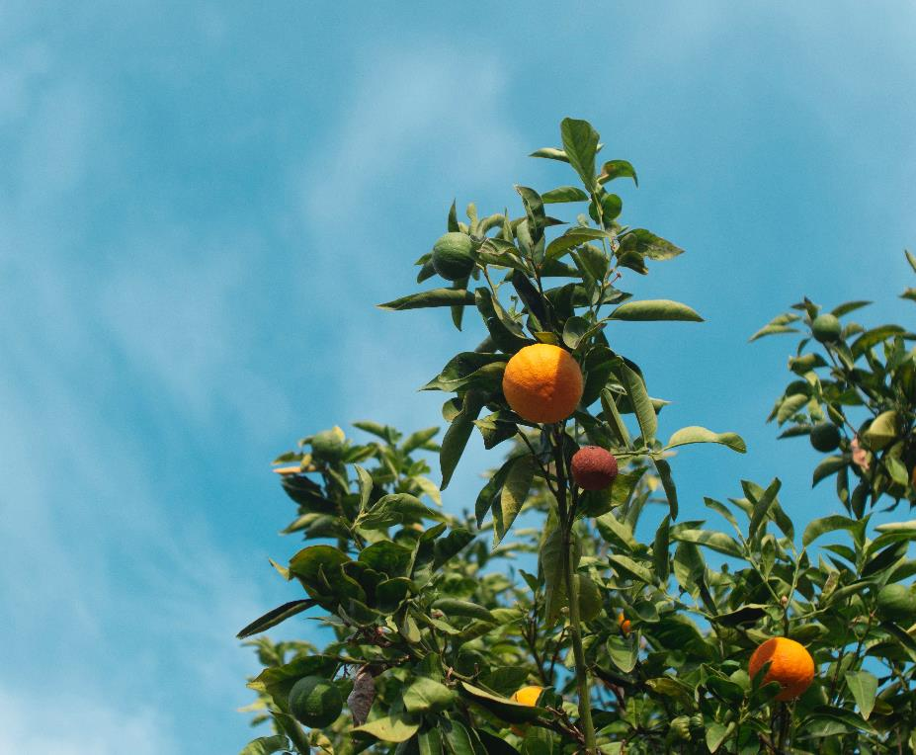
What is an Ethical Food System?
At this stage we now know that an ethical food system refers to a holistic approach to food production, distribution, and consumption that prioritises sustainability, social justice, animal welfare, and public health.
It encompasses a set of principles and practices aimed at creating a food system that is fair, responsible, and regenerative.

Slide 6
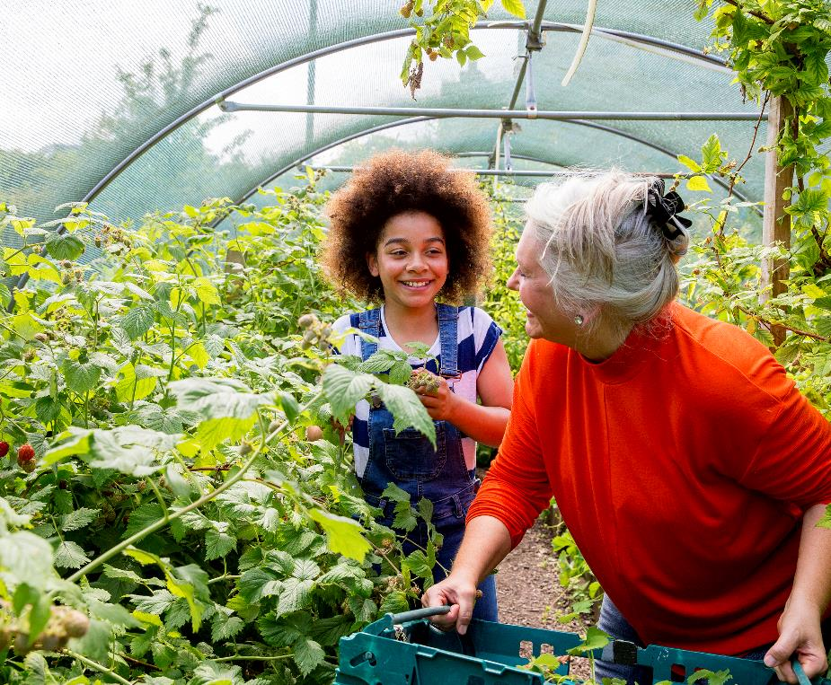
The Power of an Ethical Food System
The POWER of an Ethical Food system lies within its potential to bring about positive & transformative change across various dimensions.
Let’s recap the key aspects that illustrate the power of an ethical food system.

Slide 7

Environmental Impact
An ethical food system prioritises sustainable practices that minimise environmental harm. It promotes:
regenerative agriculture,
organic farming, and
responsible resource management.
By reducing chemical inputs, conserving water, preserving biodiversity, and mitigating climate change, an ethical food system helps protect ecosystems and supports the long-term health of the planet.
Stay up-to-date on the latest advice and topics via your local Environmental Protection Agency

Slide 8
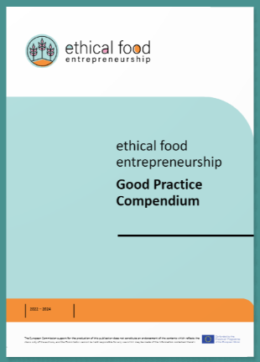
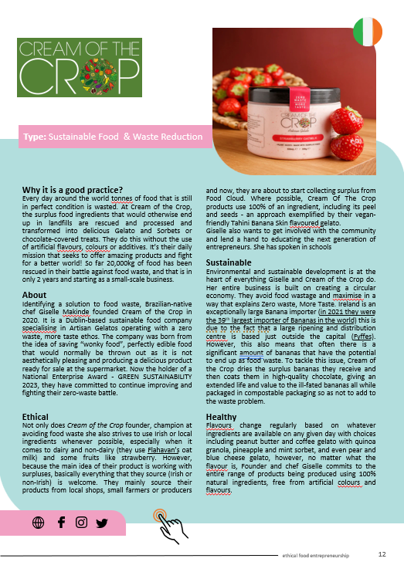
Be Inspired…
Check out our Good Practice Compendium
Cream of the Crop wants to do a part in solving global challenges. Responsibility for the environment, the economy, people and society is embedded in everything the company does. They are building a circular economy by adding using what would otherwise be food waste and adding value to this ‘waste’, supporting the local economy and consequently are having a positive impact on the Environment.

Slide 9
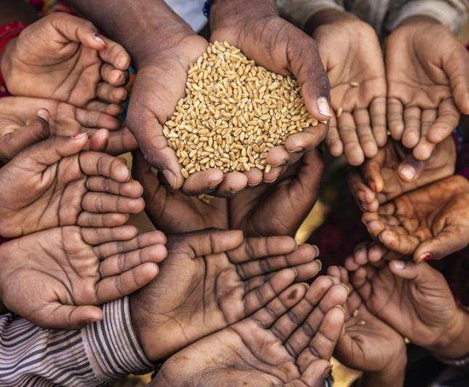
Food Security & Hunger Relief
An ethical food system aims to ensure food security for all. It advocates for equitable access to nutritious and culturally appropriate food, particularly for marginalised communities. (Module 1)
As well as this good food systems play a significant role in enhancing food sovereignty and in reducing the critical levels of food waste throughout the food system via various initiatives.
Pledge your commitment to REDUCE FOOD WASTE by signing a National Food Waste Charter

Slide 10

Public Health and Well-being
An ethical food system recognises the link between food and health (Module 1). It promotes the production and consumption of nutritious, whole foods, and discourages the use of harmful additives, pesticides, and antibiotics.
By encouraging healthier dietary choices, an ethical food system contributes to improved public health outcomes, reduced disease burdens, and increased overall well-being.
FOLLOW Food & Health TRENDS on platforms such as:
Diet and health (foodnavigator.com)
Food Trends (trendhunter.com)

Slide 11
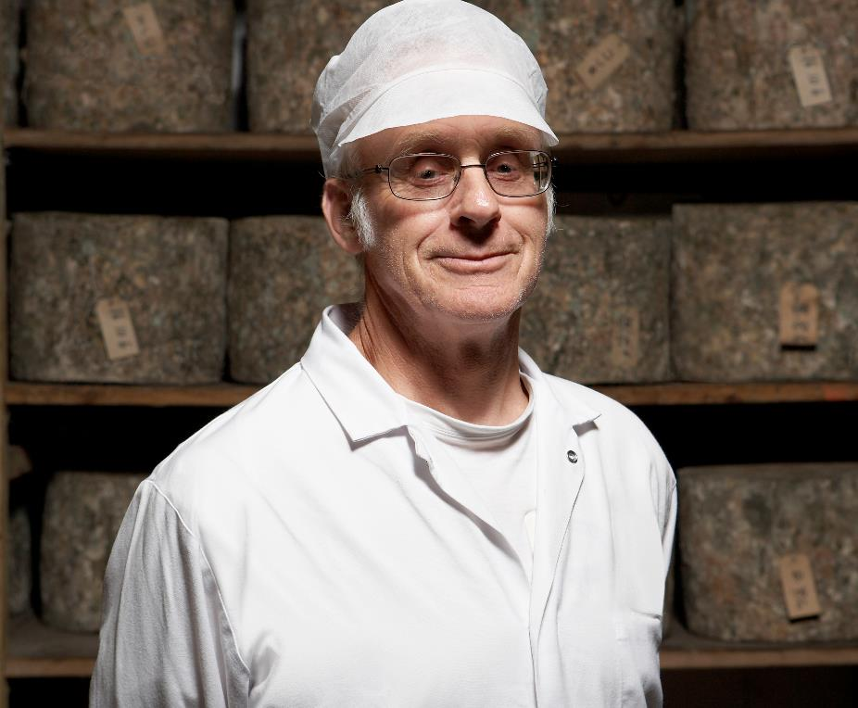
Social Justice & Fairtrade
An ethical food system emphasises fair treatment, just labour practices, and equitable economic opportunities. It advocates for fair wages, safe working conditions, and dignified livelihoods for farmers, farmworkers, and food producers. It supports fairtrade and other initiatives that ensure producers receive fair compensation for their products and promotes transparency in the supply chain.
This isn’t just the Legalities (Discussed in Module 2) but it is about doing the RIGHT thing!

Slide 12
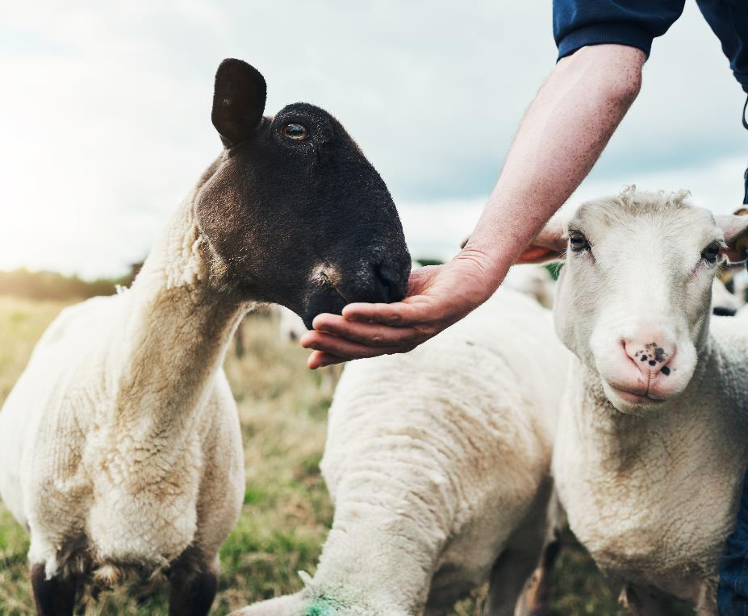
Animal Welfare
An ethical food system considers the humane treatment of animals in food production as a priority. It advocates for practices that minimise animal suffering or discomfort, such as providing ample space & feed, access to natural behaviours, and humane slaughter methods.
By promoting animal welfare, an ethical food system reflects compassion and ethical considerations in our interactions with other living beings.
To find out more…There are organisations that are passionate about Animal welfare e.g. PETA & EUgroupforAnimals

Slide 13
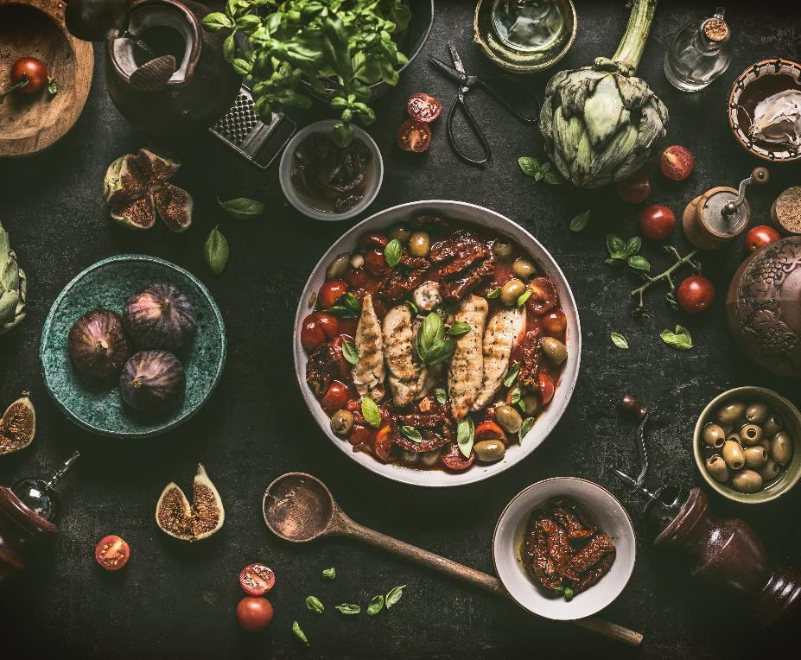
Cultural Preservation & Diversity
An ethical food system recognises the value of traditional knowledge, cultural practices, and food diversity. It supports small-scale farmers, local food traditions, and indigenous food systems. By preserving and celebrating cultural diversity, an ethical food system fosters cultural identity, community resilience, biodiversity, and culinary heritage.
Check out this Erasmus+ Project which covers this topic Culinary heritage in vocational education | Cook It Forward

Slide 14

Consumer Empowerment & Education
An ethical food system empowers consumers by providing transparent information about the origin, production methods, and ethical standards of food products. It encourages conscious consumer choices, such as supporting local, organic, fair trade, and sustainably produced foods.
As well as educating yourself and being a changemaker…by educating consumers about the impact of their food choices, you and your actions can promote responsible consumption and empower individuals to make informed decisions.
STAY INTERESTED: KEEP LEARNING & SHARING!!

Slide 15
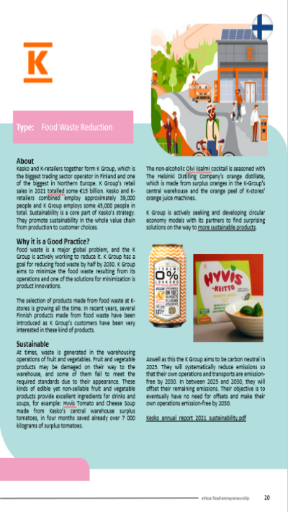
Be Inspired…
Check out our Good Practice Compendium
K Group is not only active in avoiding food waste within their organisation, but they have created their own responsible food brand. Along with this, they are embedded in expanding this responsible culture to staff and consumers. They carry out training for staff and they believe in transparency with their consumers and are actively making efforts to improve customer access to information via QR codes on the products.

Slide 16

A quick EXERCISE -
In terms of your Ethical Actions & Ambition…carry out a quick audit of your operations
List what you are doing already?
What could you do to improve?
________________________________________________________________________________________________________________________________________________________________________________________________
________________________________________________________________________________________________________________________________________________________________________________________________

Slide 17
02
Developing Sustainable Food Systems

Slide 18
Ethical Food System Versus Sustainable Food System
An ethical food system places a strong emphasis on moral and value-based principles in all aspects of food production, distribution, and consumption. It considers the social, environmental, and ethical implications of food choices and aims to promote fairness, justice, and responsible practices.
A sustainable food system focuses on the environmental aspects of food production, distribution, and consumption, aiming to minimise ecological impact, conserve resources, and maintain ecological balance. It emphasises the long-term viability and resilience of the food system.

Slide 19

Key aspects of a sustainable food system include:
Environmental Stewardship
Resource Efficiency
Climate Change Mitigation

Slide 20
As a Food Entrepreneur, you can play a role in Developing Sustainable Food Systems:
Environmental Stewardship: by making the best choices in terms of supply chain management, the conservation of natural resources in production processes and by encouraging & educating as you go in terms of sustainable practices and standards you will be doing your part for the environment.
Resource Efficiency: similarly, by ensuring your business and your suppliers optimise the use of resources (water, energy & land) and by making efforts to minimise or eliminate food waste & packaging waste you will be fulfilling your role.
Climate Change Mitigation: your role will involve emphasising strategies to minimise the food business’s carbon footprint and reduce greenhouse gas emissions associated with food production, transportation, and waste management.

Slide 21
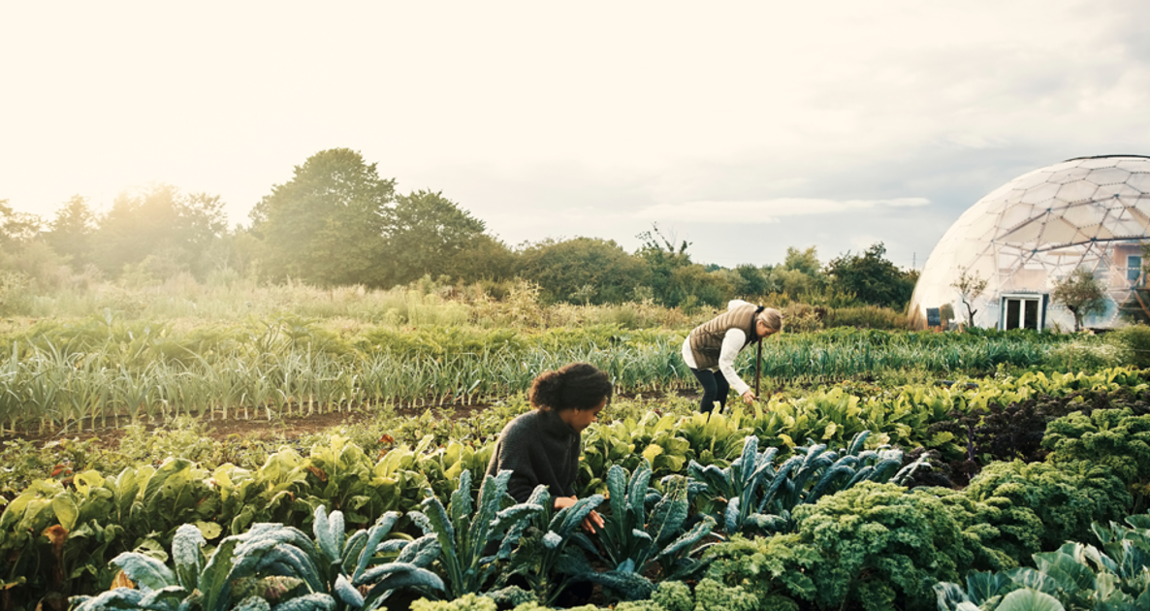
EVERY TIME YOU BUY ORGANIC, YOU’RE PERSUADING MORE FARMERS TO GROW ORGANIC

Slide 22
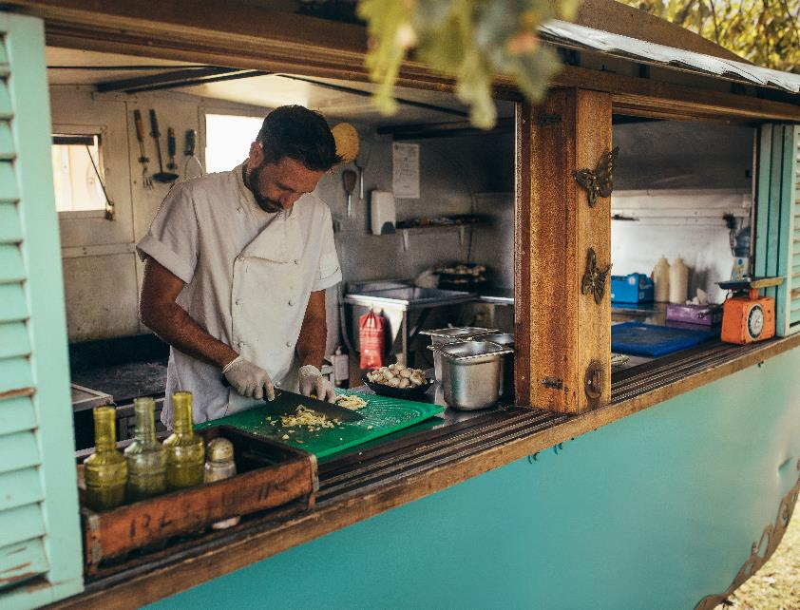
Learner Exercise:
Reflection:
List 3 actions you have already implemented in your business or personal life that make a difference in building a more sustainable food system.
List 3 additional actions that you pledge to introduce in the near future.

Slide 23
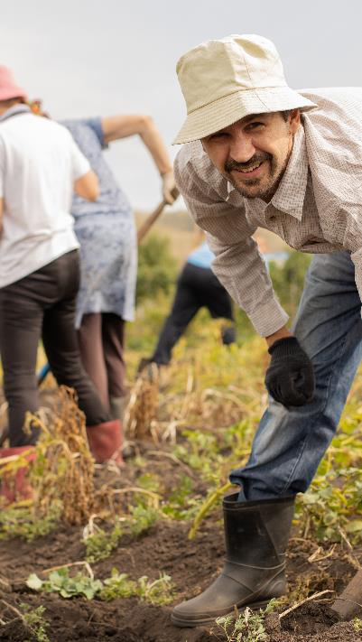
Additional Useful Resources
Do we need an ethical EU food label?
Ethical Consumer: the alternative consumer organization
Power in the food system – Food Ethics Council
Radio Davos: A World Economic Forum Podcast | World Economic Forum (weforum.org)
https://ethical-food.eu/knowledge-sharing-platform/

Slide 24
03
A Recap on Innovation as a tool for the Future

Slide 25




Innovation can offer numerous opportunities for food businesses, including:
New Product Development
Differentiation from Competitors
Improved Efficiency & Productivity
Increased Revenue & Market-share
Innovation can enable food businesses to create new products that meet changing consumer demands, e.g., healthier or more sustainable options.
By innovating & offering unique products, food businesses can stand put and create a competitive advantage.
Innovation can help food businesses streamline their operations & reduce costs, leading to increased efficiency & productivity.
By developing innovative products and solutions, food businesses can increase revenue & capture a larger share of the market.

Slide 26



Innovation can offer numerous opportunities for food businesses, including:
Improved Sustainability
Improved Safety and Quality
Enhanced Customer Experience
Innovation can also help food businesses to become more sustainable by reducing waste, conserving resources & minimising their environmental footprint.
Innovation can help food businesses to improve the safety & quality of their products through the development of new technologies and processes.
By leveraging innovation, businesses can improve the customer experience, via new products, services, or technologies that enhance convenience, speed, or personalisation.

Slide 27

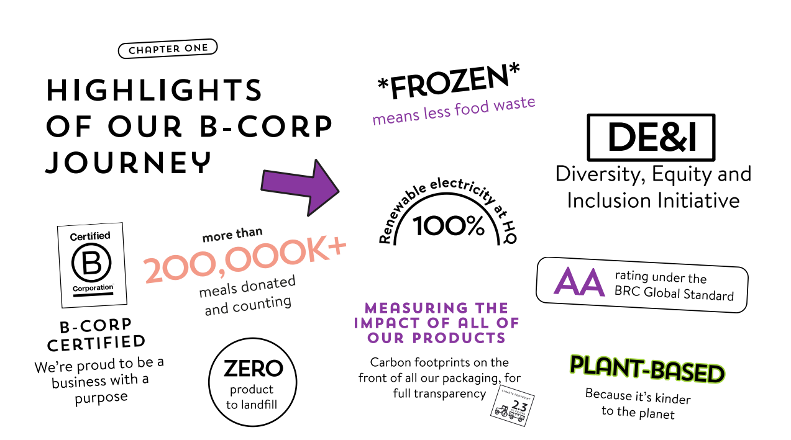
Strong Roots is an example of a food company that by using innovation along with high ethical standards and believe ‘food can be better’ has become a global brand in the frozen food market

Slide 28
The Potential Social Impact of Food Enterprises…
PEOPLE
You as an entrepreneur could also innovate by integrating social impact initiatives into your food business. This could involve creating employment opportunities for marginalised communities, supporting fair labour practices, promoting gender equity, promoting diversity and inclusivity in the workplace, and supporting community development.
This would contribute to the "People" aspect of People-Planet-Profit by addressing social issues and promoting social well-being.

Slide 29

Be Inspired – Creating a Social Impact
Here the World Economic Forum showcases the attitude and culture that Greyston Bakery is developing in an effort to make a difference in society, by creating employment opportunities for all.
Source

Slide 30
The Potential Social Impact of Food Enterprises…
PEOPLE
You could also innovate by engaging consumers in your sustainability efforts. This could involve educating consumers about the social and environmental impacts of their food choices, encouraging sustainable consumption patterns, promoting responsible packaging and waste management, and involving consumers in co-creation or feedback processes for developing more sustainable food products or services.
This would also contribute to the "People" aspect of People-Planet-Profit by empowering consumers to make informed choices and be active participants in sustainability initiatives.

Slide 31
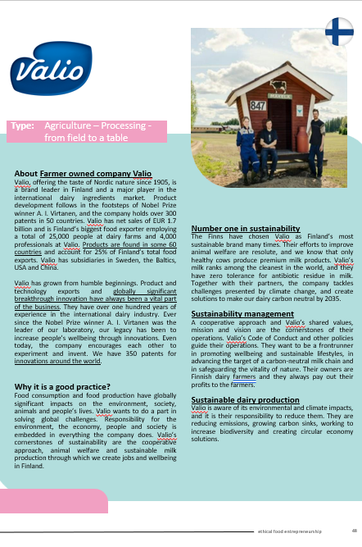
Be Inspired…
Check out our Good Practice Compendium
Valio wants to do a part in solving global challenges. Responsibility for the environment, the economy, people and society is embedded in everything the company does. Valio’s cornerstones of sustainability are the cooperative approach. Their owners are Finnish dairy farmers, and they always pay out their profits to the farmers.

Slide 32
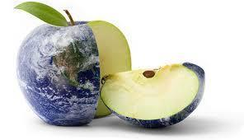

How inclusive innovation could transform food systems - and help to end world hunger
Click here to read this interesting article

Slide 33
The Potential Environmental Impact of Food Enterprises…
PLANET
Sustainable Sourcing: As an ethical entrepreneur, you could innovate by incorporating sustainable sourcing practices in your food business.
This could involve sourcing organic, locally-produced, and fair-trade ingredients, supporting regenerative agriculture practices, promoting biodiversity, and protecting natural resources.
This would contribute to the "Planet" aspect of People-Planet-Profit by reducing environmental impact and supporting sustainable food systems.

Slide 34
The Potential Economic Impact of Food Enterprises…
PROFIT
Again, as an entrepreneur, you could innovate by adopting circular economy principles in your food business. This could involve reducing food waste through innovative packaging, leaner practices or processing, and distribution methods, implementing recycling and composting programmes, promoting upcycling or repurposing of food by-products, and optimising resource use throughout the supply chain.
This would contribute to the "Profit" aspect of People-Planet-Profit by reducing costs, improving operational efficiency, and creating value from waste or by-products…while simultaneously having a good effect on the PLANET.

Slide 35

Innovation as a tool for the ‘Food-ture’
Plenty—Creating the Future of Farming in Compton - YouTube
Innovation requires thinking beyond short-term constraints to how businesses and societies need to do things differently in six months, three years, 10 years and beyond.
Innovation means evaluating external forces that are changing our world & evolving to anticipate those needs.
Plenty is an example of a company changing the future of farming and improving the quality and availability of food. Some would see this as ethical some would argue otherwise!

Slide 36
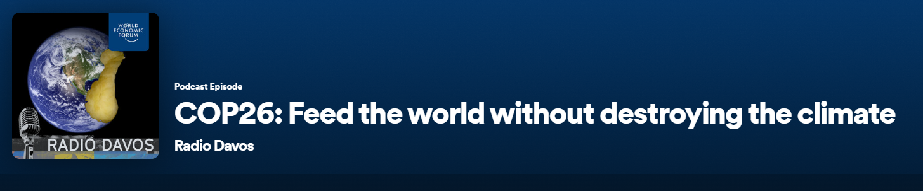
Worth a listen…PODCAST
COP26: Feed the world without destroying the climate - Radio Davos | Podcast on Spotify

Slide 37
04
Creating a healthier future for P-P-P & the SDGs

Slide 38
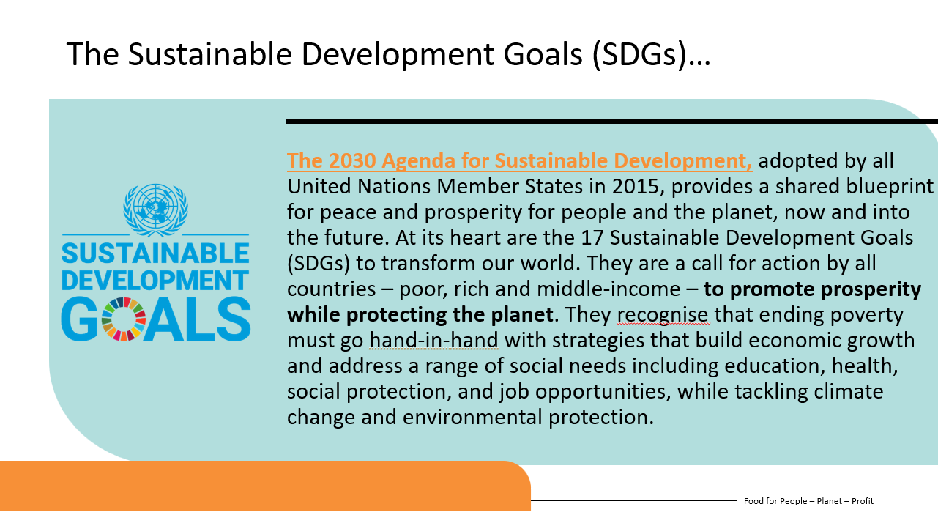
Working toward the FUTURE
In Module 1 we discussed in depth the impact of Food and Food Businesses on the 3 Ps (People – Planet – Profit) and we demonstrated the linkage to the SDGs.
Through this course, we aim to create awareness in you as potential or existing food entrepreneurs. Awareness and Knowledge are the start of change, and you are our future changemakers!!

Slide 39
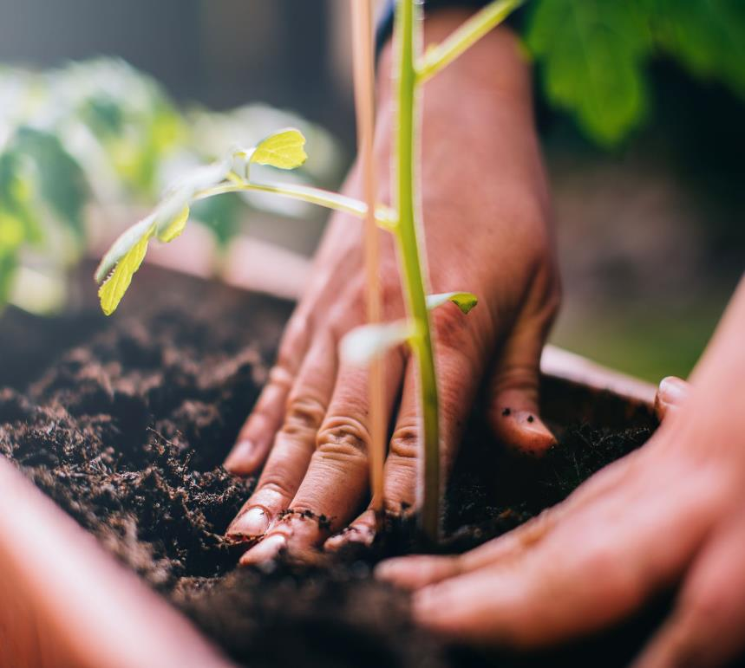
Embedding ethical values, setting goals, engaging stakeholders, and continually improving sustainability efforts are crucial for long-term sustainability planning in an ethical food business.

Slide 40

Embedding Ethical Values:
As an Ethical food business, as mentioned in previous modules you should establish a clear set of values and principles that guide your decision-making and operations.
These values may include commitments to environmental sustainability, social responsibility, animal welfare, fair trade, or community engagement.
By embedding these values into the organisational culture, policies, and practices, you will ensure that ethical considerations are integrated into all aspects of your operations and it will give direction and focus to your goals

Slide 41

Setting Goals:
Setting sustainability goals provides a roadmap for the business to work towards and measure progress. As discussed in Module 2, goals should be specific, measurable, achievable, relevant, and time-bound (SMART). Examples of sustainability goals for an ethical food business may include reducing greenhouse gas emissions or your carbon footprint, sourcing a certain percentage of ingredients from local suppliers, minimising food waste, or achieving a specific sustainability certification. Clear goals help align efforts and provide a benchmark for performance.

Slide 42

Good Communication:
The importance of engaging stakeholders, including employees, customers, suppliers, local communities, and investors, is essential for long-term sustainability planning. (Module 5)
Stakeholder engagement allows for a broader perspective, input, and collaboration. It fosters a sense of ownership, builds trust, and helps identify opportunities and challenges. Regular communication, feedback mechanisms, and involving stakeholders in decision-making processes contribute to a more inclusive and effective sustainability strategy.

Slide 43

Remaining Agile:
Sustainable practices should be seen as an ongoing journey of improvement rather than a one-time accomplishment. You & your Ethical food business should continuously evaluate and improve your operations, products, and practices. This involves conducting regular sustainability assessments, tracking key performance indicators, and implementing strategies for improvement. Regular monitoring and evaluation help identify areas for optimisation, innovation, and resource efficiency. Again, remember to stay up to date with Trends & Knowledge & Training

Slide 44

Reporting and Accountability:
Reporting on sustainability performance is vital to demonstrate transparency and accountability. You can develop sustainability reports or communicate your business’s progress through various channels such as annual reports, websites, or dedicated sustainability communications. Reporting should include key metrics, achievements, challenges, and future targets. External certifications or standards can provide additional credibility and demonstrate adherence to recognised sustainability criteria.

Slide 45
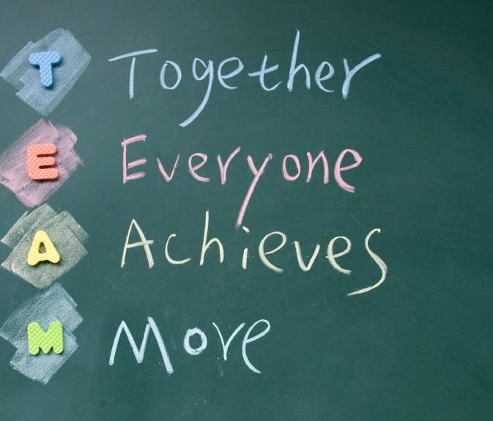
Collaboration and Partnerships:
So, we mentioned the importance of communication above, but it is also important to collaborate with industry peers, NGOs, or governmental organisations to enhance joint sustainability efforts. Partnerships allow for shared knowledge, resources, and collective action towards common sustainability goals. Collaborative initiatives can include research projects, advocacy campaigns, supply chain collaborations, or participation in industry sustainability initiatives.
An Irish example of business support:
Corporate Social Responsibility (CSR) and Sustainability (bitc.ie)

Slide 46

Recap, review, repeat…
This course is an open-access course and is available to you to use in your own time and as often as you like.
Please come back to it you reaffirm your direction and ambition in becoming an Ethical Food Entrepreneur. You can refresh your learning on specific elements of the course or review and repeat the entire course. It is flexible and forward focussed as we hope you and your business are!

Slide 47

Final Words of advice from MARY ROBINSON, Ireland’s First Female President, a former UN High Commissioner for Human Rights and Envoy on Climate Change, Chair of the Elders and in our opinion a Climate Champion!
Make Climate Change Personal.
1
"Do something you weren't doing before."
Get Angry, Get Active.
2
“…with those who have more responsibility than you do…those who should be doing far more. Governments, cities, universities, businesses-- especially the fossil fuel industries, agriculture & transport industries."
Imagine The World We Are Hurrying Towards.
3
"What kind of world will it be? It will be a much healthier world. We won't have the choking pollution of fossil fuels.”
Source

Slide 48

I saw the future; I saw a circular economy. I saw, not individual electrical vehicles but electric mobility. I saw ways of living together.
It was a wonderful sense of the world we need to be talking about more.
We are the first generation to fully understand how serious the problem is.
And we are the last generation that can do something about it.
MARY ROBINSON

Slide 49

Thank you for taking this course, ultimately this course has been created to assist in the development of more ethical food enterprises and we hope you go away feeling more equipped to step into the Food-ture!!
Keep following us for more resources…
www.ethical-food.eu

